Slide 1


Expert Level –
Test Management
July 13th, 2016

Slide 2

Improve Quality Services BV
Process Improvement
Skills
Testautomatisering
Quality & Outsourcing (QLM)
Requirements Engineering
Testing (ISTQB, TMap Next)
Agile Testing (CAT)
Context-driven testing (RST)
Quality Assurance
Testautomatisering
Mobile (CMAP)
Requirements Engineering (IREB/CABA)
Notes:
2

Slide 3

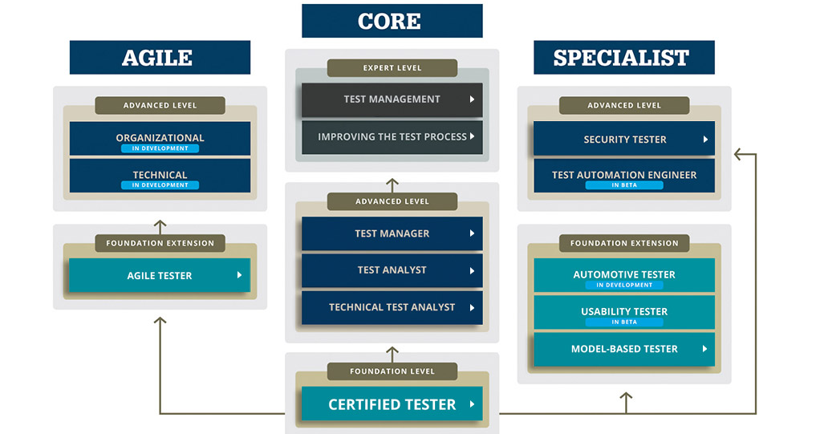
ISTQB Structure

Slide 4
Expert Level Training
Intake
Bring your own case
Theory at home
Training is used to practice
Between training days theory must be applied
Discussions about homework results

Slide 5
Test Management – Topics
Strategic Test Management
  Mission, Policy, and Metrics of Success
  Test Strategies and Alignment with the Organization
  Test Management Considerations for Lifecycle Models
Operational Test Management
  Managing External Relationships
  Project Management
  Test Project Evaluation, Reporting, Effectiveness and Efficiency
Test Team Management
  Managing the Test Team (building, developing, leading)
  Managing across the Organization (advocating, ethical issues)

Slide 6





Improve Quality Services BV
http://www.linkedin.com/company/37643
@improveqs
info@improveqs.nl +31 (0) 40 202 1803
Prof. Dr. Dorgelolaan 30, 5613 AM Eindhoven
Amsterdamsestraatweg 55A, 3744 MA Baarn

Slide 7
Company’s Vision and
Test Policy
July 13th, 2016

Slide 8
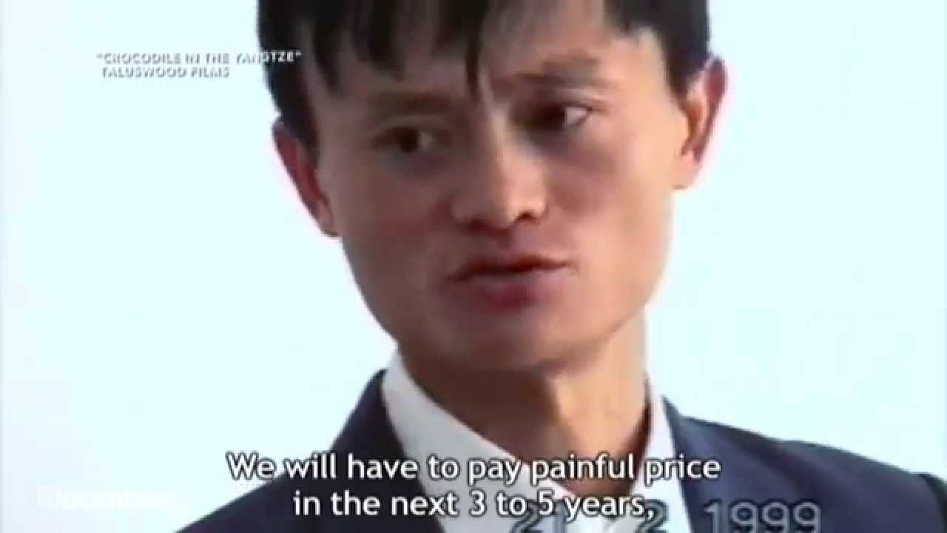
Sales pitch of Jack Ma, Alibaba, 1999

Slide 9

What do you think of this Vision?
We aim to build the future infrastructure of commerce. We envision that our customers will meet, work and live at Alibaba, and that we will be a company that lasts at least 102 years.

Slide 10
Quality Goals vs Test Policy
Company vision
Quality goals
Test policy
Product Quality
Process Effectiveness
Process Efficiency
Adherence to Process

Slide 11
How to achieve a Test Policy
How to achieve?
  Top-down
    policies, standards, laws
  Bottom-up
    project good practices

Slide 12

Analyze Vision and Quality Goals
Exercise
Form groups of 5 persons
Choose a company vision
Give 5 characteristics of the vision
Deduce quality goals from the vision
Define the test policy
Present to other groups

Slide 13
Governance
July 13th, 2016

Slide 14
Governance Model
Form groups of 5 persons
Each person reads the case
Discuss in the group how the cooperation is between supplier and customer
  What are the components you describe?
  Denote elaboration per component on flip over
Per group the results are presented to other groups

Slide 15
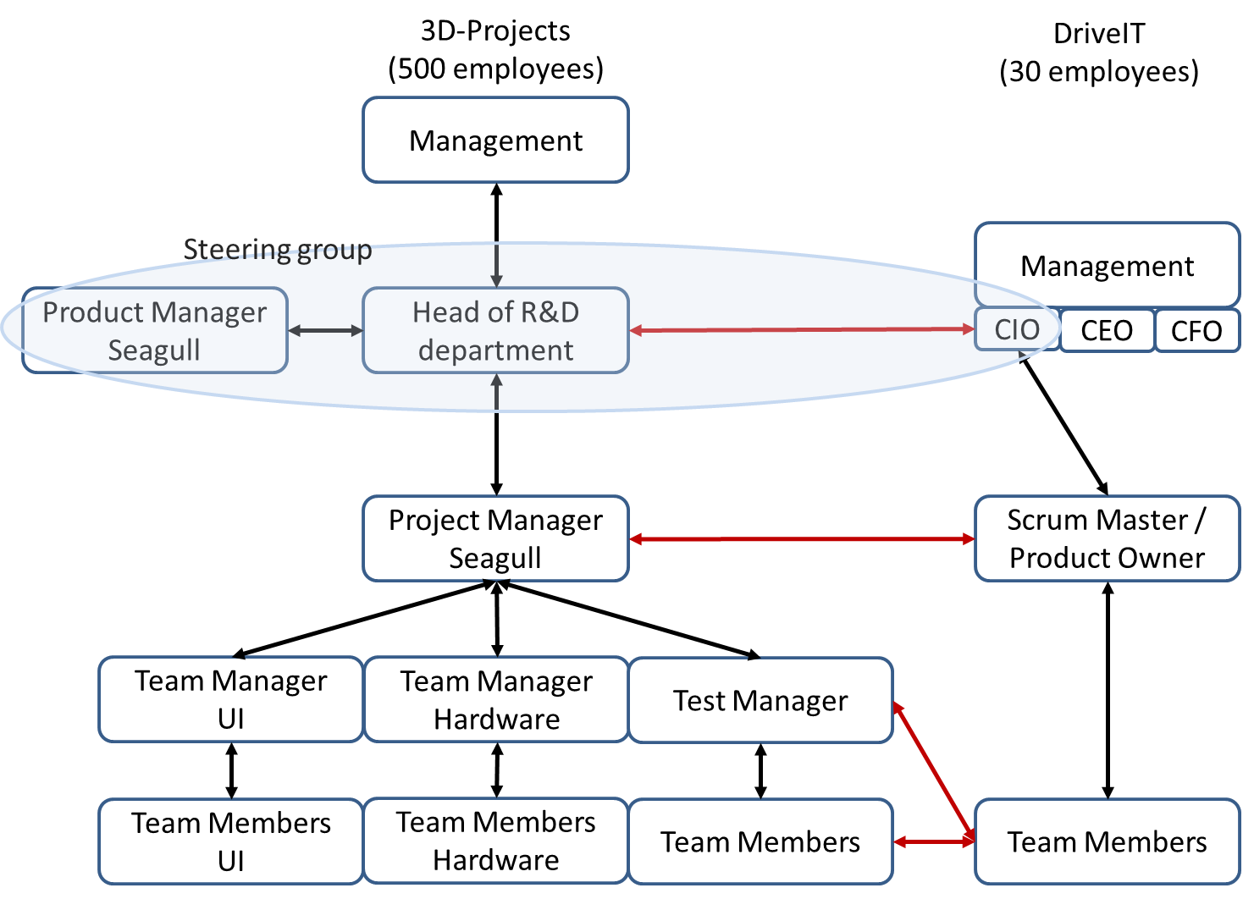
Possible governance model on case

Slide 16

Components of a Governance Model
Structure
People
Information
Business case
Status Report

Slide 17
Governance according to Prince-2
Corporate or Program management
Business and Users
Project Board
Supplier platform
Senior User
Executive
Senior Supplier
Change Authority
Project Manager
Project Support
Team Manager
Team Members

Slide 18
Evaluating Resumes
July 13th, 2016

Slide 19
Evaluating Resumes
Individually
Select 3 best resumes – 10 minutes
  Experience in resumes is latest first
As a group of 3 persons
Part 1
  Select 3 best resumes
  Write down reasons for selecting those
Part 2
  Formulate interview questions for 3 best resumes
  As a group present interview questions and selection of resumes

