Slide 1
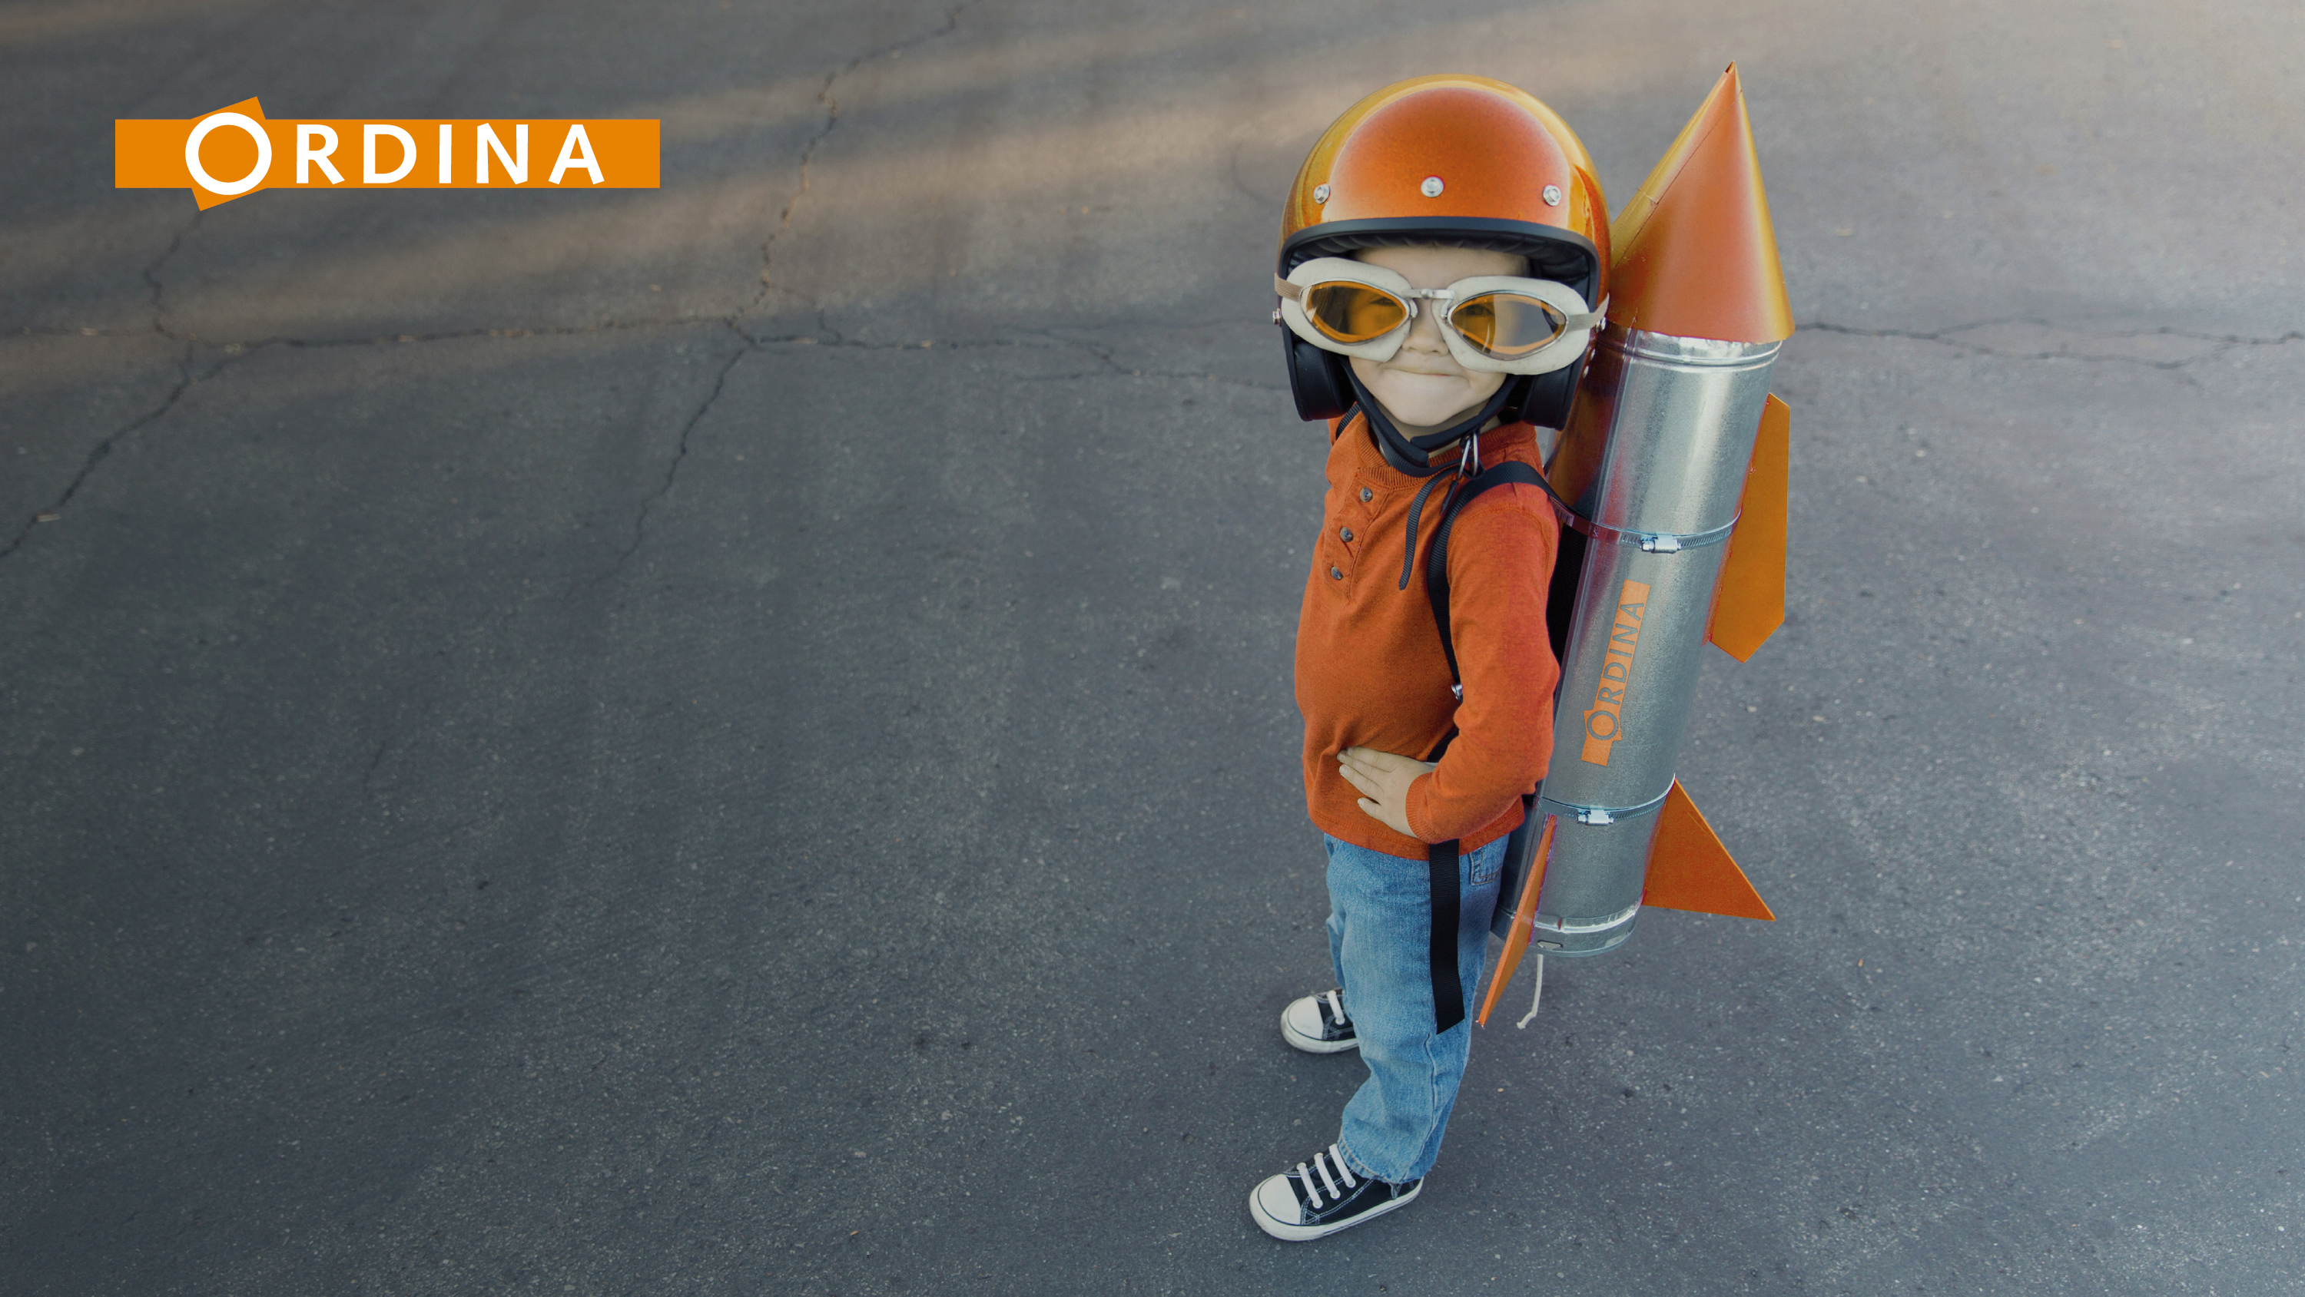

Waar kunnen we Machine Learning nog meer voor gebruiken?
Eric Jimmink

Slide 2
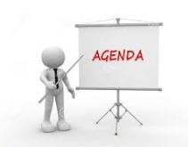
Agenda
(Supervised) Machine Learning
– though not new, it is hot
Mainstream
Algorithms
Demo and samples
ML design – build – test (loop)
More ML applications
https://youtu.be/ilP4aPDTBPE
Notes:
Sheet: FIXED Ordina in a nutshell, Grootte, versie 2
Datum: 1-4-2016
Owner: Corp Comms

Slide 3
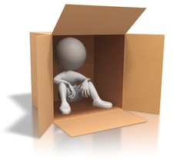
Though not new, it is hot
Movie clip was recorded in 1992
Neural networks were implemented more than 30 years ago
Computers are much faster now
We now have access to a lot more data
Frameworks to reduce code

Slide 4
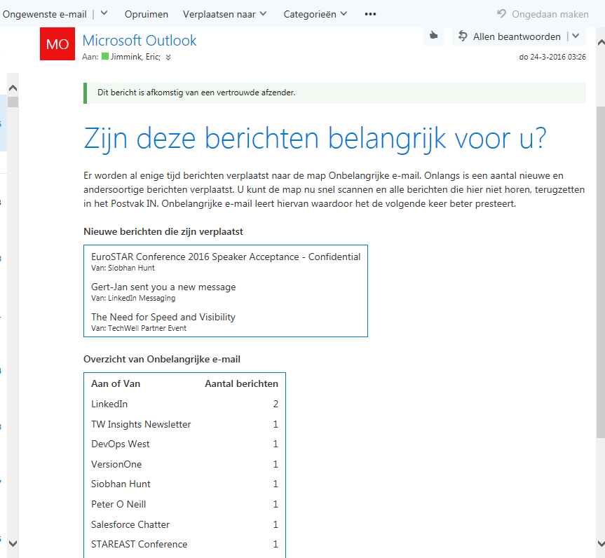
Machine Learning systems are commonplace
Zip code
Netflix, Google, social media, etc
Online advertising and webstores
Email: spam and viruses
User Feedback = Input

Slide 5
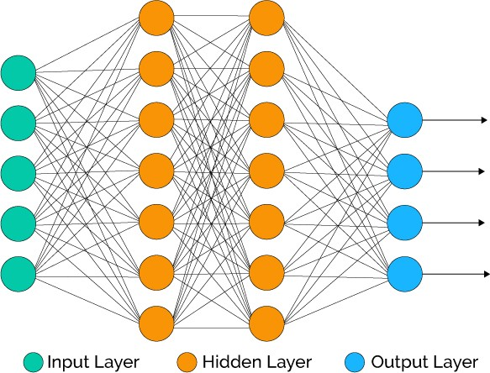
ML application areas and strengths
Extrapolation, classification, and anomaly detection
Based on (numerous) checked examples
Common model: neural network

Slide 6
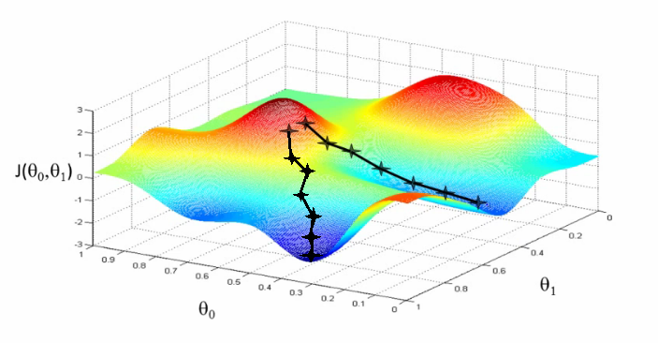
Neural networks
Coefficients → Prediction
Cost function ≈ prediction error
‘Training’ : minimizing the cost function

Slide 7
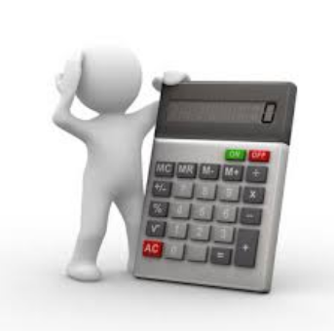
Mathematics of neural networks
Input: n-dimensional vector for each example
Matrix multiplication of input and coefficients
  Z^{L} = g( Z^{L-1} * W^{L} + b^{L} )
Activation function to normalize outputs
Derivative calculus: gradients of coefficients
  Tools and frameworks
Gradient descent

Slide 8
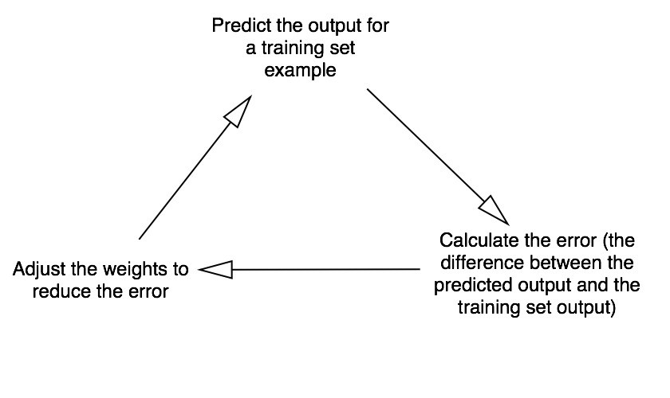
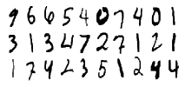
Short demo
Recognizing (handwritten) digits

Slide 9
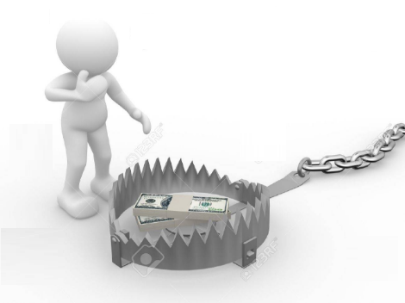
Pitfalls and solutions (1)
100% training data accuracy
  Much lower accuracy on new data → acceptance?
  Learning curves
  Cross validation accuracy

Slide 10
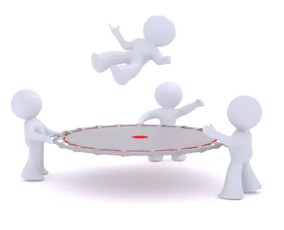
Pitfalls and solutions (2)
Calculation time
  Use batches rather than all training data at once
Uniform data
  Filtering, transformation, and normalization
Chain processing
  Pinpointing weak links with numerical results
Random initialization and local optima
  Try training your network more than once

Slide 11
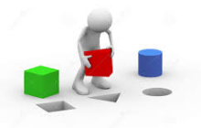
ML: Design – Build – Test
Initial architecture
  Simple model to get feedback
Business process
Define small steps
Normalize / filter / transform data for processing
Build and measure 1 ML system at a time
Visualize (measurable) results
Improve the chain

Slide 12

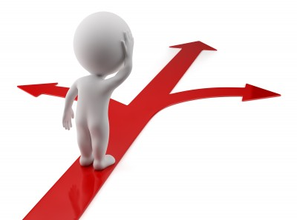
Testing == Tuning?
Algorithms have parameters
  Learning curves to discover good settings
Deciding whether more data will help
  Larger network; fewer features
Analyzing where the network went wrong
  On cross validation set
  Categorize misclassifications

Slide 13

Present applications of Machine Learning
Medical diagnosis
Refridgirator predicts and recommends
Anomylous web visitor behavior
Autonomous vehicle: 20⁺ ML subsystems

Slide 14
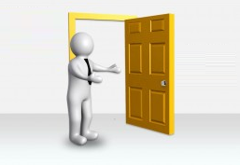
The future?
Medical prediction / prevention
Prediction of natural phenomena
  Hurricanes, earthquakes, volcanic eruptions
Crowd security
Predicting traffic jams
Declarative ML programming

Slide 15
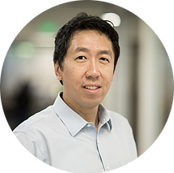
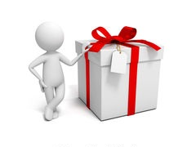
Resources
Coursera
  Machine Learning (Andrew Ng)
  Deeplearning.ai
Kaggle.com
https://www.kaggle.com/getting-started/3642
Tenserflow.org
https://www.youtube.com/watch?v=u4alGiomYP4

Slide 16

Eric.Jimmink@ordina.nl

Slide 17
