Slide 1
Hebben we wel meer testautomatiseerders nodig?
Bas Dijkstra
www.ontestautomation.com
bas@ontestautomation.com
@_basdijkstra

Slide 2
Mijn verhaal, tot niet zo heel lang geleden…
@_basdijkstra
Notes:
In the first 8 years of my career I wrote an awful lot of horrible automation

Slide 3
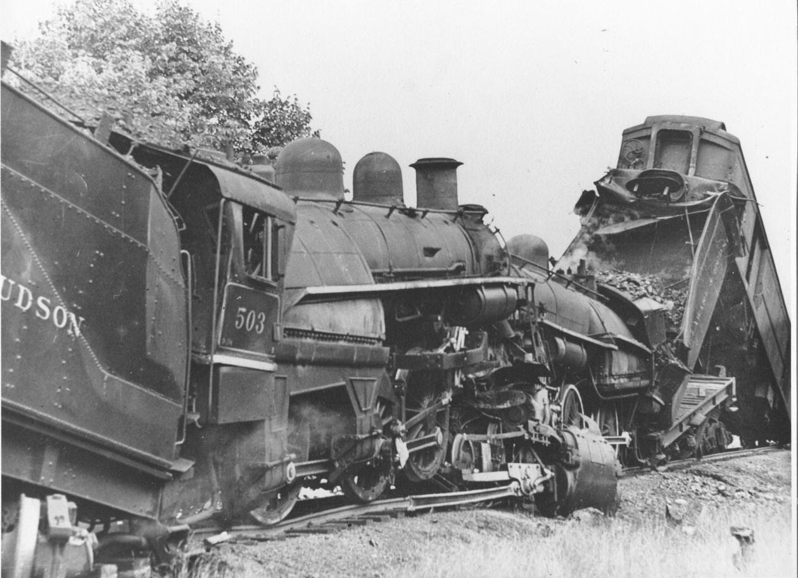
@_basdijkstra
Notes:
This was basically my motto (use example from Orange) – metrics: number of regression tests automated

Slide 4
Alles automatiseren.
End to end.
@_basdijkstra
Notes:
This was basically my motto (use example from Orange) – metrics: number of regression tests automated

Slide 5
“I’m sick and tired of repeating myself”
-- History
@_basdijkstra
Notes:
This was basically my motto (use example from Orange) – metrics: number of regression tests automated

Slide 6
Vragen, vragen…
Welke tool en welke taal moet ik leren?
Hoe kan ik mijn API testen met Selenium?
Hoe kan ik mijn tests automatisch opnieuw draaien?
Ik wil een keyword-data-driven hybrid multiplatform AI-gedreven testframework^{(*)}, help me!
@_basdijkstra
(*) Moet op blockchain draaien
Notes:
Saving money > discuss ROI
NEEDS REWORK

Slide 7
Hoe kan dat?
@_basdijkstra
Notes:
This was basically my motto (use example from Orange) – metrics: number of regression tests automated

Slide 8

Tools! Tools! Tools!
Middel, geen doel
@_basdijkstra
Notes:
There’s a relentless focus on tools, while not enough people are studying how to use them properly

Slide 9
Bijna geen enkele discussie op LinkedIn, Quora, StackOverflow…
Bijna elke discussie op
LinkedIn, Quora, StackOverflow…
WAAROM
WAT
HOE
>
>
@_basdijkstra
Notes:
Part of the problem is people not asking the right questions, it’s all about the how, how, how…

Slide 10
HOE?
Create your own HTML report from Selenium tests
2014
14080
FindBy strategies for Selenium explained
2015
12037
Data driven testing in Selenium Webdriver using Excel
2013
10011
WAAROM?
Stop sweeping your failing tests under the RUG
2017
365
Trust automation
2017
774
On asking ‘why?’ in test automation
2016
470
@_basdijkstra
Notes:
Do we really want more of those test automation engineers?

Slide 11
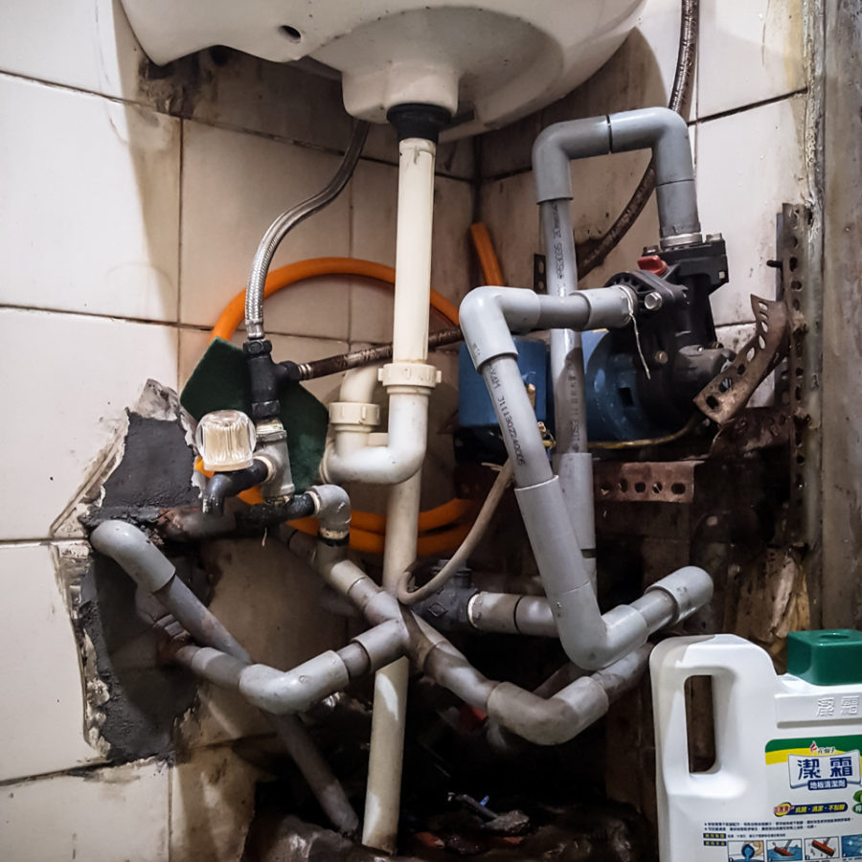
Resultaat!?
@_basdijkstra
Notes:
As a result, we end with a lot of horribly inefficient automation that’s hard to maintain

Slide 12
Willen we daar echt meer van hebben?
@_basdijkstra
Notes:
Do we really want more of those test automation engineers?

Slide 13
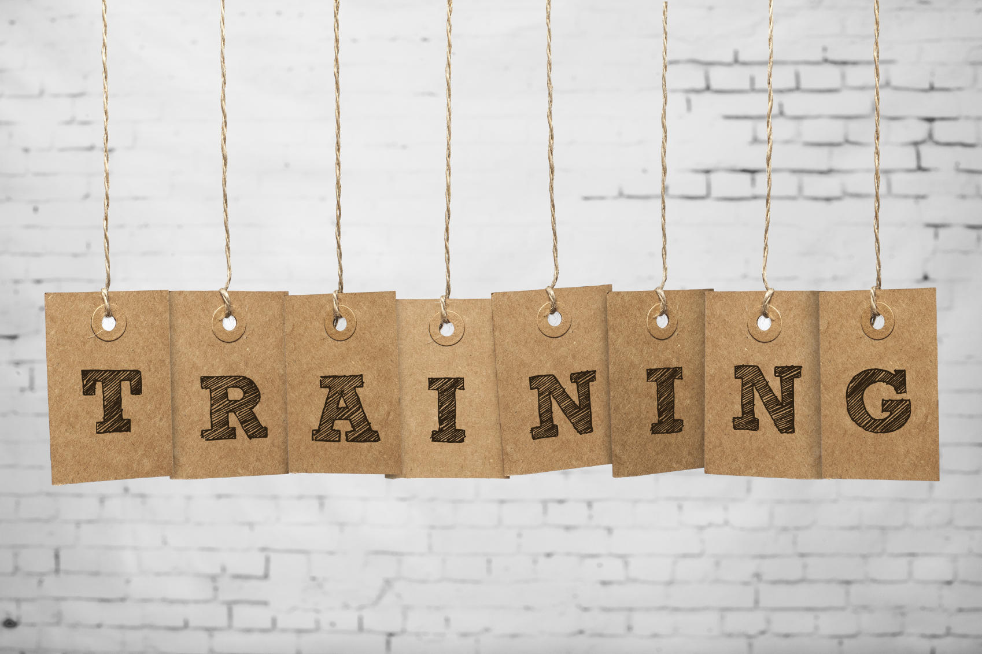
@_basdijkstra
Notes:
There are a couple of good training resources out there, like Automation in Testing. There’s room for much more, though, so don’t be afraid to ask for better training, coaching, room to learn, experiment and fail

Slide 14
Waardevolle automatisering
Development
Awareness
Patterns
Tools
Software testing
@_basdijkstra
Notes:
So, how DO you become a better automation engineer?

Slide 15

@_basdijkstra
Notes:
Automation isn’t the holy grail, so stop treating it like that. Don’t feel forced to learn or ‘do’ automation. This goes for engineers, managers and recruiters alike. Speaking of recruiters…

Slide 16
Oh ja, over die recruiters…
@_basdijkstra
Notes:
Do we really want more of those test automation engineers?

Slide 17
Awesomely hot job opening
Software Developer in Test (SDET!!)
Amsterdam, full time, permanent
The ideal candidate has
Built frameworks before
10+ years of experience
Mad skills with Selenium (knockout!)
Mad skills with Cucumber (knockout!)
Mad skills with SpecFlow (knockout!)
Mad skills with Jenkins (knockout!)
Mad skills with Knockout (knockout!)
…
@_basdijkstra
Notes:
A typical job opening

Slide 18
Even hotter job opening
Test automationeer / BDDeveloper
Amsterdam, full time, contracting
You’ll be operating in a greenfield environment, responsible for creating and implementing the automation strategy from scratch.
You’ll be automating the tests using Cucumber-JVM.
@_basdijkstra
Notes:
A typical job opening

Slide 19
“Alright stop, collaborate and listen”
-- Robert Matthew Van Winkle
@_basdijkstra
Notes:
Do we really want more of those test automation engineers?

Slide 20
Maar wat kan ik doen?
Stop je blind te staren op tools alleen
Deel je ervaringen
Wees niet bang om je mening te geven
Vraag eerst ‘waarom?’ en ‘wat?’, en daarna pas ‘hoe?’
@_basdijkstra
Notes:
What can YOU do?

Slide 21
We hebben niet meer automatiseerders nodig…
We hebben betere nodig.
En daar dan weer meer van.
@_basdijkstra
Notes:
Do we really want more of those test automation engineers?

Slide 22
Contact
Email: bas@ontestautomation.com
Blog: https://www.ontestautomation.com
LinkedIn: https://www.linkedin.com/in/basdijkstra
Twitter: @_basdijkstra

