Slide 1

Setting Up The Testing Shop
The Philosophy of Sales in Testing
Rick Tracy
TestNet Spring Event

Slide 2
Preview
Bit of Background
Why Sales?
7 Rules
7 Tips
Questions

Slide 3
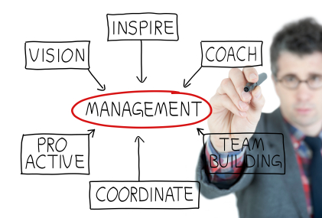







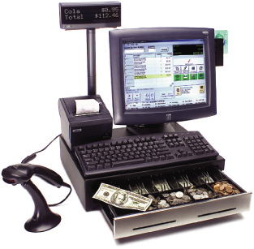

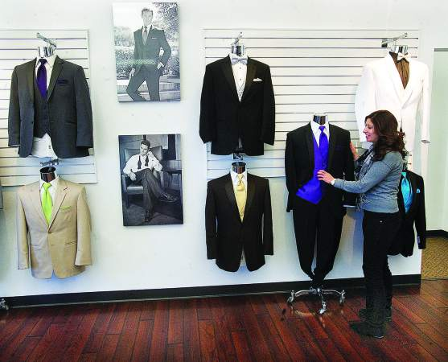
Background

Slide 4
Background
Testing Requires a Broad Skillset
Testing is Evolving
Good relationships with users is essential to your success

Slide 5
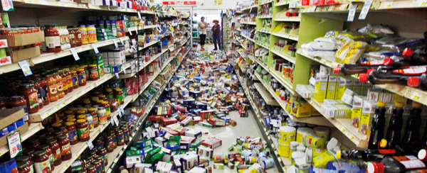
Why Sales?
What does it have to do with Testing?
  Setting up the proper shop
  Testing minus communication:

Slide 6

Why Sales?
  Customers
  Testing Results minus Interested Users:

Slide 7
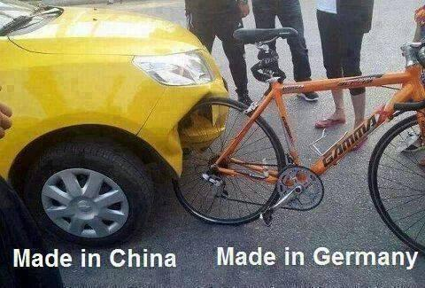
Why Sales?
Quality of products
Companies without Testers:

Slide 8

Why Sales?
Sales profile
Tester without ability to sell testing:

Slide 9
Why Sales?
We tend to see IT as a completely separate industry from all others
  It isn’t
    Needs a purpose
    Needs clients who value purpose
    Needs marketing to reach users
    Needs internal investments to continue

Slide 10
Why Sales?
Sales has important skillsets
  Often ignored in Testing in favour of pure technical skills
    Communication
    Organization
    Presentation
    Application
    Etc.

Slide 11


1st Rule of Sales: Fulfill a need

Slide 12

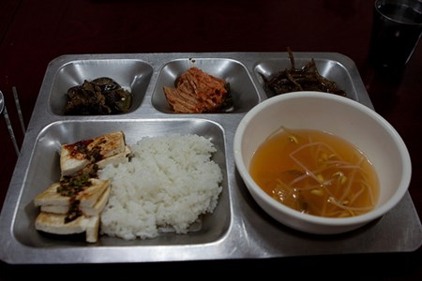


2nd Rule: Excite the buyer

Slide 13
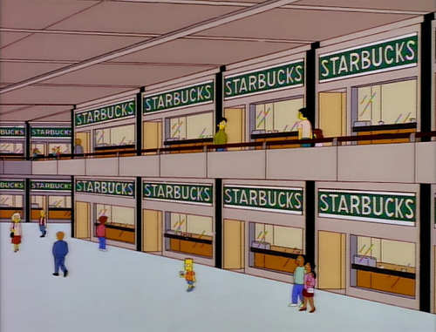

3rd Rule: Create multiple venues/access

Slide 14
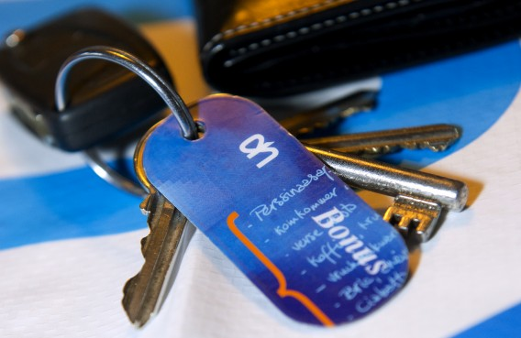
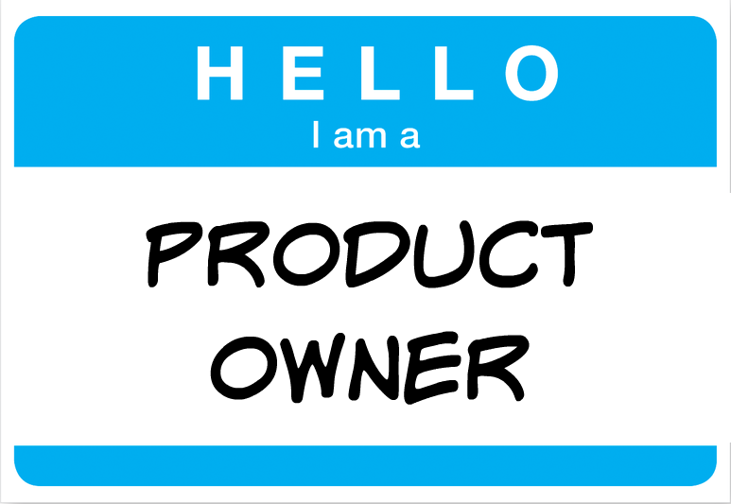
4th Rule: Don’t Close, Commit!

Slide 15


5th Rule: No One Cares Until They Do

Slide 16
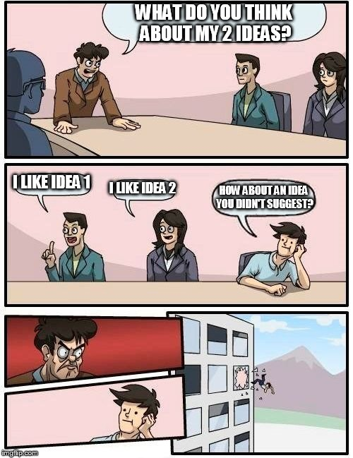

6th Rule: Everyone loves their own ideas

Slide 17


7th Rule: Love what you do

Slide 18
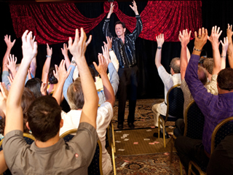



WARNING!
Audience Participation Ahead!

Slide 19
7 Tips
Tip 1: Find out what your user wants
Specifically, what do they want from you as a tester?
If their answer isn’t enough for you, ask them why they want it

Slide 20
Tip 2: Get a clear idea on how users want things
What do your users react best to?
Experiment!

Slide 21
Tip 3: Find the best method to present results
Which communication style works best in your experience?
  Fastest?
  Most Complete?
  Correct?
  Repeatable?

Slide 22
Tip 4: Involve your Stakeholders
What makes your users get interested/involved?
What is in it for them?
Think long term!

Slide 23
Tip 5: Change Apathy to Empathy
What is important to your users?
  What have they expressed?
Again, experiment.
  Don’t give in to first impressions
    Or Second ones
    Or Third ones
    Or Fourth ones
    Or Fifth ones
    ……………………………………………………

Slide 24
Tip 6: Listen to the underlying wants
When have you been surprised by what a user wanted/liked?
If the request doesn’t make sense, ask.
If you value your idea, promote it.

Slide 25
change!
Tip 7: If you don’t love it,
What else stokes your passion at work?
Testers have a phenomenal scope of potential
  Coding
  Analysis
  Stakeholder
  Product Owner
  Project management
  Supporting

Slide 26
Summary
Find what makes your stakeholders tick
Sell them on the process
Involve and listen to them
Experiment
  Results
  Communication
  Your skillsets

Slide 27
Final Bonus Tip
Testing isn’t just a profession
  It’s a way of thinking, living, reacting, communicating, and being
Don’t let current definitions of testing limit you
  Find your way to set up the testing shop!

Slide 28
