Slide 1
Data 2 DiamondsTM - BIG Data Inspire Testnet
Tim van Soest & Henk van Haaster
10 april 2014

Slide 2
Agenda
Opening
About CGI
Introduction BIG Data
BIG Data demonstrator

Slide 3
About CGI

Slide 4
CGI is a global information technology and business process services leader
High-end business and IT consulting
Client proximity model complemented by unique global delivery network
Serving 5000+ clients from over 400 offices around the world
End-to-end IT and business process services
100+ leading IP-based solutions
72,000 professionals,
85% are shareholders*
Over 35 years of successfully partnering with our clients
Revenue: C$10.4B **
Backlog: C$17.7B
Focused industry and domain expertise
* Excluding members coming from Logica
** CGI revenue based on financial results for the twelve month period ending Dec 31, 2011 (IFRS); Logica revenue based on CY2011 financial results on a pro-forma basis (“Underlying Revenue”)

Slide 5
We leverage strong industry expertise to help clients succeed
Financial
Services
Government
Manufacturing, Retail &
Distribution
Telecom &
Utilities
Health
Oil & Gas
23 of top 25 banks in the Americas and 22 of top 25 in Europe
Partner to 190+ global P&C, life and commercial health insurers
Maintain more than $830B in assets for leading wealth mgmt. services providers
Majority of government agencies in North America and Europe
Manage $700B+ in financials for US government organizations
Generate nearly $1.7B in tax recoveries for 5 US states
Protect against 1M+ cyber attack incidents a day
Leading global firms in aerospace, metals, mining and chemicals
Partner to 250+ retailers across North America and Europe
Implemented POS and back-office solutions for 100+ retailers
Partner to 200+ utilities in North America and Europe
Managing 27 call centers handling 40 million calls per year for a leading telecom firm
Industry solutions used by 200,000+ professionals
250+ hospitals and federal, state and provincial governments as clients
Recover more than $1B in fraud and waste for healthcare payers
17 of top 35 oil & gas producers globally
Running 30M retail fuel card transactions per year

Slide 6
IM and BI is a strategic growth area for CGI
Over 4,200 members working in IM, BI and Analytics
Covering major Data Integration, Data Governance, BI and Analytics projects
Well positioned in Gartner ratings
400
240
350
600
900
1160
300
250
4200
Members in CGI Global IM Practice
6

Slide 7
Focus on the right Use Case
Fraud Detection
Customer Intelligence
Regulatory Compliance
Reducing Total Cost of Ownership
Payments have shifted from cash to cards or electronic transfers, containing fraud and complying with rules on money-laundering is becoming even more challenging.
Turning unstructured data into intelligence to make the claims process more efficient as well as move toward a customer-centric approach.
Providing a total customer view based on a single identifier and consistent hierarchies, to improve the overall experience and reporting for customers.
Time, location and sentiment analysis leveraging he voluminous streams of data generated by consumers to help inform a variety of business decisions.
Improving the trustworthiness of risk management information.
Ensuring compliance with regulations based on better information.
Moving from having an accounting, or retrospective use to becoming proactive and forward-looking.
Lowering the cost-to-income ratio based on improved governance of information.
Establishing an information governance organization, with alignment between IT and the business.
Rationalize the existing BI landscape, based on “fit for purpose” solution map and roadmap.

Slide 8
Introduction BIG Data

Slide 9
Data explosion
1 ZB = 1.000.000.000.000.000.000.000 (= 10²¹) bytes
90%
90 percent of the data in the world today
was generated in the last two years

Slide 10
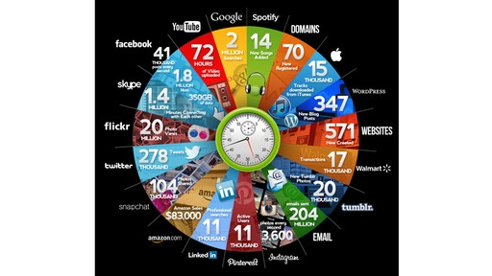

Slide 11
What defines BIG Data?
Extracting insight from an immense volume, variety and velocity of data, in context, beyond what was previously possible
4V’s
Volume: zettabytes of data
Variety: structured, semi- and unstructured
Velocity: batch and streaming
Veracity: reliable and less accurate data

Slide 12
Big data! Big deal? (Trajectcontrole)

Slide 13
Additional or new business models: Shining diamonds

Slide 14
Traditional Business Intelligence
What happened?
Why did it happen?

Slide 15
Next generation analytics
What will happen?
How can we make it happen?

Slide 16
Improving Business Value of IM & BI
To Date
Governance
Business Value and Adoption
Process and Governance
Technology
How we can make it happen?
Value
Business Value Driven
What will happen?
BI&Analytics Maturity
+
Why did it happen?
Delivery
User Experience
Competitive Costing
Agility
Sustainability
IT Cost Driven
What happened?
Descriptive Analytics
Predictive Analytics
Diagnostic Analytics
Prescriptive Analytics
Time

Slide 17
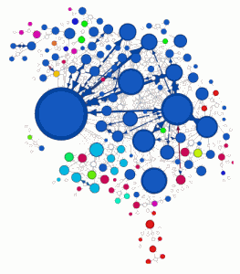
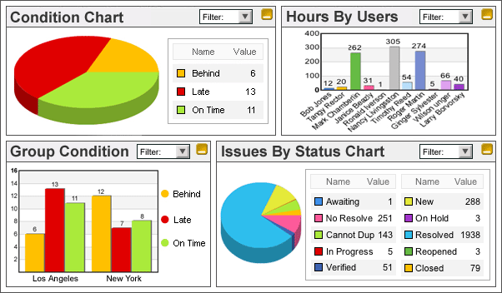
BIG Data solutions
BI & Reporting
(Predictive) Analytics
Visualization & Discovery
Data Ware House
Big Data at Rest
Big data in Motion
In-Memory/MPP
Hadoop
Streams
Information Integration & Governance

Slide 18
Leveraging the power of Big Data
Capture
Process
Analyze
Structured Data
Pre-defined Filtering and Aggregation
Answers to known Questions
Traditional
BI & IM
What happened
Why did it happen
What will happen
How can we make it happen
Unstructured & Streaming Data
Categorizations and Predictive Analytics
Revealing answers to unknown Questions
Big Data
Features
(Potential) Customer Profiling
Maximise Marketing & Sales Hit-Rate
Actionable
Information
Improved
Business Value

Slide 19
BIG Data approach

Slide 20
Data to Diamonds BIG Data approach
D2D BIG Data Inspire
D2D BIG Data Deep dive
D2D BIG Data Proof of Value
D2D BIG Data Implementation
Vision | Shape | Change | Deliver
Maturity & Quality Scan | Roadmap & Blueprint Scan | Project Scan | Service Scan
Business Analysis Strategy Study Feasibility Study | Requirements Analysis Architecture Design | Build IM Foundation Build BI & Analytics Test & Transition | Application Mgmt. Data Resourcing Information Delivery
Strategy Assessment | Roadmap & Blueprint Assessment | Compliance Audit | Service Evaluation

Slide 21
Important BIG Data applications
Network analytics (e.g. defense, water, social)
Predictive maintenance (e.g. multifunctionals)
Supply chain optimization (e.g. pharma)
Fraud detection (e.g. finance, public)
Behavior profiling (customer, safety, patients, citizen)

Slide 22
BIG Data demonstrator

Slide 23
Our commitment to you We approach every engagement with one objective in mind: to help clients succeed

