Slide 1
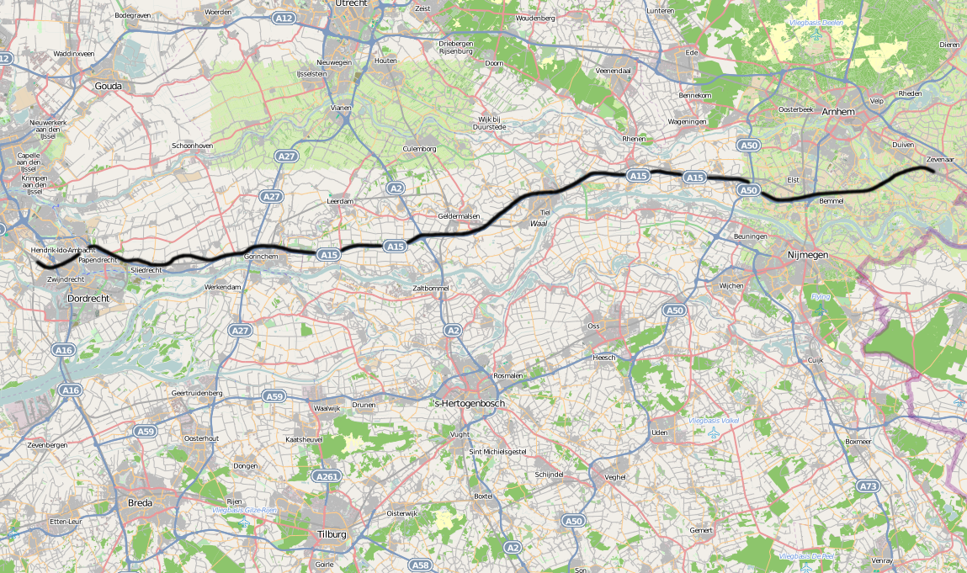

“Fast delivery on a slow train”
Marc van 't Veer

Slide 2

Amsterdam Central Station
Source: ARCADIS NL
Bicycle
Ferry-boat
Subway
Train
Bus

Slide 3
Casus
New e-commerce program with 100+ employees
Back-end in waterfall, (mobile)website in iterations, mobile app in agile mode
A big chain of applications (20+), enterprise service bus with web services
Multiple suppliers from NL, UK, IND, BG
1 go live moment
Suppliers are responsible for system testing

Slide 4
Problem definition
Natural focus on processes and the logistic chain in a waterfall process
Market analysis
  Competition, high demanding customer, device/platform fragmentation, response/agile, time to market
Risks
  Product owner can’t be part of all parallel teams
  Missing impact of decisions made on the other development parts (front- vs. back-end)
  Missing perspectives (usability) and direct input of end users during DLC

Slide 5
Parallel development – no alignment
Back-end
Waterfall
Design
Build
Test
supplier development
SIT
UAT
TiP / Pilot
Iteration
Go live
Agile
Front-end

Slide 6
Is alignment needed?
Process
Is there a risk analysis? One central planning? A mile-stone roadmap? A progress report? A DTP/MTP? When are you done? What is your scope? What and how do you prepare? Do you have preparation time and when is this? How many test runs do you have? Who is responsible for regression effects? Responsibilities? To whom do you report? How do you collaborate with other teams? Do you review? Are there dependencies? How to handle system integration defects? When do you have a total product? How stable is your test environment? When to install, patch, delivery, hotfix, upgrade, backup a system? Are there supplier conflicts?
Team

Slide 7
What happens if ….?
A defect is found?
The market or business is changed?
A change is needed?
There is a missed impact or dependency?
Delivery deadline of a system is changed?
An extra release is needed?

Slide 8

What makes it so complex for a tester?
Continuous switch between process and product view
Sensitive to changes in planning
Looks like a matrix organization
Complex communication process
Regular (weekly) merges
Parallel working releases
There is waiting time
Constant scope discussions
Do we have time to test after all alignments?
How do we plan the testing?

Slide 9

My approach - Changing gears
Enablers, what is helping a testers
Testers need to be flexible, deliver a service and have extra skills
  Gears in your head
  Gears in your working methods

Slide 10
What is helping a tester - enablers
Centralized defect management (process and tool)
A product owner for all teams
Multiple fully deployed integration environments
A unified stub framework for all interfaces
A central heartbeat on a combined release calendar
Central register of interface descriptions
A forum to discuss planning, defects, design choices and risks within all teams
Clear list of dependencies between projects
Automated regression test (incl. the tools to run it)
Overview of the progress of the different teams
Alignment process over the teams

Slide 11

How many heartbeats can you handle?
Consider how many normal installations, fixes, re-deployments, backups, test preparation and execution is possible in X period of time (like a month)?
Look at the method: Do you want to go multiple times through the waterfall or is agile more fixed to the expected features and time line?
Select a heartbeat that fits
the whole organization

Slide 12
Combined release calendar
Back-end
Design
Build
Test
SIT regression
UAT Chain
Test environment 1
supplier development
Iteration
SIT
UAT
TiP / Pilot
?
Go live
Test environment 2
Agile
Front-end
70% Must haves
30%
Next release

Slide 13

Gears in your head
Terms / vocabulary
Cope with changing priorities
Able to switch between process and product focus
Handle multiple roles, responsibilities and tasks
Able to time travel on the release calendar
Concurrent have a scrum master, test and project manager
Need domain knowledge (applications/organization)
Be flexible in your traditional work in phases and join multi-disciplinary agile team

Slide 14

Gears in your working methods
Perform risk sessions
Keep your administration constant up to date
You can transfer defects between the agile, iterative and waterfall team
Able to schedule your work multiple ways
Be a specialist on a system and understand the chain
Multiple suppliers internal, local and outsourced
Determine impact of defects over multiple releases
Your communication skills need to be top

Slide 15
Conclusion
Every supplier can run in a different pace or follow a different development method
Combination of agile, iterative and waterfall makes it complex
Key is the chosen hart beat for the release calendar
(some) Development alignment is needed
Testers can help and be the oil in the machine
A tester needs to be flexible and learn to change gears between the multiple teams

Slide 16

“Fast delivery on a slow train”
Questions?

