Slide 1

Rabobank’s Customer On-Boarding Program
Continuous Delivery as a Journey
11-Oct-2017

Slide 2


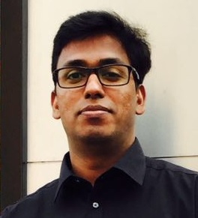

Who are we?
Speaker’s profile summary
Experience: 20 Years in IT of which 15 in testing, focused a Test consulting and management
Strength: Highly analytical mind-set, Result oriented and Team excellence
Role in project: Test Manager for project and Product Owner of the Continuous Delivery team
Hobbies: Camping and Sailing
Experience: 12 Years in IT, focused on solution design and architecture of cutting edge technologies
Strength: Integration specialist, Calm and focused
Hobbies: Poker and Long drive
Notes:
Introduction of speakers.
Maximum 2 minutes to introduce yourself

Slide 3

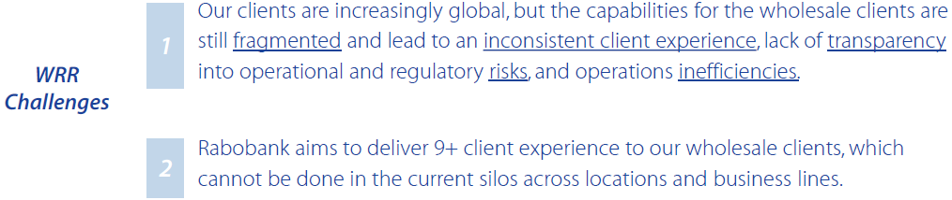






Background and Vision
Wholesale Rural and Retail (WRR)
The Wholesale Rural and Retail (WRR) department within Rabobank is responsible for life cycle management of International clients worldwide. Client on-boarding is one of the key domains of WRR which has built a solution on the Pega platform to facilitate an efficient on boarding process and uniformity across systems that interacts with Customers.
Our
Function
Notes:
For Rien
Introduction of the domain where automation is done
Describe challenges like unmanaged processes without any transparency
Describe about the goals (driver to go forward)

Slide 4
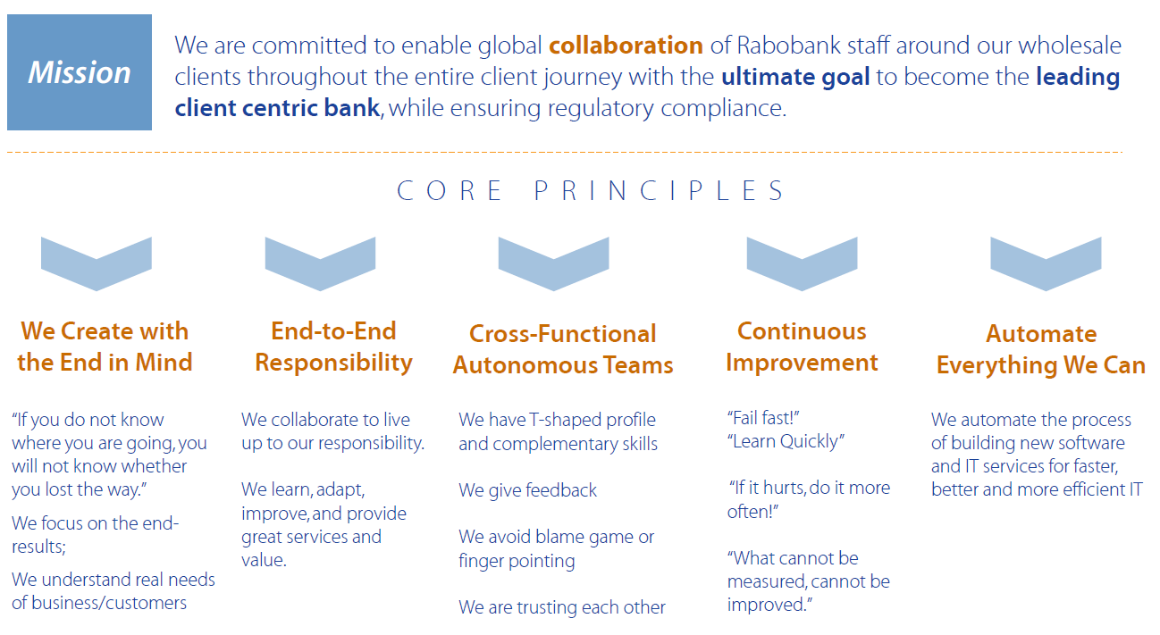
Way forward →
Notes:
For Rien
Key principles to focus on going forward
Continuous Improvement and Automate Everything (last 2 pillars) are the drivers
We had responsibility to pick up the last 2 pillars and implement till the extent we can

Slide 5
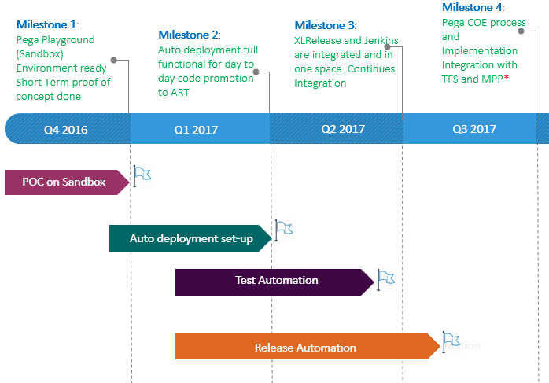
Start of continuous journey
Assessment and planning
Notes:
For Rien
We set-up our first high level timeline
We wanted to realize the step by step progress and measure the changes
This planning helped us to focus on goal and determine what kind of capacity and support we need

Slide 6

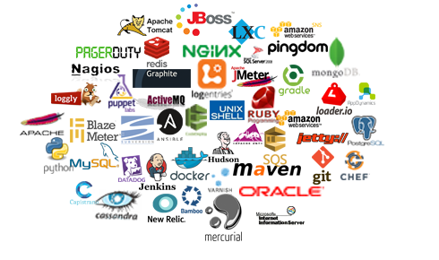






Zoom into market products
Capability and feature assessment
Notes:
For Amrendra
Continuous delivery has many pieces: Continuous deployment, Continuous integration and Release automation
Proof of concept was scoped for continuous deployment (Automation in deployment)
Looked in technology landscape (Software or tools used for main IT application )
Then decide on tooling stack

Slide 7






Selection of tools and technologies
What is best suitable for you!
 | Audit Trail of Code | 4 Eye principle | Impact on Release Methodology | Data Protection from Unauthorized entity | Audit Support
 |  | Not applicable (only storage and no trigger) | None
 |  | Not applicable (No GUI trigger, trigger only from XLRelease) | None
 |  |  | None
 |  | Not applicable (No GUI trigger, trigger only from XLRelease) | None
 |  | Not applicable (No GUI trigger, trigger only from XLRelease) | None
 |  | Not applicable (No GUI trigger, trigger only from Jenkins) | None |  | Not applicable (Audit is logged in Jenkins)
Notes:
For Amrendra
Finalized list of tools that fits into Rabobank standards (Security and approved softwares)
Describe about tools little bit

Slide 8
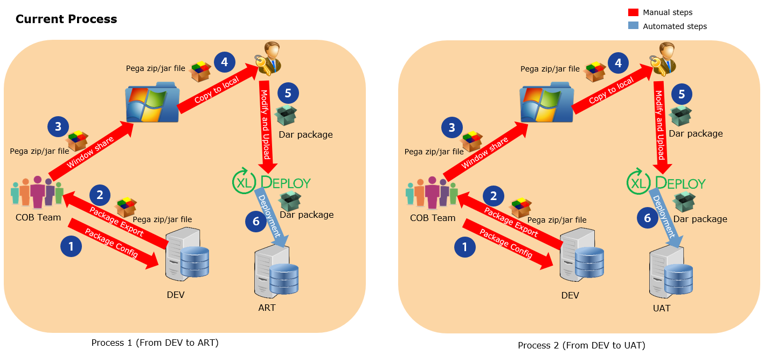
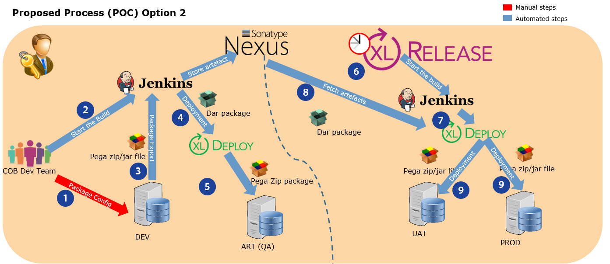
Transition Architecture
Build Deployment process transformation
Challenges:
Team cultural shift
Security stops
Connectivity/technical issue
Not enough stakeholder attention
Notes:
For Amrendra
Describe steps before and after
Speak about key challenges (like firewall challenge, XLDeploy remote trigger security challenge)
Automation achieved with full scale of end to end release automation

Slide 9
Impact Measurement
Before and After Continuous delivery
Test environment
UAT/PROD environment
Average cycle time for deployment process improved from 4 hrs (including packaging time) to 8 minutes
Average cycle time for release process till UAT and PROD has been improved from 4 hrs 17 min (including packaging time) to 37 min
Notes:
From Amrendra to Rien
First graph is about deployment time comparison between DEV to QA (before automation and after automation)
Second graph is about Production release time comparison (before and after)
It is not only timing has improved but also time has become consistent: this helps in planning and outage time management for business

Slide 10

The bottom line
Achievements after Continuous delivery
~€134K
Saving till date
~€300K
Projected Saving annually
2 applications
8 pipelines are automated
0%
Manual Coordination
100%
Fully automated configuration
98%
Success delivery
Notes:
For Rien
Change in way of working
Highly efficient with 95% success delivery and 0% manual coordination
Savings till now and Forecasted saving per year

Slide 11








Detail Timeline and Phases for 2 apps
Roadmap Status
NAW (ECO)
Q4 2017
Validation to check quality automatically before deployment from Jenkins. Stop deployment if minimum quality criteria not met like 0 warning, 100% unit test execution success
Q3 2017
Completed Browser End to end regression test automation. Browser automation was only in the scope for NAW
Q4 2016
Deployment Automation from DEV to ART with set-up of Jenkins, Nexus and Pega API
Q1 2017
Nexus Integration from DEV LAN to PROD LAN for establishing one source of artifacts/code
Q2 2017
Integration with XLRelease and Jenkins for establishing End to End delivery pipeline till PROD
Deployment Automation
Artifact Management
Release Automation
Test Automation
Intelligence & control
Q1 2018
Validation to check quality automatically before deployment from Jenkins. Stop deployment if minimum quality criteria not met like 0 warning, 100% unit test execution success
Client Life
Q3 2017
Integration with XLRelease and Jenkins for establishing End to End delivery pipeline till UAT. PROD pipeline is in progress
Q1 2017
Deployment Automation from DEV to ART with set-up of Jenkins, Nexus and Pega API
Q2 2017
Nexus Integration from DEV LAN to PROD LAN for establishing one source of artifacts/code
Q4 2017
Complete End to End regression test for integrations, browser and backend
Deployment Automation
Artifact Management
Release Automation
Test Automation
Intelligence & control
In Progress/Not Completed
Completed
Notes:
For Rien
Full detail roadmap including tools used in each and every phases
2 separate lanes are showing progress of ECO and ClientLife
Future path where we want to go!

Slide 12

Please contact us for any further question here –
Rien.Krol@Rabobank.com
Kumar.Amrendra@cognizant.com
LinkedIn –
https://www.linkedin.com/in/rikrol/
https://www.linkedin.com/in/amrendrakumar052001/
Notes:
For Audience

