Slide 1
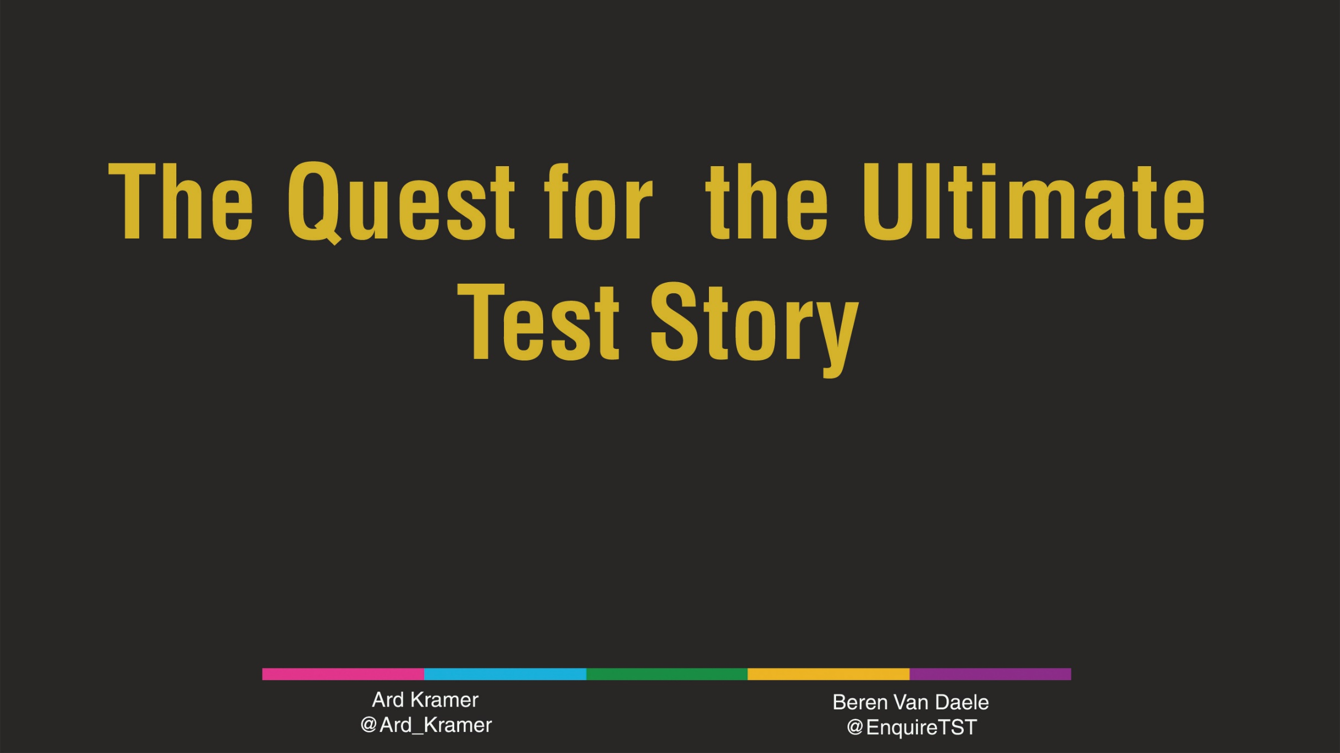

The Quest for the Ultimate Test Story
Continu verbeteren met testverhalen
Ard & Beren
Andreas Faes
@AndreasFaes

Slide 2
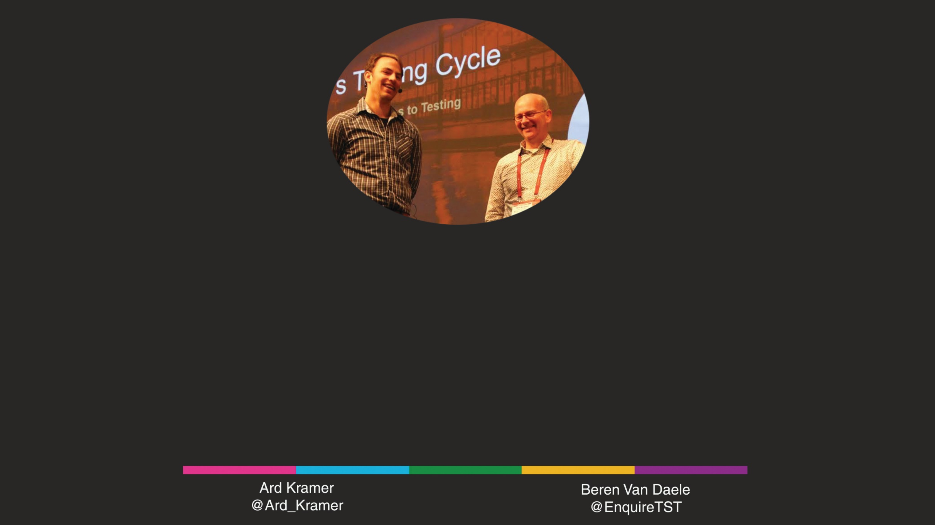
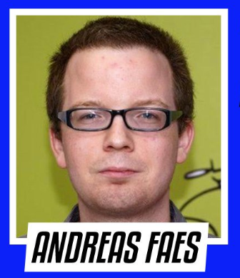
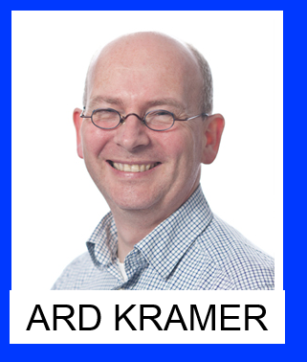
Andreas
Ard
My Dream:
In the summer of 2008, Andreas and software testing first met. They have been best friend ever since, and continuously explore each other to fully understand the other. Neither one has succeeded so far, but they keep trying with unfaltering enthusiasm.
My Dream:
Participate, as a good qualisopher, in all kind of projects such as sports, culture or software testing. Projects which add value to our community.
I want to inspire other people through cooperation, fun and empathy and hopefully bring light in someone's life.
Andreas Faes
@AndreasFaes

Slide 3
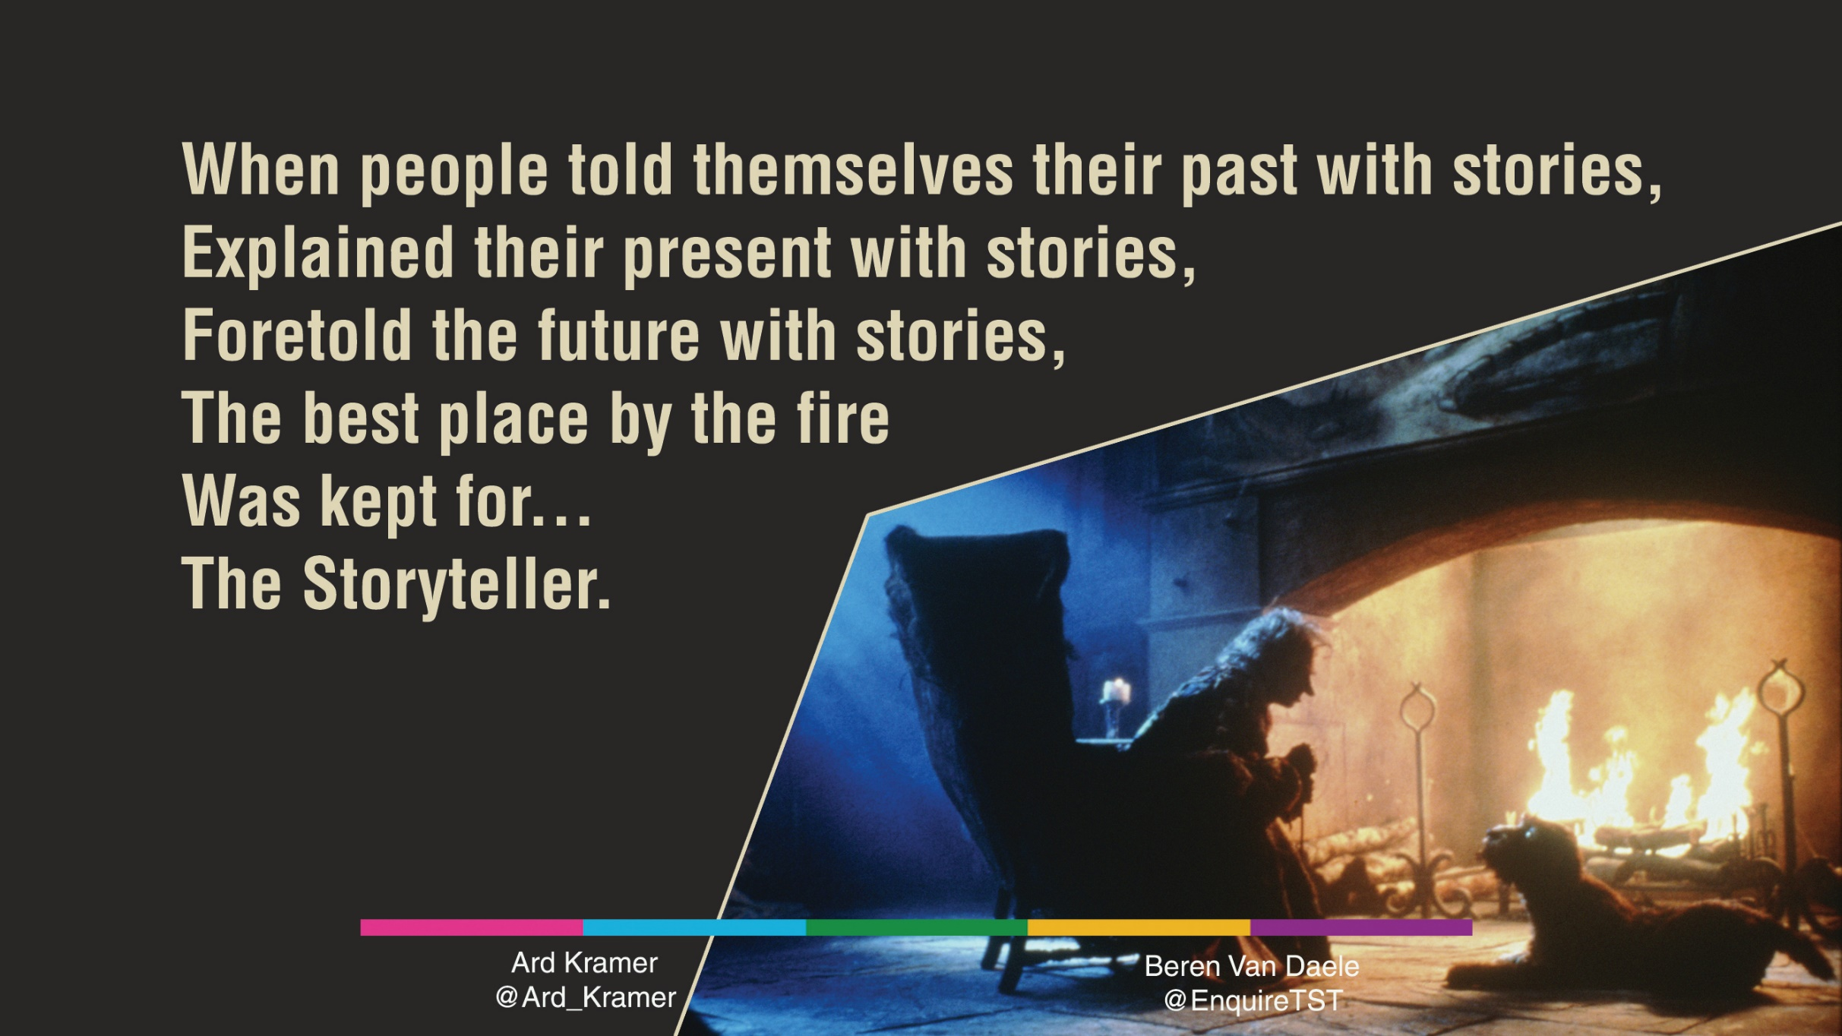
Picture & quote from:
Jim Henson’s ‘The Storyteller’
Andreas Faes
@AndreasFaes

Slide 4
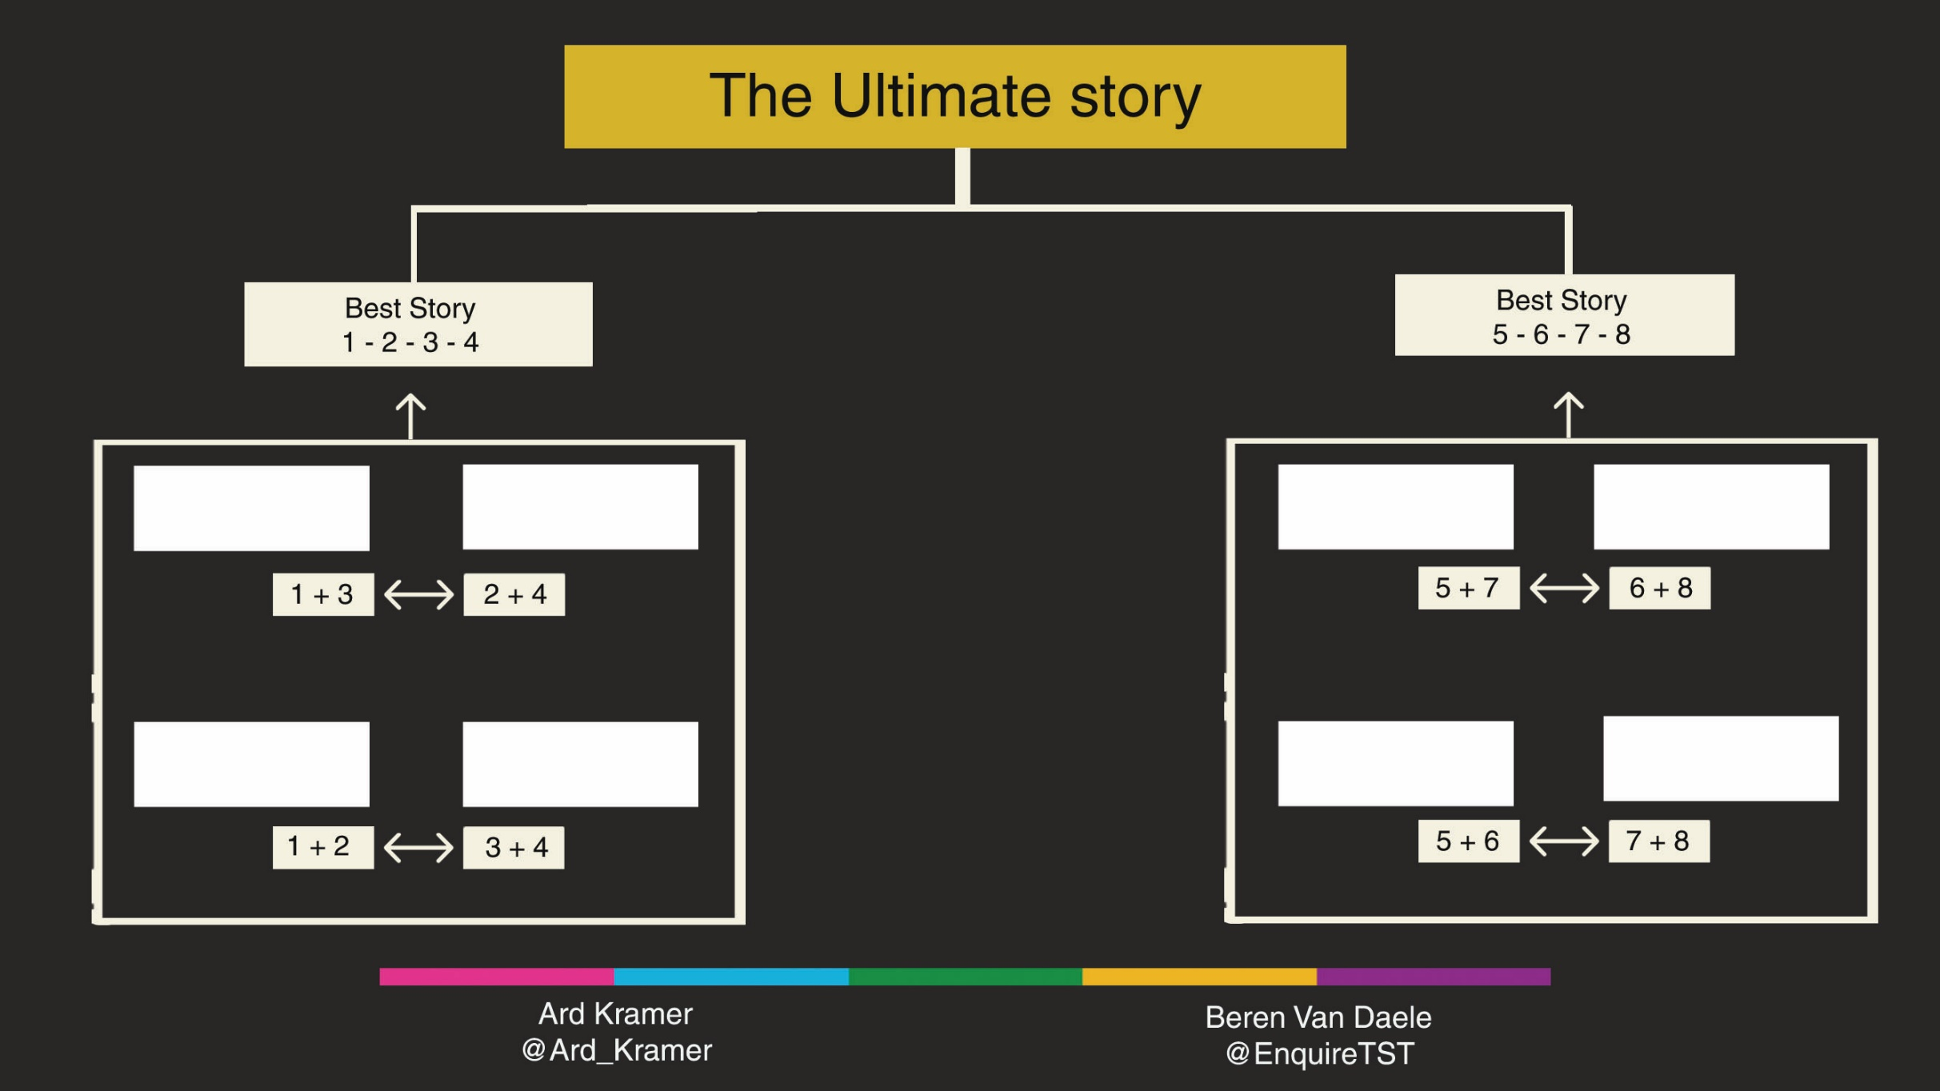
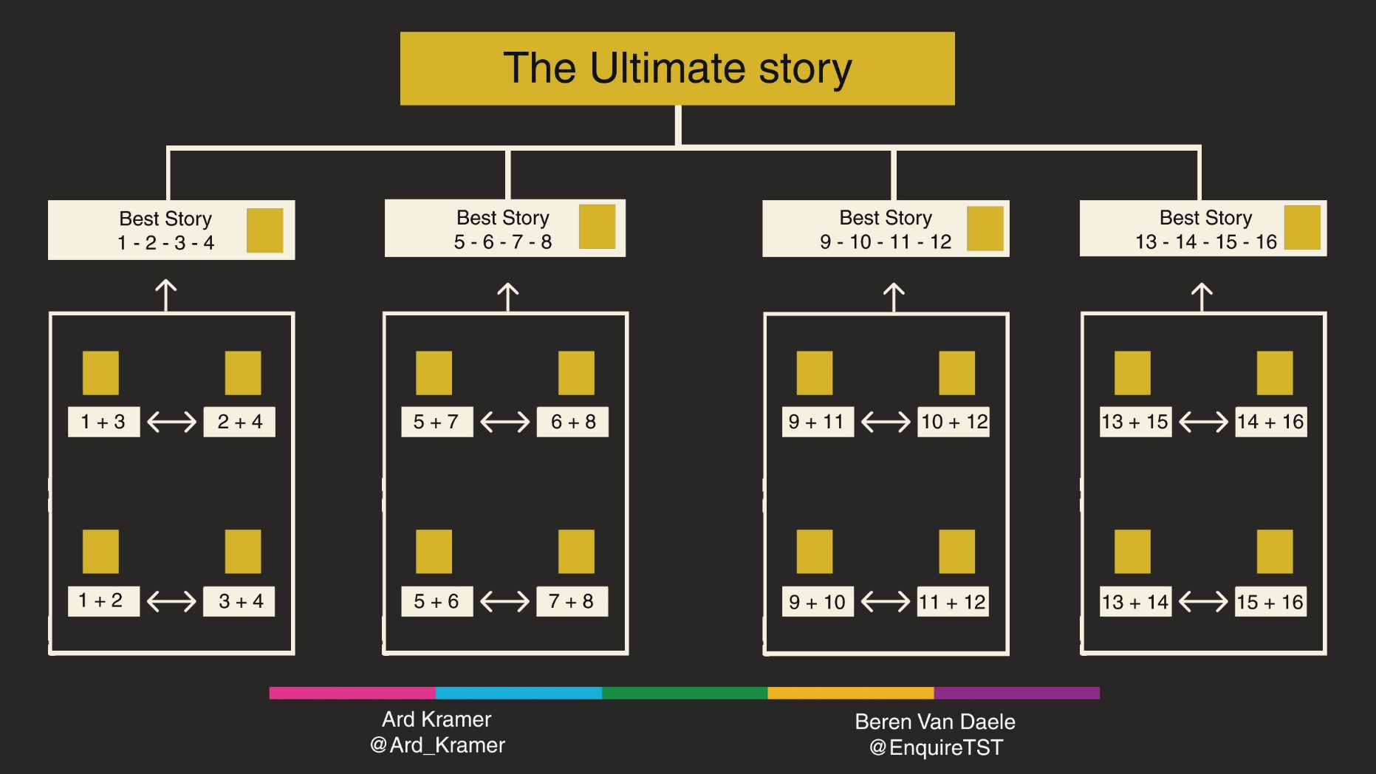
Round 4
Table 1
Table 2
Round 3
Table 3
Table 4
Team 1
Team 2
Team 5
Team 6
BREAK
Round 2
Table 1
Table 2
Table 3
Table 4
Team 3
Team 4
Team 7
Team 8
Round 1
Andreas Faes
@AndreasFaes

Slide 5
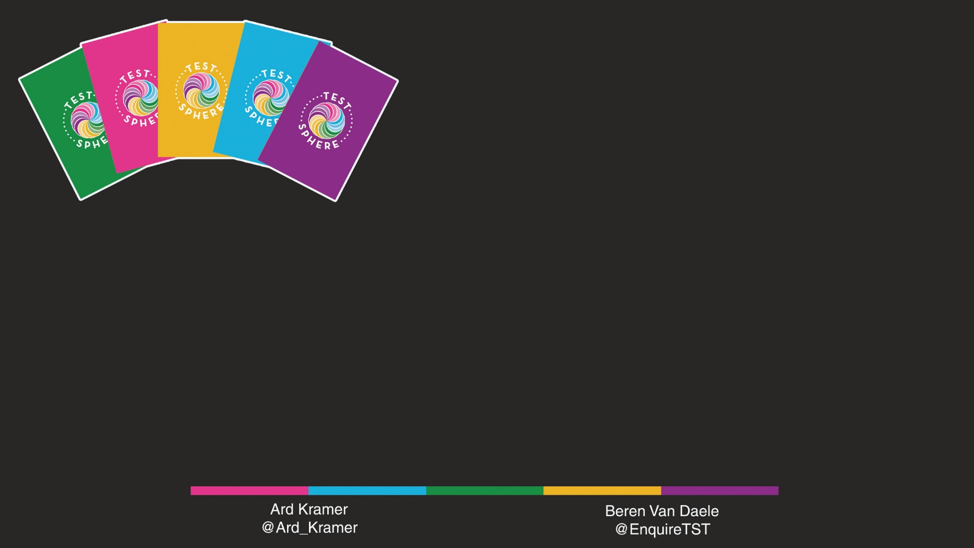
How To Play: Test Sphere
Reveal one card of a random colour.
As soon as you can think of a story that features that cards: knock on the table.
Tell the story.
The others give feedback on: Content and Storytelling.
Write title of story on a Post-It.
Award appreciation Stickers!
Andreas Faes
@AndreasFaes

Slide 6
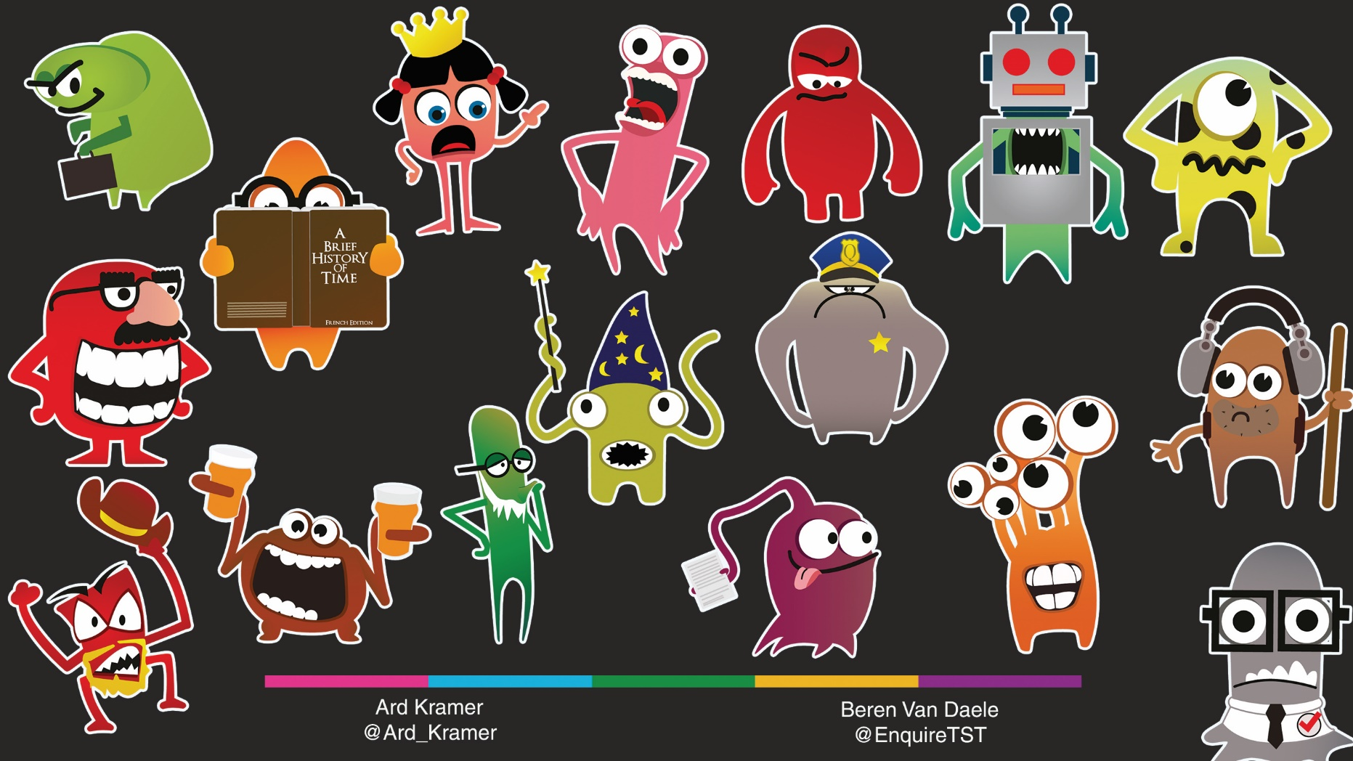
Stickers
Andreas Faes
@AndreasFaes

Slide 7
Round 1
Table 4
Table 1
Team 1 + 2
Table 3
Team 5 + 6
Table 2
Team 3 + 4
Table 4
Team 7 + 8
Table 1
Table 2
Table 3
Table 4
Andreas Faes
@AndreasFaes

Slide 8
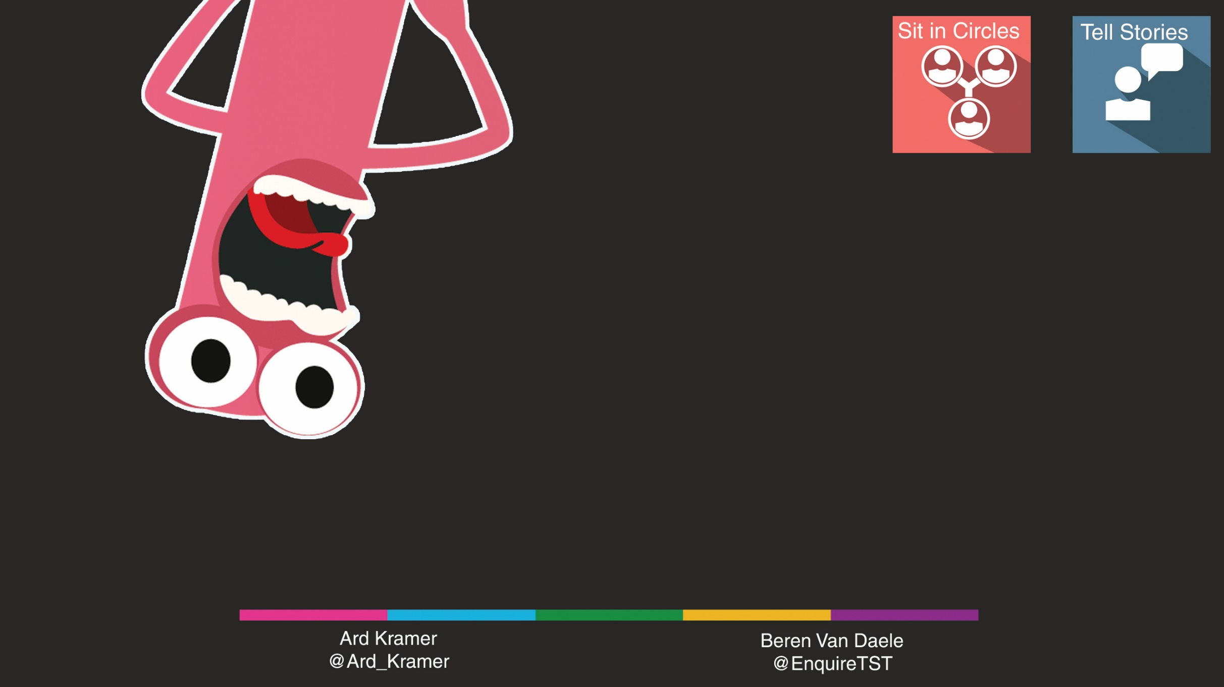
Round One & Two & Three: Play
Find your group
  → Check your flyer!
Play Test Sphere
Gather a number of Test Stories on Post-Its
Sit with your groups in circles
  Group 1 & 2
  Group 3 & 4
  …
Play the Test Sphere game
Andreas Faes
@AndreasFaes

Slide 9
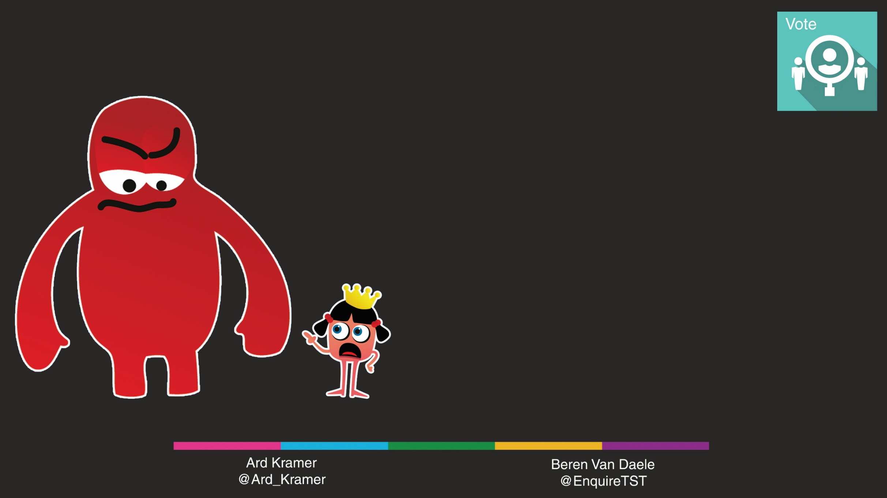
Round One & Two & Three:
Dot-Voting
Every team member has 2 votes.
Use these votes to put ‘dots’ on the Post-Its with your favourite story.
The Story with the most dots wins this round!
Andreas Faes
@AndreasFaes

Slide 10
Round 2
Table 4
Table 1
Team 1 + 3
Table 3
Team 5 + 7
Table 2
Team 2 + 4
Table 4
Team 6 + 8
Table 1
Table 2
Table 3
Table 4
Andreas Faes
@AndreasFaes

Slide 11
Round 3
Table 4
Table 1
Team 1 + 4
Table 3
Team 5 + 8
Table 2
Team 2 + 3
Table 4
Team 6 + 7
Table 1
Table 2
Table 3
Table 4
Andreas Faes
@AndreasFaes

Slide 12
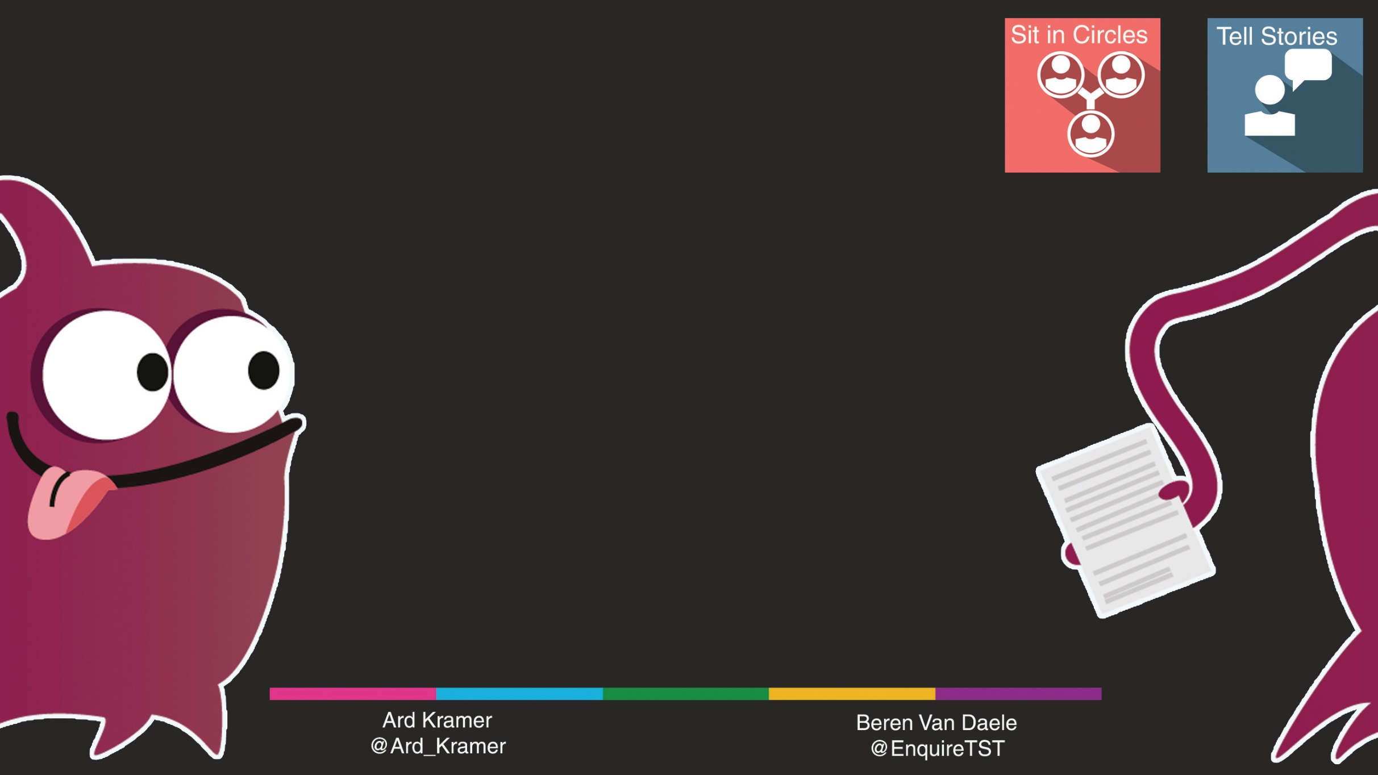
Round Three:
In-Group showdown
Stand up and find a nice spot for your group to confer.
Each group has 4 Top Stories:
Let the Story Tellers repeat them to the whole group
The rest of the group:
Go stand with the person who told the best story
Andreas Faes
@AndreasFaes

Slide 13
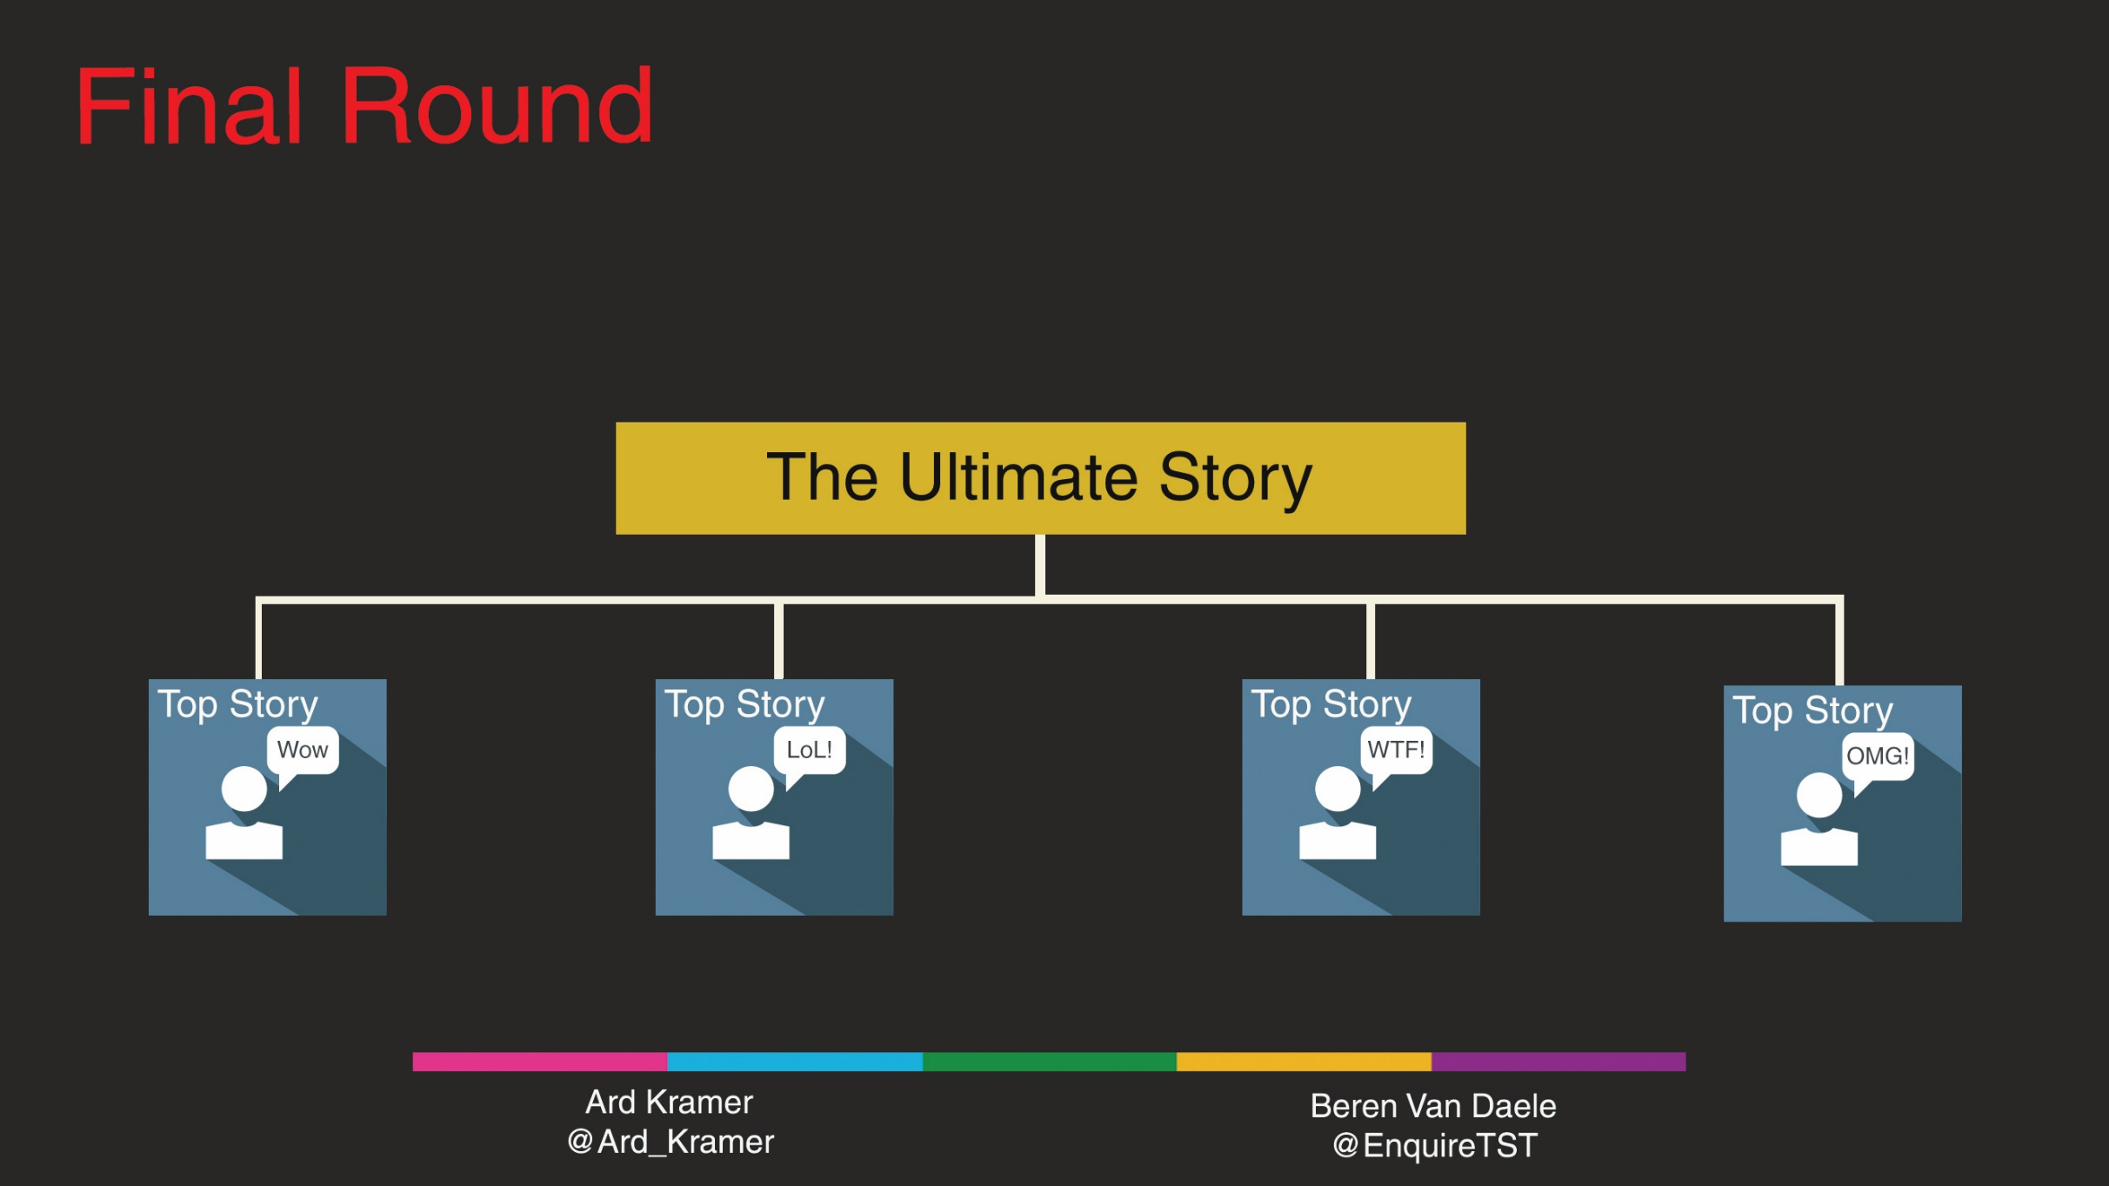
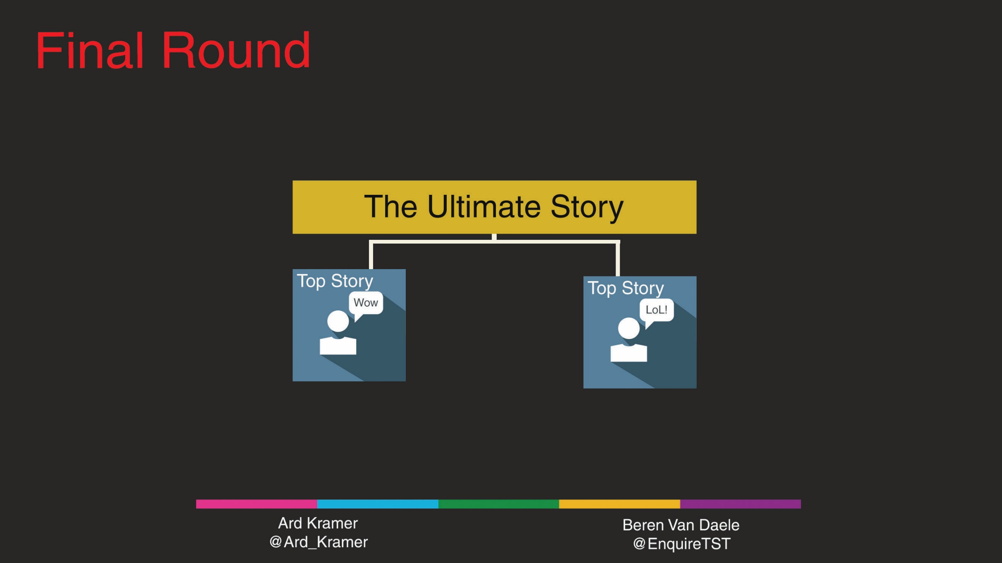
The Final Round
Each team presents their best story
Andreas Faes
@AndreasFaes

Slide 14
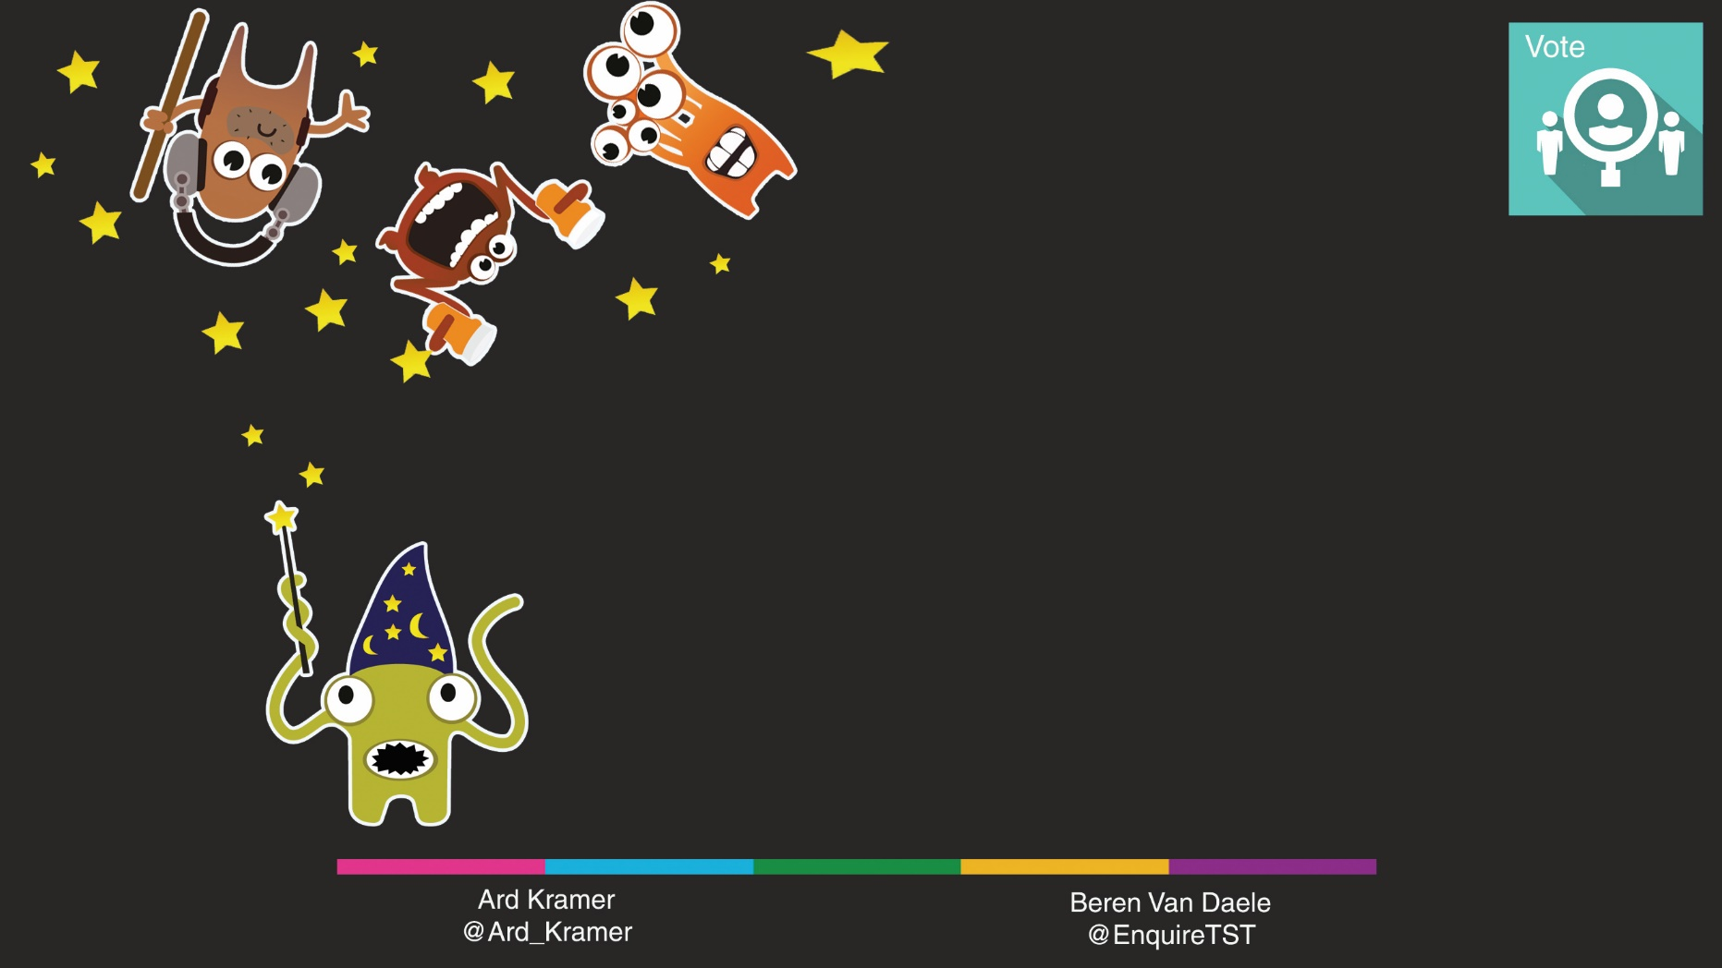
Final Round: The Ultimate Testing Story
Listen to the best stories
Applaud as loud as you think the story is good.
Find out today’s Ultimate Testing Story
Andreas Faes
@AndreasFaes

Slide 15
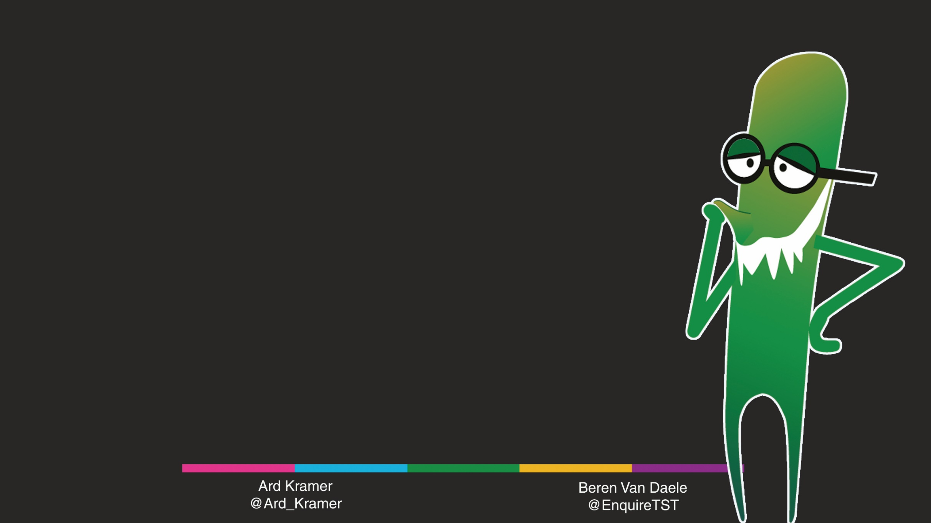
Thank You!
We hope you had a blast!
… and learned a thing or two.
Andreas Faes
@AndreasFaes

Slide 16
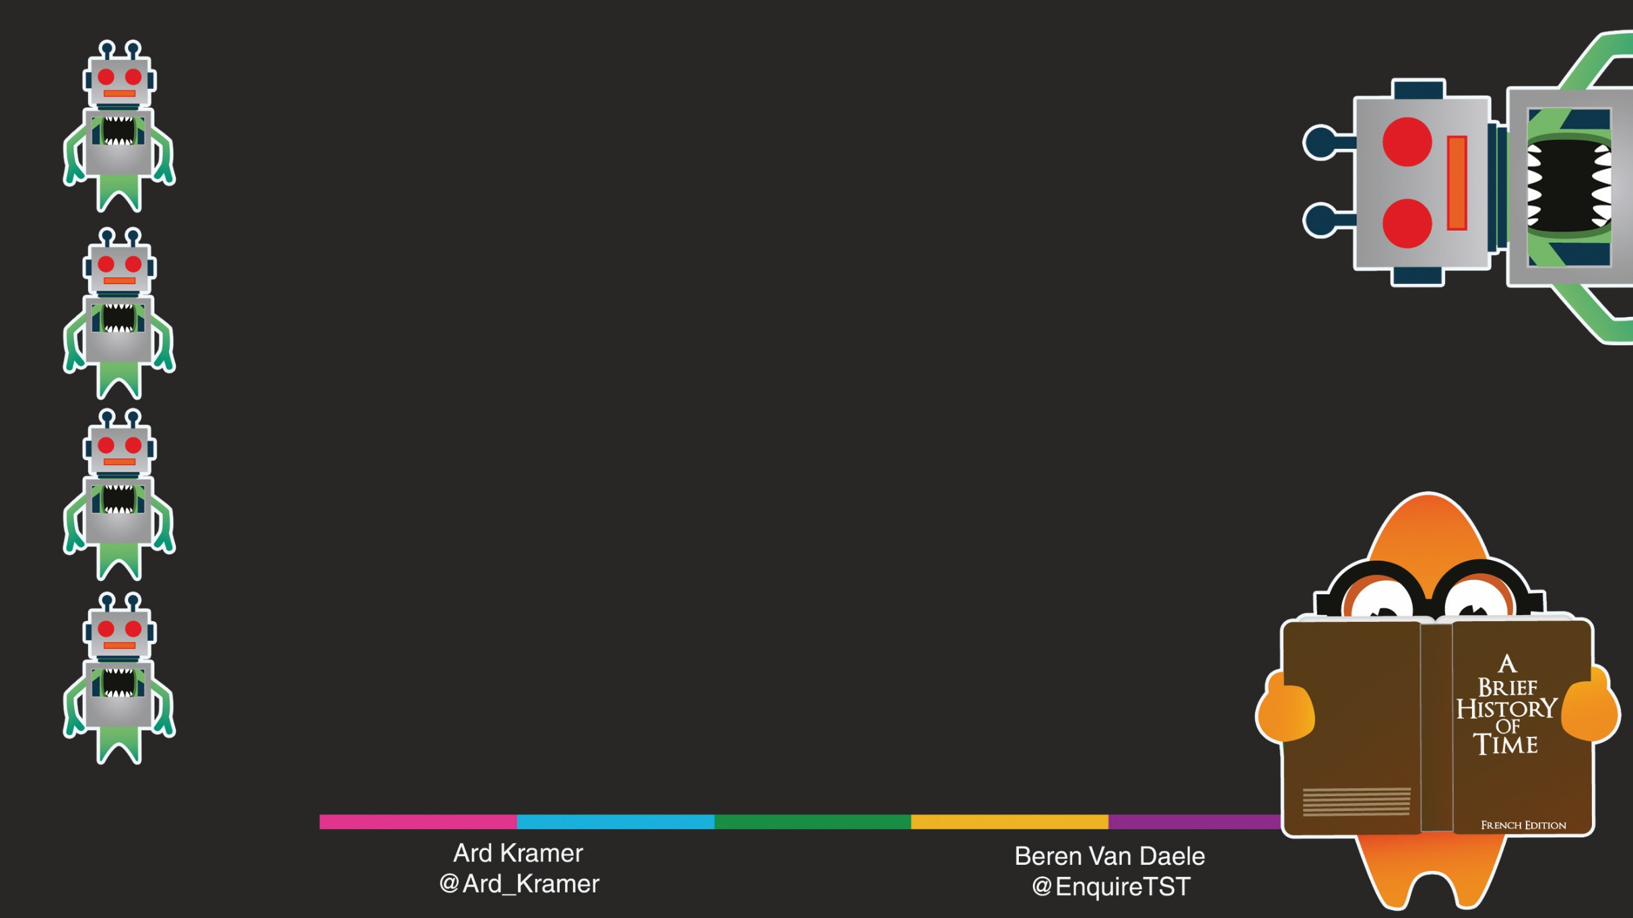
Characters from Ministry of Testing & Rob Lambert
Test Sphere co-created by Ministry of Testing and Beren Van Daele
Picture & quote from Jim Henson’s ‘The Storyteller’
Icons Designed by Photoroyalty - Freepik.com
Andreas Faes
@AndreasFaes

