Slide 1
Hoe snel durf jij te rijden zonder remmen?
Bas Dijkstra
bas@ontestautomation.com
www.ontestautomation.com

Slide 2
Hoe snel durf jij te rijden in een auto zonder remmen?
Notes:
In the first 8 years of my career I wrote an awful lot of horrible automation

Slide 3
Notes:
In the first 8 years of my career I wrote an awful lot of horrible automation

Slide 4
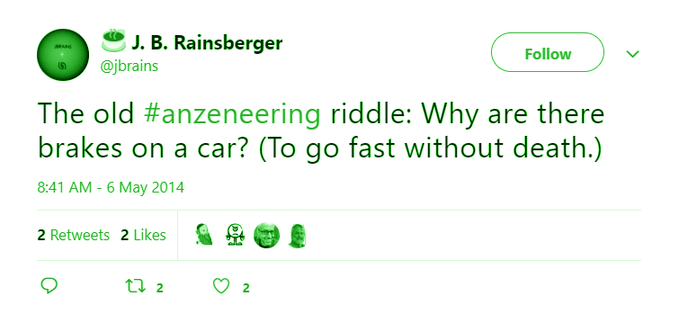
Notes:
In the first 8 years of my career I wrote an awful lot of horrible automation

Slide 5
Notes:
In the first 8 years of my career I wrote an awful lot of horrible automation

Slide 6
Notes:
We see a desire for speed in software development as well (CI/CD, rapid deployments, …)

Slide 7
Notes:
What we don’t want is mistakes, though (no matter how easy it is to fix them)

Slide 8
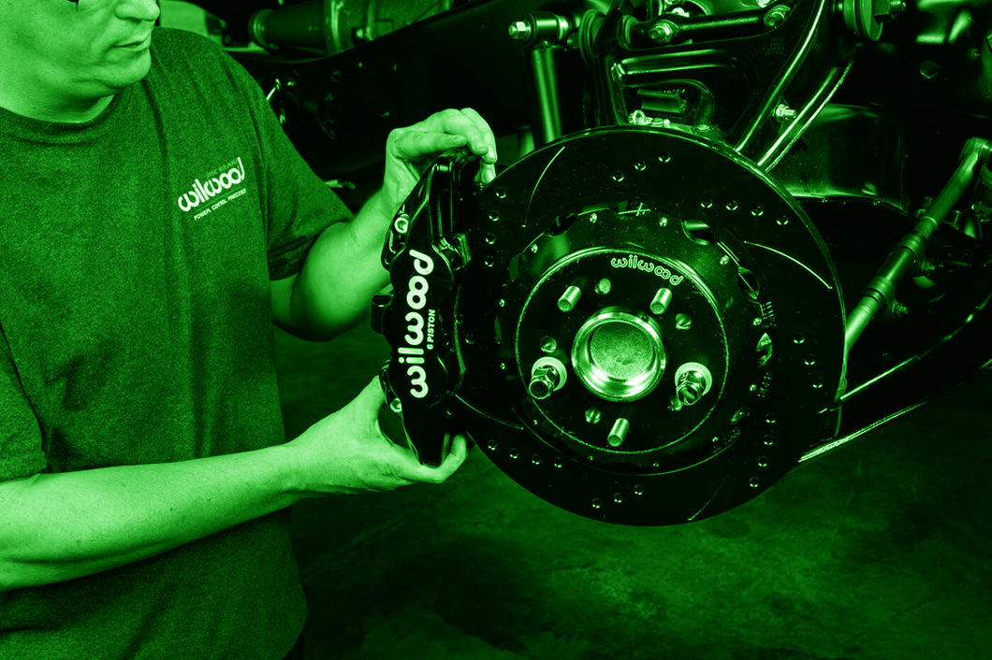
Notes:
That’s why we install brakes in our pipeline > automated tests

Slide 9
Snel opleveren van software met vertrouwen…
Notes:
In the first 8 years of my career I wrote an awful lot of horrible automation

Slide 10
…omdat je weet dat je ‘remmen’ het doen
Notes:
In the first 8 years of my career I wrote an awful lot of horrible automation

Slide 11
Notes:
I see quite a few problems in practice, though

Slide 12
Notes:
Too many tests (every feature should have tests, lots of added maintenance)

Slide 13
Notes:
Too few tests (failures in production)

Slide 14
“Are we comfortable with not having the information provided by this test?”

Slide 15
“Are we comfortable with not having the information provided by this test before we deploy?”

Slide 16
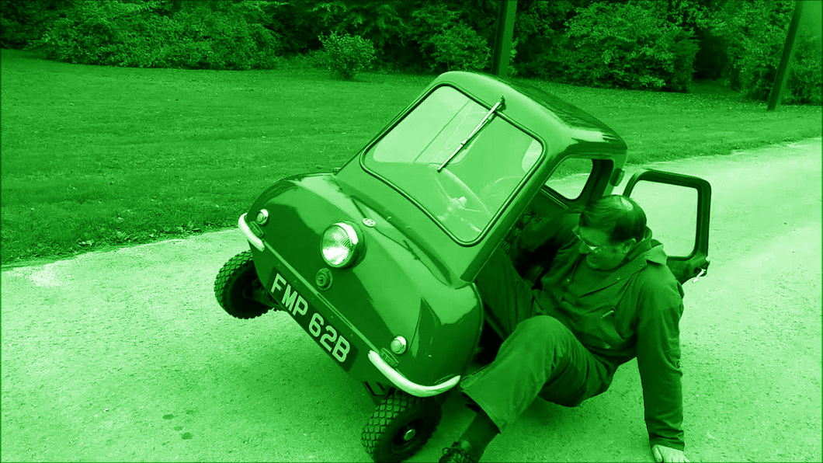
Notes:
Inefficient tests (Blu, Orange)

Slide 17
“Is this the most efficient way to get the information we’re looking for?”

Slide 18
Notes:
Reliable / trustworthy tests – false positives / false negatives

Slide 19
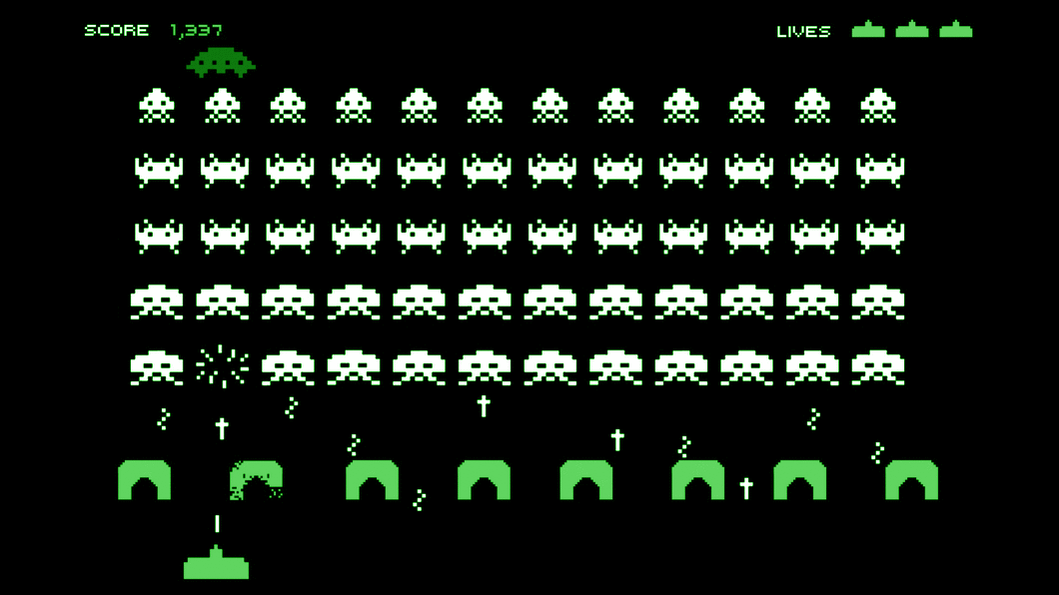

Slide 20
Notes:
Review / refactor / remove your tests periodically – tell story of brake pads here

Slide 21
Notes:
Craftsmanship - training

Slide 22
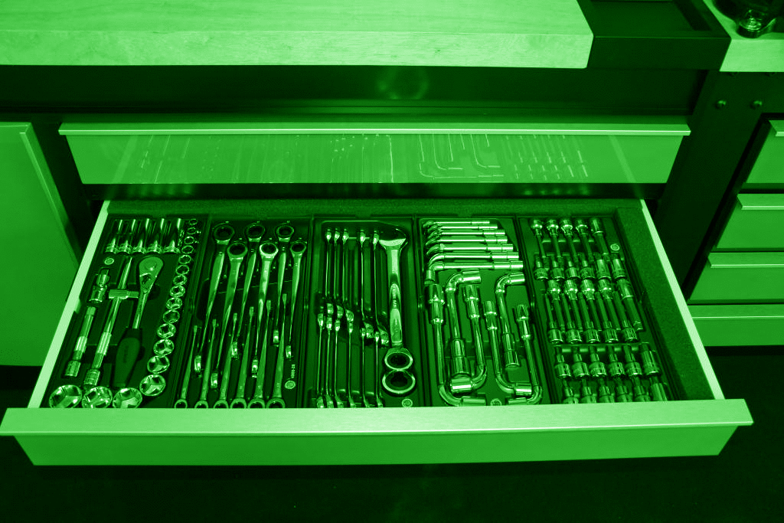
Notes:
It’s about the right tools

Slide 23
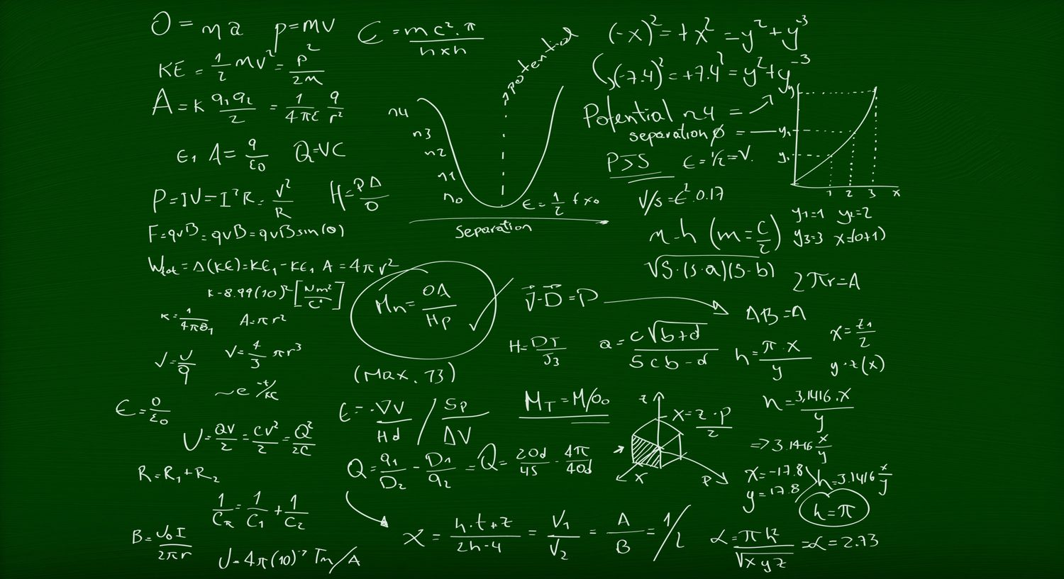
Notes:
It’s about the right knowledge

Slide 24
Testautomatisering beschermt je niet tegen alle risico’s
Notes:
Flat tires for example - don’t rely on automation alone

Slide 25
Notes:
In the first 8 years of my career I wrote an awful lot of horrible automation

Slide 26
Hoe snel durf jij te rijden met jouw remmen?
Notes:
In the first 8 years of my career I wrote an awful lot of horrible automation

Slide 27
Contact
Email: bas@ontestautomation.com
Website: https://www.ontestautomation.com/training
LinkedIn: https://www.linkedin.com/in/basdijkstra

