Slide 1
Van bagger…
…naar behaviour
TestNet najaarsevenement
10 oktober 2018
Bas Dijkstra
bas@ontestautomation.com
www.ontestautomation.com
@_basdijkstra
Notes:
In the first 8 years of my career I wrote an awful lot of horrible automation

Slide 2
Wat gaan we doen?
Wat is BDD?
Welke rol spelen tools als Cucumber en SpecFlow in BDD?
Valkuilen bij het schrijven van BDD-scenario’s
Hoe kunnen we deze scenario’s verbeteren en onze automatisering effectiever maken?
Notes:
Saving money > discuss ROI
NEEDS REWORK

Slide 3
Wat gaan we niet doen?
Workshop Cucumber / SpecFlow
Scenario’s automatiseren
Code schrijven
Laptops gebruiken
Notes:
Saving money > discuss ROI
NEEDS REWORK

Slide 4
Een korte introductie van BDD en tools
Notes:
In the first 8 years of my career I wrote an awful lot of horrible automation

Slide 5
Wat is BDD?
Behaviour Driven Development
Ondersteunen van software-ontwikkeling door communicatie
Gedeeld begrip, gedeelde begrippen
Vooraf specificeren van gewenst gedrag
Notes:
Saving money > discuss ROI
NEEDS REWORK

Slide 6
Hoe werkt BDD?
Three amigos-sessies
Business analisten, product owners weten wat ze krijgen
Ontwikkelaars weten wat ze moeten bouwen
Testers weten wat ze moeten verifiëren
Notes:
Saving money > discuss ROI
NEEDS REWORK

Slide 7
Gherkin
Given / When / Then ( / And / But )
Uitgangssituatie / actie / verwacht resultaat
Features en scenario’s
Diverse mogelijkheden voor verduidelijking
Notes:
Saving money > discuss ROI
NEEDS REWORK

Slide 8

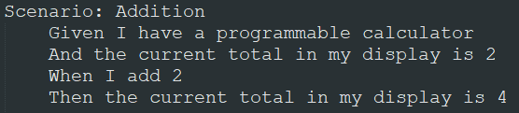
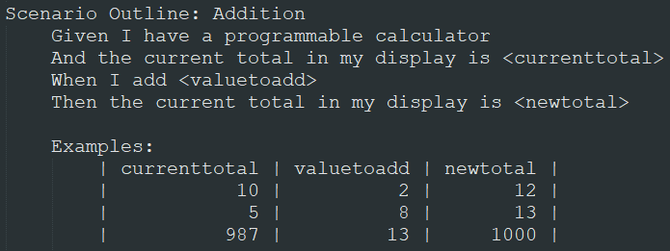
Notes:
In the first 8 years of my career I wrote an awful lot of horrible automation

Slide 9
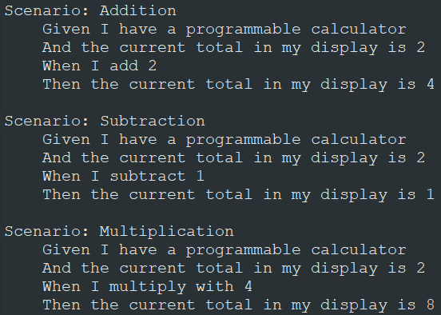
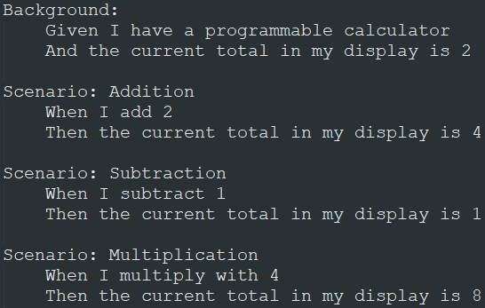
Notes:
In the first 8 years of my career I wrote an awful lot of horrible automation

Slide 10
Cucumber en SpecFlow
Tools ter ondersteuning van BDD
Cucumber: verschillende talen (Java, Ruby, JS, …)
SpecFlow: .NET
Andere, soortgelijke tools beschikbaar (Ginkgo voor Go, Behat voor PHP, …)
Notes:
Saving money > discuss ROI
NEEDS REWORK

Slide 11
Cucumber en SpecFlow
Het zijn geen (pure) testtools!
Tests automatiseren met Cucumber == DOES NOT COMPUTE
Omzetten leesbare specificaties naar executeerbare code
Helpers, hooks, rapportage
Notes:
Saving money > discuss ROI
NEEDS REWORK

Slide 12
Aan de slag
Introductie van een applicatie
BDD-scenario’s ‘met ruimte voor verbetering’
Opstellen verbeterde versie in groepjes
Presenteren aan de groep
Notes:
Saving money > discuss ROI
NEEDS REWORK

Slide 13
Ronde 1: Rotterdam
Notes:
In the first 8 years of my career I wrote an awful lot of horrible automation

Slide 14
Scenario: verify the existence of a search result
Given I have opened https://www.rotterdam.nl
When I type parkeren in occurrence 3 of the input element with the attribute name with value query
And I click on occurrence 1 of the button element with the attribute type with value submit
Then I see an a element with the attribute href with value
/wonen-leven/parkeren/
And I see an a element with the attribute href with value
/wonen-leven/betaald-parkeren/
Notes:
In the first 8 years of my career I wrote an awful lot of horrible automation

Slide 15
Verbeter dit scenario
Wat vind je van dit scenario?
Hoe zouden jullie dit scenario eruit laten zien?
Samenwerken, leer van elkaars ervaringen
Eén groep presenteert plenair
Notes:
Saving money > discuss ROI
NEEDS REWORK

Slide 16
Lesson learned
Cucumber / SpecFlow zijn geen keyword driven test tools
Toch proberen geeft onleesbare scenario’s
Maak onderscheid tussen ‘wat?’ en ‘hoe?’
Geen implementatiedetails in scenario’s
Notes:
Saving money > discuss ROI
NEEDS REWORK

Slide 17
Oh, en als je dacht dat ik dit had verzonnen…
Notes:
In the first 8 years of my career I wrote an awful lot of horrible automation

Slide 18
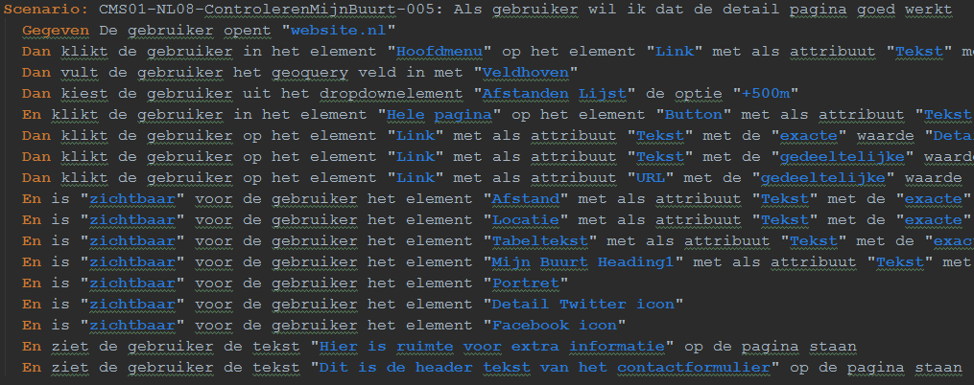
Notes:
In the first 8 years of my career I wrote an awful lot of horrible automation

Slide 19
Ronde 2: Accountancy
Notes:
In the first 8 years of my career I wrote an awful lot of horrible automation

Slide 20
Scenario: a new account can be created
Given I am on the organization page for BananaOrg
When I import financial data for BananaOrg
Then the account InitialAccount exists for BananaOrg
Scenario: an existing account can be renamed
Given I am on the organization page for BananaOrg
When I rename the InitialAccount account to RenamedAccount
Then the account RenamedAccount exists for BananaOrg
And the account InitialAccount does not exist for BananaOrg
Scenario: an existing account can be deleted
Given I am on the organization page for BananaOrg
When I delete the RenamedAccount account
Then the account RenamedAccount does not exist for BananaOrg
Notes:
In the first 8 years of my career I wrote an awful lot of horrible automation

Slide 21
Verbeter dit scenario
Wat vind je van dit scenario?
Hoe zouden jullie dit scenario eruit laten zien?
Samenwerken, leer van elkaars ervaringen
Eén groep presenteert plenair
Notes:
Saving money > discuss ROI
NEEDS REWORK

Slide 22
Lesson learned
Scenario’s moeten onafhankelijk van elkaar zijn
Stelt specifieke eisen aan je testdata-strategie
Volgorde van uitvoeren scenario’s niet gegarandeerd
Afhankelijkheden maken parallelle uitvoer praktisch onmogelijk
Notes:
Saving money > discuss ROI
NEEDS REWORK

Slide 23
Oh, en als je dacht dat ik dit had verzonnen…
Importeren van data kostte +/- 1 minuut
Honderden scenario’s
Realiteit zag er precies zo uit als het voorbeeld
‘Oplossing’: naamsconventies voor scenario’s (SpecFlow)
Notes:
Saving money > discuss ROI
NEEDS REWORK

Slide 24
Ronde 3: Telecom
Notes:
In the first 8 years of my career I wrote an awful lot of horrible automation

Slide 25
Scenario: an existing subscription can be cancelled
Given I have created a new basic subscription
And I have approved the subscription in the subscription manager
And I have run the subscription processing batch job
And I have time traveled 7 days
And the subscription has the status active
When I cancel the subscription
Then the subscription has the status canceling
Scenario: an existing subscription can be upgraded
Given I have created a new basic subscription
And I have approved the subscription in the subscription manager
And I have run the subscription processing batch job
And I have time traveled 7 days
And the subscription has the status active
When I upgrade the subscription to a premium plan
Then the subscription has the status active
And the monthly installment is 25 euros
Scenario: an existing subscription is automatically renewed
Given I have created a new basic subscription
And I have approved the subscription in the subscription manager
And I have run the subscription processing batch job
And I have time traveled 7 days
And the subscription has the status active
When a year has passed
Then the subscription has the status active
And the new end date is another year in the future
Notes:
In the first 8 years of my career I wrote an awful lot of horrible automation

Slide 26
Verbeter dit scenario
Wat vind je van dit scenario?
Hoe zouden jullie dit scenario eruit laten zien?
Samenwerken, leer van elkaars ervaringen
Eén groep presenteert plenair
Notes:
Saving money > discuss ROI
NEEDS REWORK

Slide 27
Lesson learned
Gedeelde uitgangssituatie uit scenario halen
Cucumber / SpecFlow hebben hiervoor de Background
Wat is de meest handige manier om een uitgangssituatie klaar te zetten?
Vermijd de user interface hierbij wanneer mogelijk!
Notes:
Saving money > discuss ROI
NEEDS REWORK

Slide 28
Oh, en als je dacht dat ik dit had verzonnen…
Notes:
In the first 8 years of my career I wrote an awful lot of horrible automation

Slide 29
Aanvraag abonnement
Verwerk abonnement
Time travel +7 dagen
Check status abonnement
Verwerk abonnement
Cool-off verwijderen
Notes:
In the first 8 years of my career I wrote an awful lot of horrible automation

Slide 30
Ronde 4:
Autoverzekering
Notes:
In the first 8 years of my career I wrote an awful lot of horrible automation

Slide 31
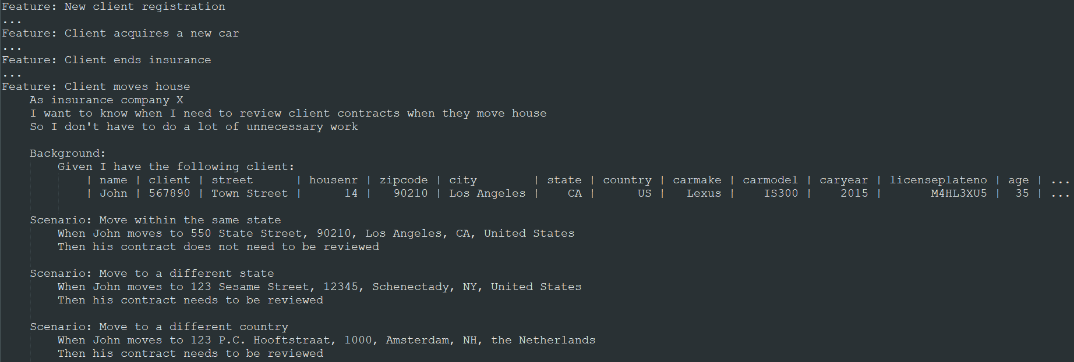
Notes:
In the first 8 years of my career I wrote an awful lot of horrible automation

Slide 32
Verbeter dit scenario
Wat vind je van dit scenario?
Hoe zouden jullie dit scenario eruit laten zien?
Samenwerken, leer van elkaars ervaringen
Eén groep presenteert plenair
Notes:
Saving money > discuss ROI
NEEDS REWORK

Slide 33
Lesson learned
Background is een goede manier om een uitgangssituatie te specificeren
Specificeer alleen de data die er toe doet!
Heeft een parameter invloed op het resultaat van het scenario? Specificeren!
Heeft een parameter geen invloed op het resultaat van het scenario? Beter achterwege laten om verwarring te voorkomen
Notes:
Saving money > discuss ROI
NEEDS REWORK

Slide 34
Ronde 5: Hypotheekorientatie
Notes:
In the first 8 years of my career I wrote an awful lot of horrible automation

Slide 35
@user-interface
Scenario Outline: Check if a single applicant is eligible for a mortgage
Given the applicant is on the mortgage orientation website home page
And their employment contract type is <contractType>
And their gross income is <grossIncome>
And the price of the house is <askingPrice>
And the applicant invests <savings>
And the rebuilding costs of the house are <renovationCosts>
When the applicant completes all forms in the mortgage orientation tool using this data
Then the application displays a message stating that the applicant is eligible for a mortgage
Examples:
| contractType | grossIncome | askingPrice | savings | renovationCosts |
| Vast dienstverband | 100000 | 100000 | 10000 | 10000 |
| Tijdelijk dienstverband | 100000 | 500000 | 20000 | 25000 |
| Pensioen | 100000 | 500000 | 20000 | 25000 |
| Zelfstandig ondernemer | 100000 | 500000 | 20000 | 25000 |
| Overig | 100000 | 500000 | 20000 | 25000 |
Notes:
In the first 8 years of my career I wrote an awful lot of horrible automation

Slide 36
Verbeter dit scenario
Wat vind je van dit scenario?
Hoe zouden jullie dit scenario eruit laten zien?
Samenwerken, leer van elkaars ervaringen
Eén groep presenteert plenair
Notes:
Saving money > discuss ROI
NEEDS REWORK

Slide 37
Lesson learned
Automatisering kan op meer manieren dan alleen via de UI
Dwing de aanpak (‘hoe’?) niet af in je scenario’s
Meerdere keren doorlopen van dezelfde schermen of formulieren?
Onderzoek alternatieven voor de user interface
Don’t Repeat Your Paths: http://chrismcmahonsblog.blogspot.com/2017/11/ui-test-heuristic-dont-repeat-your-paths.html
Notes:
Saving money > discuss ROI
NEEDS REWORK

Slide 38
Oh, en als je dacht dat ik dit had verzonnen…
Notes:
In the first 8 years of my career I wrote an awful lot of horrible automation

Slide 39
Scenario Outline: Check if a JOINT APPLICANT with EXTENDED checked in the application is eligible for Mortgage.
Given Applicant has a contract of type "<contract>"
And partner with type of contract "<partner contract>"
And Applicant has a yearly income of "<BrutoJaarincome>"
And partners yearly income "<partner income>"
And Price of the house is "<vraagprijs>"
And Applicant with DOB "<DOB>"goes to Pension in ten years with yearly Pension of "<pensioenjaarinkomen>"
And Partner with DOB "<partnerDOB>"goes to Pension in ten years with yearly Pension of "<partnerpensioenjaarinkomen>"
And Applicant invests "<eigen spaargeld>"
And Applicant has a monthly loan of "<leningen>" and monthly alimony of "<alimentatie>" and student loan of "<studieschuld>"
And Partner has a monthly loan of "<partnerleningen>" and monthly alimony of "<partneralimentatie>" and student loan of "<partnerstudieschuld>"
And extra cost of the new house "<Meerwerk>"
And Applicant lives in an apartment which has mortgage amount of "<hypotheekbedrag>" and mortgage date "<ingangsdatum>" and selling price "<Verkoopprijs>"
Then Display the eligibility
Examples:
| contract | partner contract | BrutoJaarincome | partner income | vraagprijs | DOB | pensioenjaarinkomen | partnerDOB | partnerpensioenjaarinkomen | eigen spaargeld | leningen | alimentatie | studieschuld | partnerleningen | partneralimentatie | partnerstudieschuld | Meerwerk | hypotheekbedrag | ingangsdatum | Verkoopprijs |
| "Vast dienstverband" | "Vast dienstverband" | "200000" | "129300" | "500000" | "10/01/1989" | "90000" | "10/01/1978" | "85000" | "20000" | "500" | "400" | "1500" | "400" | "500" | "500" | "25000" | "10000" | "10/03/2015" | "50000" |
| "Vast dienstverband" | "Tijdelijk dienstverband" | "100000" | "200000" | "500000" | "10/02/1989" | "90000" | "10/02/1978" | "85000" | "20000" | "500" | "400" | "1500" | "400" | "500" | "500" | "25000" | "10000" | "10/01/2015" | "50000" |
| "Vast dienstverband" | "Pensioen" | "108560" | "200000" | "500000" | "10/02/1989" | "90000" | "10/02/1978" | "85000" | "20000" | "500" | "400" | "1500" | "400" | "500" | "500" | "25000" | "10000" | "10/01/2015" | "50000" |
| "Vast dienstverband" | "Zelfstandig ondernemer" | "190000" | "250000" | "500000" | "10/02/1989" | "90000" | "10/02/1978" | "85000" | "20000" | "500" | "400" | "1500" | "400" | "500" | "500" | "25000" | "10000" | "10/01/2015" | "50000" |
| "Vast dienstverband" | "Overig" | "100000" | "200000" | "500000" | "10/02/1989" | "90000" | "10/02/1978" | "85000" | "20000" | "500" | "400" | "1500" | "400" | "500" | "500" | "25000" | "10000" | "10/01/2015" | "50000" |
| "Tijdelijk dienstverband" | "Vast dienstverband" | "100000" | "200000" | "500000" | "10/03/1989" | "90000" | "10/01/1978" | "85000" | "20000" | "500" | "400" | "1500" | "400" | "500" | "500" | "25000" | "10000" | "10/03/2015" | "50000" |
| "Tijdelijk dienstverband" | "Tijdelijk dienstverband" | "100000" | "200000" | "500000" | "10/02/1989" | "90000" | "10/02/1978" | "85000" | "20000" | "500" | "400" | "1500" | "400" | "500" | "500" | "25000" | "10000" | "10/01/2015" | "50000" |
| "Tijdelijk dienstverband" | "Pensioen" | "100000" | "200000" | "500000" | "10/02/1989" | "90000" | "10/02/1978" | "85000" | "20000" | "500" | "400" | "1500" | "400" | "500" | "500" | "25000" | "10000" | "10/01/2015" | "50000" |
| "Tijdelijk dienstverband" | "Zelfstandig ondernemer" | "100000" | "200000" | "500000" | "10/02/1989" | "90000" | "10/02/1978" | "85000" | "20000" | "500" | "400" | "1500" | "400" | "500" | "500" | "25000" | "10000" | "10/01/2015" | "50000" |
| "Tijdelijk dienstverband" | "Overig" | "100000" | "200000" | "500000" | "10/02/1989" | "90000" | "10/02/1978" | "85000" | "20000" | "500" | "400" | "1500" | "400" | "500" | "500" | "25000" | "10000" | "10/01/2015" | "50000" |
| "Pensioen" | "Vast dienstverband" | "100000" | "200000" | "500000" | "10/03/1989" | "90000" | "10/01/1978" | "85000" | "20000" | "500" | "400" | "1500" | "400" | "500" | "500" | "25000" | "10000" | "10/03/2015" | "50000" |
| "Pensioen" | "Tijdelijk dienstverband" | "100000" | "200000" | "500000" | "10/02/1989" | "90000" | "10/02/1978" | "85000" | "20000" | "500" | "400" | "1500" | "400" | "500" | "500" | "25000" | "10000" | "10/01/2015" | "50000" |
| "Pensioen" | "Pensioen" | "100000" | "200000" | "500000" | "10/02/1989" | "90000" | "10/02/1978" | "85000" | "20000" | "500" | "400" | "1500" | "400" | "500" | "500" | "25000" | "10000" | "10/01/2015" | "50000" |
| "Pensioen" | "Zelfstandig ondernemer" | "100000" | "200000" | "500000" | "10/02/1989" | "90000" | "10/02/1978" | "85000" | "20000" | "500" | "400" | "1500" | "400" | "500" | "500" | "25000" | "10000" | "10/01/2015" | "50000" |
| "Pensioen" | "Overig" | "100000" | "200000" | "500000" | "10/02/1989" | "90000" | "10/02/1978" | "85000" | "20000" | "500" | "400" | "1500" | "400" | "500" | "500" | "25000" | "10000" | "10/01/2015" | "50000" |
| "Zelfstandig ondernemer" | "Vast dienstverband" | "108900" | "200000" | "500000" | "10/03/1989" | "90000" | "10/01/1978" | "85000" | "20000" | "500" | "400" | "1500" | "400" | "500" | "500" | "25000" | "10000" | "10/03/2015" | "50000" |
| "Zelfstandig ondernemer" | "Tijdelijk dienstverband" | "100000" | "204500" | "500000" | "10/02/1989" | "90000" | "10/02/1978" | "85000" | "20000" | "500" | "400" | "1500" | "400" | "500" | "500" | "25000" | "10000" | "10/01/2015" | "50000" |
| "Zelfstandig ondernemer" | "Pensioen" | "159820" | "200000" | "500000" | "10/02/1989" | "90000" | "10/02/1978" | "85000" | "20000" | "500" | "400" | "1500" | "400" | "500" | "500" | "25000" | "10000" | "10/01/2015" | "50000" |
| "Zelfstandig ondernemer" | "Zelfstandig ondernemer" | "100000" | "200120" | "500000" | "10/02/1989" | "90000" | "10/02/1978" | "85000" | "20000" | "500" | "400" | "1500" | "400" | "500" | "500" | "25000" | "10000" | "10/01/2015" | "50000" |
| "Zelfstandig ondernemer" | "Overig" | "100000" | "200000" | "500000" | "10/02/1989" | "90000" | "10/02/1978" | "85000" | "20000" | "500" | "400" | "1500" | "400" | "500" | "500" | "25000" | "10000" | "10/01/2015" | "50000" |
| "Overig" | "Vast dienstverband" | "100000" | "175900" | "500000" | "10/03/1989" | "90000" | "10/01/1978" | "85000" | "20000" | "500" | "400" | "1500" | "400" | "500" | "500" | "25000" | "10000" | "10/03/2015" | "50000" |
| "Overig" | "Tijdelijk dienstverband" | "178220" | "200000" | "500000" | "10/02/1989" | "90000" | "10/02/1978" | "85000" | "20000" | "500" | "400" | "1500" | "400" | "500" | "500" | "25000" | "10000" | "10/01/2015" | "50000" |
| "Overig" | "Pensioen" | "100000" | "200000" | "500000" | "10/02/1989" | "90000" | "10/02/1978" | "85000" | "20000" | "500" | "400" | "1500" | "400" | "500" | "500" | "25000" | "10000" | "10/01/2015" | "50000" |
| "Overig" | "Zelfstandig ondernemer" | "101000" | "200000" | "500000" | "10/02/1989" | "90000" | "10/02/1978" | "85000" | "20000" | "500" | "400" | "1500" | "400" | "500" | "500" | "25000" | "10000" | "10/01/2015" | "50000" |
| "Overig" | "Overig" | "100000" | "200000" | "500000" | "10/02/1989" | "90000" | "10/02/1978" | "85000" | "20000" | "500" | "400" | "1500" | "400" | "500" | "500" | "25000" | "10000" | "10/01/2015" | "50000" |
Notes:
In the first 8 years of my career I wrote an awful lot of horrible automation

Slide 40
Wat hebben we gezien?
Cucumber != keyword of data driven test tool
BDD scenario’s beschrijven het ‘wat?’, niet het ‘hoe?’
Denk goed na over je testdatastrategie!
Gedeelde uitgangssituatie? Background!
Cucumber / SpecFlow zijn onafhankelijk van type test
Notes:
Saving money > discuss ROI
NEEDS REWORK

Slide 41
Nog een paar dingen…
Cucumber / SpecFlow zijn een waardevolle aanvulling…
… zolang ze worden gebruikt als communicatiemiddel
Denk goed na over het publiek van je scenario’s
Er is altijd de optie om het niet (langer) te gebruiken
Notes:
Saving money > discuss ROI
NEEDS REWORK

Slide 42
Meer weten?
Cucumber School - https://cucumber.io/school
Specification by Example (Gojko Adzic) – boek, training
The Cucumber Book (2nd edition) – Matt Wynne, Aslak Hellesøy
The Internet ☺
Notes:
Saving money > discuss ROI
NEEDS REWORK

Slide 43
Contact
Email: bas@ontestautomation.com
Site: https://www.ontestautomation.com/training
LinkedIn: https://www.linkedin.com/in/basdijkstra
Twitter: @_basdijkstra

