Slide 1
Workshop
Agile Performance Testing with mBrace Agile
TestNet Najaarsevenement
10 oktober 2018

Slide 2
Inleiding
Load & stress testen is ongeschikt voor Agile
Ook Shift Left Performance Testen
Is gewoon niet snel genoeg
In de workshop kun je ervaren hoe het anders kan mbv de mBrace Agile Tool

Slide 3
Deel 1
Introductie / test method
Deel 1 Optimaliseer responstijden
  Nuros
  Use case
  Test en productie omgeving
  Norm voor beoordeling van applicatie performance
  De mBrace Agile Performance Test Tool
  Doe de Performance Test
  Inspecteer de test resultaten
  Vind Performance Improvement Opportunities (PIOs)
  Vergelijk de resultaten van alle testers
Vragen, vragen, vragen

Slide 4
Agenda Deel 1
Introduction
  Methodology: Stage 1 of 3
Hands-on Agile Performance Test Stage 1
  Application: Nuros
  Use case
  Test and production environments
  The Agile Performance Test Tool
Step 1 - Do Performance Test
Step 2 - Inspect test results
Step 3 - Find PIOs

Slide 5
Nuros – Application Under Test (AUT)
User transactions
  Claim hours made
  Register appointments
  Claim costs of kilometers
  Claim costs
Management transactions

Slide 6
Nuros - Use case
You can do any use case
Take this one for a start:
  Login Post /
  Navigate to hours form Get / Create/ . . .
  Fill in and submit form Post / Create/ . . .
  Logout Get / Login/ Logout

Slide 7
Test omgeving
Test environment
NUROSPC
NUROSWEB
NUROSDB
CPU speed 1 1 1
CPUs per host 1 1 1
Servers per cluster 1 1 1
Roundtrip time (millisecond) 0.0004 0.0004
Bandwidth In (Mbps) 1,000 1,000
Bandwidth Out (Mbps) 1,000 1,000
Production environment
NUROSPC
NUROSWEB
NUROSDB
NUROSPC
NUROSWEB
NUROSPC
CPU speed 0.5 1.15 1.15
CPUs per host 4 4 4
Servers per cluster 1 2 1
Roundtrip time (millisecond) 20 0.2
Bandwidth In (Mbps) 40 1,000
Bandwidth Out (Mbps) 8 1,000

Slide 8
Productie omgeving
Test environment
NUROSPC
NUROSWEB
NUROSDB
CPU speed 1 1 1
CPUs per host 1 1 1
Servers per cluster 1 1 1
Roundtrip time (millisecond) 0.2 0.2
Bandwidth In (Mbps) 1,000 1,000
Bandwidth Out (Mbps) 1,000 1,000
Production environment
NUROSPC
NUROSWEB
NUROSDB
NUROSPC
NUROSWEB
NUROSPC
CPU speed 0.5 0.5 0.5
CPUs per host 4 4 4
Servers per cluster 1 2 1
Roundtrip time (millisecond) 100 0.0004
Bandwidth In (Mbps) 3 1,000
Bandwidth Out (Mbps) 1 1,000

Slide 9
Test en productie omgeving
Test environment
NUROSPC
NUROSWEB
NUROSDB
CPU speed 1 1 1
CPUs per host 1 1 1
Servers per cluster 1 1 1
Roundtrip time (millisecond) 0.0004 0.0004
Bandwidth In (Mbps) 1,000 1,000
Bandwidth Out (Mbps) 1,000 1,000
Production environment
NUROSPC
NUROSWEB
NUROSDB
NUROSPC
NUROSWEB
NUROSPC
CPU speed 0.5 0.5 0.5
CPUs per host 4 4 4
Servers per cluster 1 2 1
Roundtrip time (millisecond) 100 0.0004
Bandwidth In (Mbps) 3 1,000
Bandwidth Out (Mbps) 1 1,000

Slide 10
Use case
Transactions in performance test
Transaction type Name of the transaction type
1. Login Post /
2. Navigate to Hours-Create Get / Gebruiker/Uren/Create
3. Submit filled-in Hours Post / Gebruiker/Uren/Create
12. Logout Get / Login/Logout

Slide 11
Test / projectie
Test environment /
measurements
Model: Projection
Test environment
+ tooling
Production environment
Performance?

Slide 12
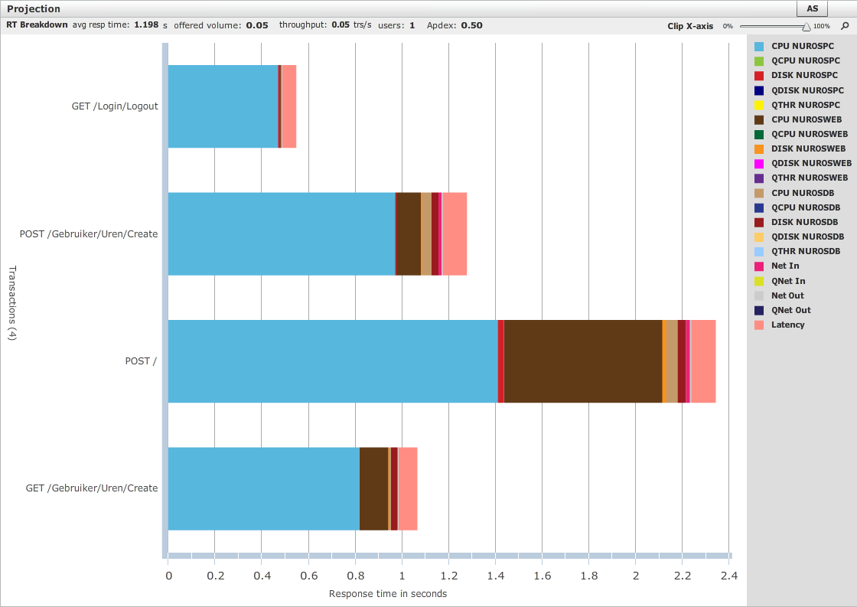
Profiles Production / Norm
Excellent
Tolerated
Unacceptable

Slide 13
OK / Not OK?
Norm: 0.3 seconds
(Apdex: 0.3 / 0.7)

Slide 14
At on outcomes
If response time is greater than norm, the transaction does not have enough performance potential
First optimise the software
If response time is below the norm, release it

Slide 15
Drill down features
Breakdown of response time by host and by network
Profiles of transaction occurrences
Time per process for each host
Details of networks
Http requests
Database calls

Slide 16
Database calls per transaction
Nr | TR-DESC | SERVER TIME | PKTS OUT | BYTES OUT | PKTS IN | BYTES IN | Call | Call
1 | POST / | 0.024371 | 2 | 346 | 2 | 91
2 | POST / | 0.226974 | 3 | 139 | 3 | 17089 | QUERY | SHOW VARIABLES
3 | POST / | 0.051215 | 2 | 124 | 2 | 174 | QUERY | SELECT TIMEDIFF(NOW(), UTC_TIMESTAMP())
4 | POST / | 0.034187 | 2 | 99 | 2 | 8964 | QUERY | SHOW COLLATION
5 | POST / | 0.002879 | 2 | 101 | 2 | 91 | QUERY | SET NAMES latin1
6 | POST / | 0.00091 | 2 | 115 | 2 | 91 | QUERY | SET character_set_results=NULL
7 | POST / | 0.000118 | 2 | 90 | 2 | 91 | INIT-DB | nuros
8 | POST / | 0.110711 | 2 | 1434 | 2 | 1401 | QUERY | SELECT `Limit1`.`IdUser`, `Limit1`.`Id
9 | POST / | 0.00009 | 2 | 85 | 2 | 91 | PING
10 | POST / | 0.000126 | 2 | 90 | 2 | 91 | INIT-DB | nuros
11 | POST / | 0.000094 | 2 | 140 | 2 | 91 | QUERY | SET SESSION TRANSACTION ISOLATION LEVEL R
12 | POST / | 0.000038 | 2 | 90 | 2 | 91 | QUERY | BEGIN
13 | POST / | 0.133545 | 2 | 165 | 2 | 132 | QUERY | UPDATE `user` SET `LastAccessed`='2018-01
14 | POST / | 0.032011 | 2 | 91 | 2 | 91 | QUERY | COMMIT
15 | POST / | 0.00009 | 2 | 85 | 2 | 91 | PING
16 | POST / | 0.000121 | 2 | 90 | 2 | 91 | INIT-DB | nuros
17 | POST / | 0.001149 | 2 | 298 | 2 | 418 | QUERY | SELECT `Extent1`.`ID`, `Extent1`.`Jaar
18 | POST / | 0.000037 | 2 | 85 | 2 | 91 | PING
19 | POST / | 0.000081 | 2 | 90 | 2 | 91 | INIT-DB | nuros
20 | POST / | 0.002221 | 2 | 350 | 2 | 460 | QUERY | SELECT `Extent1`.`ID`, `Extent1`.`Jaar
21 | POST / | 0.000076 | 2 | 85 | 2 | 91 | PING
22 | POST / | 0.000107 | 2 | 90 | 2 | 91 | INIT-DB | nuros

Slide 17
Hands-on
Connect via RDP to the Public IP
  Run: mstsc /v:<public IP>
Chrome tab: mBrace Measurement Control S . . .
  Click: Start Test and wait until Running
6x: Login Nuros + Click Uren => Toevoegen + Logout
Chrome tab: mBrace Measurement
  Click: Stop Test and wait until Stopped
Go to www.mbrace.nl + click Login
  Login with Model user

Slide 18
Deel 2 Optimaliseer Capaciteit

Slide 19
Agenda Deel 2
Introduction
  Methodology: stage 2 of 3
Hands-on Agile Performance Test Stage 1
  Application: Nuros
  Use case including all transactions
  Projection on production environment
  mBrace Performance Model
Step 1 – Set up load model
Step 2 – Increase the load in the model to 6,000 users
Step 3 – incease / optimise capacities

Slide 20
Application intelligence
Full stack / multitier
Response time division by tier / host / network
Interfaces detail
CPU usage by process
Software resources
First / next transaction behaviour
Parallelism
Performance stability
10-10-2018
mAPTT V1

Slide 21
mBrace Agile V1 (used in the Demo)
Stage 1
Rapid performance test cycles: 3 – 5 minutes
Clear test outcomes
Application Intelligence
Load model support
Application with a Chrome browser
Low cost

Slide 22
mBrace Agile V2
Planning: 2019Q1
Memory leaks and locks covered in Stage 1
Performance testing on Mobile devices
No manual repetitions in performance test
Resolution improved for txs with RT <100 msec
Stage 3 reduced to simple health check
No browser limitation

Slide 23
mBrace Vision: 3 risk areas
(Why performance testing? – Risk mitigation)
1
Application
software code
2
Capacities
3
Implementation

Slide 24
3 risk areas == > 3 stages
Stage 1: Performance potential of the code
Stage 2: Capacities
Stage 3: Implementation
Not all stages need always to be done!
Decisions based on Product Risk Assessment

Slide 25
mBrace – 3 stage approach
Previous event
Stage 1. Optimize performance potential of the code
Stage 2. Optimize capacities
Stage 3. Eliminate defects from Implementation
Notes:
The mBrace method for performance testing works in three stages
In the previous event we did Stage 1, a performance test with the mBrace Agile Performance Test Tool on the 4 txs of a sprint.
Next slide shows them.
But in the mean time all other txs of the Nuros application are finished and tx profiles of them have been created.
From this we have the tx profiles of all txs that we can use in the capacity optimization scenario.

Slide 26
Stage 1 - Performance potential
1 sprint

Slide 27
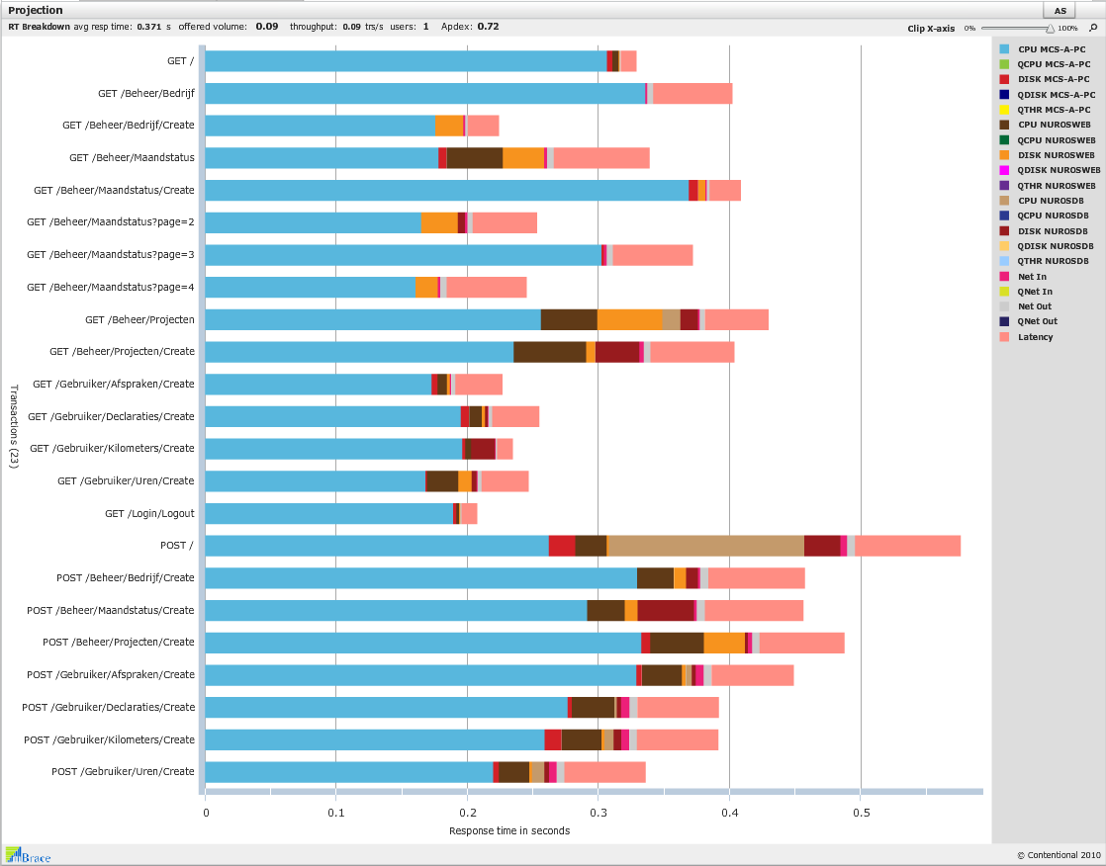
Full application
Notes:
We are going to use these transaction profiles for the capacity optimization scenario

Slide 28
mBrace – 3 stage approach
Stage 1. Optimize performance potential of the code
Part 2:
Stage 2. Optimize capacities
Stage 3. Eliminate defects from Implementation
Notes:
The mBrace method for performance testing works in three stages
Now we are going to do Stage 2, Optimize Capacities.
So we are going to do a Capacity Optimization Scenario with the mBrace Model.
When we have optimized the capacities for Nuros, we have eliminated the risk of insufficient capacity.
First, let’s have a look at what capacities are.

Slide 29
Capacities
Hardware
  Servers, CPUs, Hard disks, SSDs, networks
Software
  Memory pools
  Connection pools
  Single threaded software modules
  Mutexes / synchronisation locks
  Database locks
Notes:
Tonight we are going to focus on hardware capacities.
In a future event we may treat capacities of software resources

Slide 30
Model: Volumes en Configuration
Notes:
When we want to determine how mauch capacity is needed, we need a Workload Model or Load Model.
Attention! A load model is not a performance model!
The mBrace Model provides extensive support for crating a load model.
Most of the work is done for you in Stage 1 to populate the Load Model.
Still there may be quite some work to be done to prepare an accurate load model!
You may have to consult the Product Owner and / or business analysts to gather the data for the load model.

Slide 31
Load model
Is not a performance model!
Ingredients:
    #Users
    Think times
    Use cases and transactions
    Transaction blend
    Transactions per second
    Little’s law
Supported by mBrace Model
Notes:
When we want to determine how mauch capacity is needed, we need a Workload Model or Load Model.
Attention! A load model is not a performance model!
The mBrace Model provides extensive support for crating a load model.
Most of the work is done for you in Stage 1 to populate the Load Model.
Still there may be quite some work to be done to prepare an accurate load model!
You may have to consult the Product Owner and / or business analysts to gather the data for the load model.

Slide 32
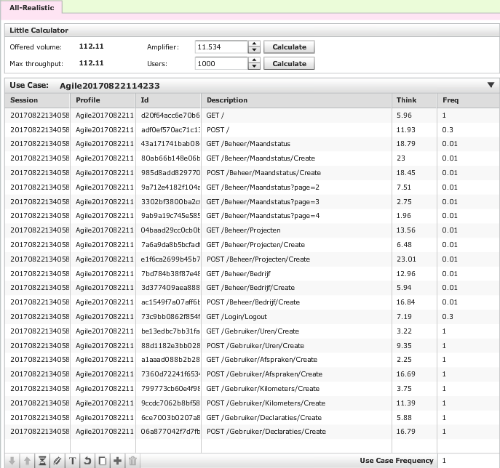
Load model in mBrace
Transactions
Users
Blend
10-10-2018
Capacities
Notes:
Next picture is added to support you in treating all of these parts.
Treat the following parts of the mBrace load Model:
The load model, which consists of:
One or more Volumes
Each Volume may consist of one or more use cases
Concurrent users
Think: think times from test
Freq: number of times tx is done in use case
Use case frequency
Amplifier
Offered volume
Max throughput
Little’s calculator

Slide 33
Load model in mBrace
One or more use cases
Concurrent users
Think: think times from test
Freq: number of times tx is done in use case
Use case frequency
Amplifier
Offered volume
Max throughput
Little’s calculator

Slide 34
Prepare load model: two tracks
Determine transactions per sec == > calculate # users
Determine #users == > calculate transactions per sec
Switch with the Little calculator
Notes:
If you have information about how many times use cases and transactions are executed,
but you have no information about the number of concurrent users (#users), you can fill in the transaction-data
and calculate the number of uers with the Little Calculator.
You need this because the mBrace Closed Model only works with #users.
Also, when you have data about #users, you can calculate transactions per second.
In the scenario for calculating the Login storm we make the following steps, switching between #users and transactions per second:
Fill in the #users
Calculate the transactions per second (which has a blend)
Change the blend and thus the transactions per second
Calculate the #users from this.

Slide 35
Blend
Blend
10-10-2018
Capacities
Notes:
You may skip the next slide if you can treat the blend on the items below.
When the users are busy executing the transactions of the application:
Not all transactions are used at the same frequency
Example: Login is used less than other transac
Some transactions are executed more then others
Alltogether the transactions form a certain mix or blend
The transactions do not cause the same load
Some transactions are “heavier” than others
Hence th blend has great impact on the capacity need of the application.
In the Model the blend is defined in the column Freq.
The Offered volume is calculated: (Sum of (Freq x Use Case Frequency)) x Amplifier

Slide 36
Blend
In the Model the blend is defined in Freq
In a symmetric or even blend all transactions are executed with the same frequency (not normal)
In general not all transactions are executed with the same frequency
E.g. Login and Logout are executed less than other
Example
Notes:
This slide may support the presenter, but can be skipped

Slide 37
Utilization targets
 |  |  | Target | Min | Max
 | CPU |  | 60% | 40% | 80%
 | Memory |  | 90% | 70% | 95%
 | Disks |  | 30% | 10% | 40%
 | Networks |  | 30% | 10% | 40%
10-10-2018
Capacities
Notes:
Capacity need is judged by the %utilization of the resources
When %utilization is below Min, than you may decrease capacity (the number of resources)
When %utilization is above Max, than you may increase capacity (the number of resources)
You try to get as close to Target as possible
Further you try to realize an infrastructure with balanced resources.
For example avoid a situation with %CPU-utilisation on 30% on one host and 80% on the other.
Divide %utilization by Target and multiply the result by the number of resources to obtain the needed capacity.

Slide 38
Your mission
The developer tested the Nuros application
And produced Tx profiles
And mimicked a real user == > accurate Think Times
Find hardware capacities needed
  Use the Tx Profiles that are already there
  Create load model for 6,000 users
  1. Steady state
  2. Login storm

Slide 39
Action! Optimization scenario

Slide 40
Not enough capacity for 6,000 users
Increase / optimise capacity for steady state usage
Notes:
There is not enough capacity for 6,000 users.
Increase the capacitye as usual
Etc . . .

Slide 41
Login storm
Change Freq of Post / (=Login) from 1 into 3 and hit enter
Hit Calculate button!
Post / is represented 3 times as much in the blend
So now you have the blend for the Login Storm
Increase / optimise capacity again

