Slide 1
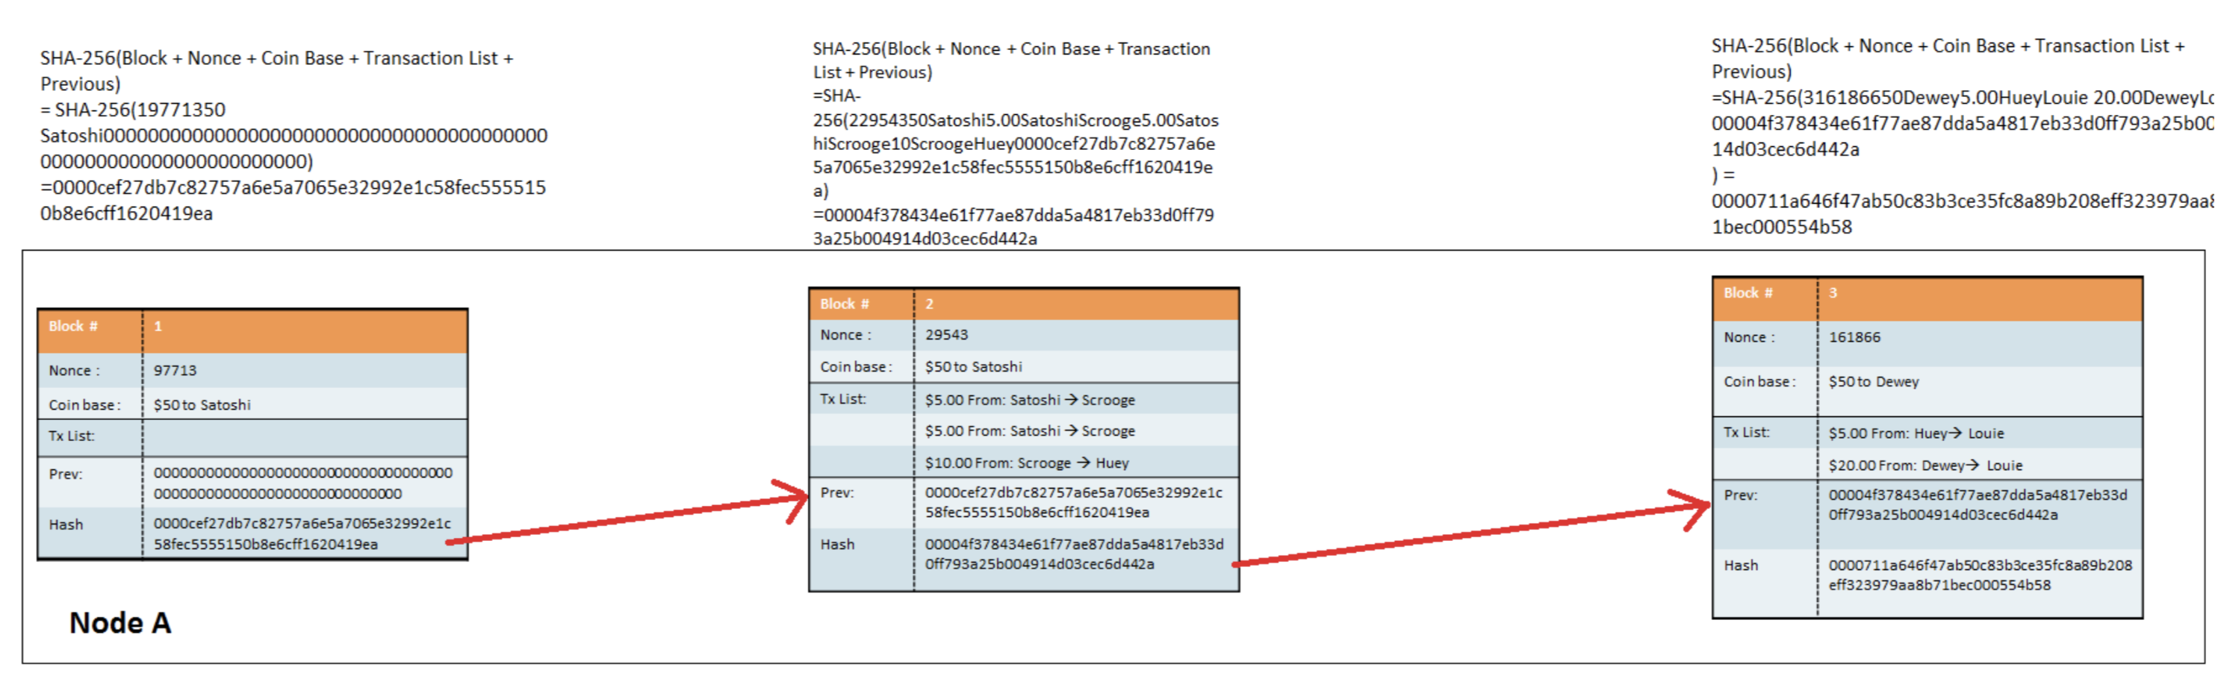


The Cypherpunk Legacy - From Crypto to Blockchain via GDPR

Slide 2
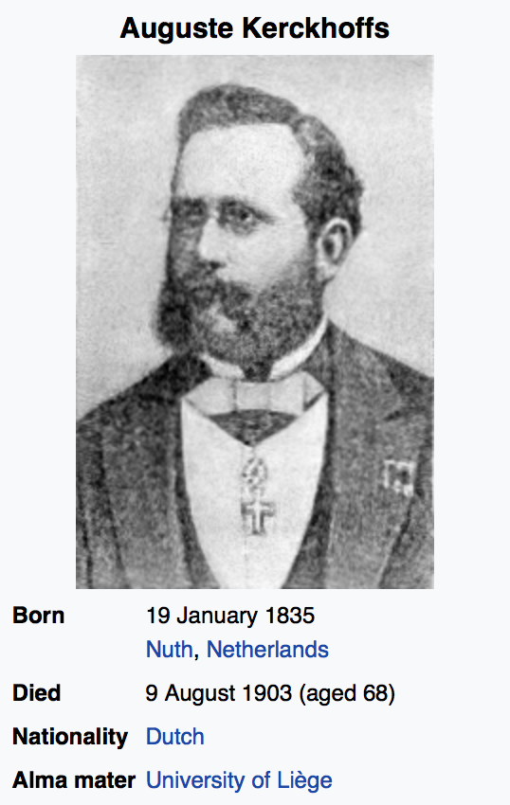
Kerckhoffs's principle
Auguste Kerckhoffs: 1883
A cryptosystem should be secure even if everything about the system, except the key, is public knowledge.
As opposed to: Security through obscurity
Workshop: Which is best, and why?

Slide 3
Cryptography is the art of secret communication
To establish secret communication, participants must first have the secret key. Thus arises the problem of key distribution— how to share a secret key with all participants of a secure conversation before the conversation starts.
October 1944 - Project C-43: Walter Koenig, a Bell technician, suggested a theoretical way of securing a telephone call by having the recipient of a call add noise to the signal and then subtract it afterward. Only ‘Bob’ could subtract the noise, because only he knew what he had added in the first place. An eavesdropper, ‘Eve’, simply would not know how to modify the noise, because she wouldn’t have access to the noise that had been added to the phone conversation in the first place.
The recipient, therefore takes an active part in the encipherment process. A paradigm shift from symmetric to asymmetric cryptography had begun.
1970: James Ellis, a leading British cryptographer randomly discovered and read the “Final Report on Project C-43”, then published a thought experiment on how to manage secret keys. The unthinkable was becoming possible, but needed better mathematics to work for the recipient.

Slide 4
Public Key Cryptography
1973: Clifford Cocks, a Cambridge mathematician joins the spy agency in Cheltenham. Six weeks into his new job a supervisor casually mentions Ellis’s idea.
Cocks immediately realised number theory was the answer.
Multiplying two large primes is easy, even if they are more than a hundred digits long. Factoring the two numbers from the much larger product is hard — very hard. It took the freshly recruited spy about thirty minutes to come up with this prime solution.
The young mathematician’s discovery seemed immediately applicable to military communications, and it would become one of GCHQ’s most prized secrets.
Workshop: Choose two prime numbers (only evenly divisible by 1 and itself) 3, 5, 7, 11, 13, 17, 19, 23, 29, 31, 37, 41, 43, 47, 53, 59, 61, 67, 71, 73, 79, 83, 89, 97, etc. These two numbers are the private key. Multiplying them produces a public key.
Let’s now try doing the reverse. Which two prime numbers produce a public key = 589?
Answer 19 x 31 = 589
Multiplication is easy. Factoring is HARD!
Asymmetric (Public Key) Crypto – The receiver generates their own (secret) private key, and sends the public key to anyone wishing to send secret and authenticated messages to the receiver.

Slide 5
The Cypherpunks
1970’s: Government spy agencies dominate public key cryptography.
Until the discovery is repeated by independent researchers and comes out of the shadows.
1976: Whitfield Diffie and Martin Hellman of Stanford University, and Ralph Merkle of UC Berkeley published a theoretical paper: “New Directions in Cryptography”.
1977: Ron Rivest, Adi Shamir, and Leonard Adleman, three MIT academics, discovered an actual and elegant method for public-key cryptosystems based on very large, randomly chosen prime numbers, over a hundred digits long.
Multiplication took seconds; factoring would take millions of years.
The public encryption key would contain the product; the private decryption key would contain the two primes. It was safe to share the public key on an insecure channel because the factorization problem was so hard that it was, in effect, already encrypted, scrambled by a one-way function that was easy to perform but nearly impossible to reverse.
NSA employees warned cryptographers that presenting and publishing their research could have legal consequences. They issued gag orders. Fort Meade tried to censor the National Science Foundation and to take over funding crypto research directly.
And so the war began...

Slide 6
9th March 1993 Eric Hughes published The Cypherpunk Manifesto
“Privacy is necessary for an open society in the electronic age. Privacy is not secrecy. A private matter is something one doesn't want the whole world to know, but a secret matter is something one doesn't want anybody to know. Privacy is the power to selectively reveal oneself to the world.”
The closing statement provided a reason why cryptocurrency was needed: “The act of encryption, in fact, removes information from the public realm. Even laws against cryptography reach only so far as a nation's border and the arm of its violence. Cryptography will ineluctably spread over the whole globe, and with it the anonymous transactions systems that it makes possible.”

Slide 7

The present, and future, is rooted in the past
1970s: Breakthroughs in cryptography
..but not for ordinary people
1991: PGP
US Criminal investigation for "munitions export without a license"
1993: A Cypherpunk’s Manifesto
2018: EU GDPR
1994: THE CYPHERNOMICON
Digital currencies
2004: Reusable Proof-of-work
Mining
2008: ₿itcoin white paper
Peer-to-peer electronic currency
2009: Genesis block
Blockchain

Slide 8
Building a Digital Currency
Workshop:
What features do we need?
What do we want to avoid?
How can users trust the money is authentic and not counterfeit?
Can we trust money only be spent once (not copied and re-spent)?
How can we be sure who owns the money?
How are transactions settled?

Slide 9
Transactions
In Bitcoin, there are no coins, no senders, no recipients, no balances no accounts, and no addresses. The appearance of these attributes is constructed at a high level for the benefit of the user.
The fundamental building block is the Unspent Transaction Output (UTXO)
Every transaction represents a change in the UTXO set.
A wallet “receiving” bitcoin = a wallet has detected an UTXO that can be spent with one of the keys controlled by that wallet.
“Balance” = sum of all UTXO that users’ wallet can spend.
UTXO may be scattered among hundreds of transactions and blocks.
UTXO values are expressed in ‘satoshis’ 1/100,000,000, or 0.00000001, or one-hundred millionth of a bitcoin.
UTXO are indivisible

Slide 10
Outputs and Inputs
To consume a UTXO larger than the desired transaction three outputs are produced:
Payment from user’s wallet to recipient
Payment of change from user’s wallet to another wallet address owned by the same user
Payment of a Transaction fee from the user’s wallet to the miner
CAUTION! If payment of change is not specified, all the change is assumed to be a transaction fee for the miner!

Slide 11
The Distributed Ledger
In the case of bitcoin, there is no central ledger.
The bitcoin ledger is distributed as a copy to every full node in the peer-to-peer network and each miner races to complete a Proof of Work solution based upon the Hashcash algorithm.
Satoshi Nakamoto’s most important invention is the decentralised mechanism for emergent consensus.
Thousands of independent nodes follow a common set of rules to reach majority agreement built upon four processes, continuously executed by Machine to Machine Testing:
Independent verification of each transaction through a comprehensive set of criteria such as syntax, data structure, size, value, unlocking cryptographic scripts to prove ownership, matching unique outputs and inputs etc. By verifying each transaction as it is received and before propagating it across the peer-to-peer network, every node builds a pool of valid but unconfirmed transactions known as the transaction pool.
Mining nodes perform independent aggregation of transactions in the transaction pool and place valid transactions into new ‘candidate blocks’, coupled with demonstrated computation through the Proof-of-Work algorithm.
New blocks are independently verified by every node and assembled into the chain of blocks.
The chain with the most cumulative computation demonstrated through Proof-of-Work is independently selected by every node in the peer-to-peer network.

Slide 12
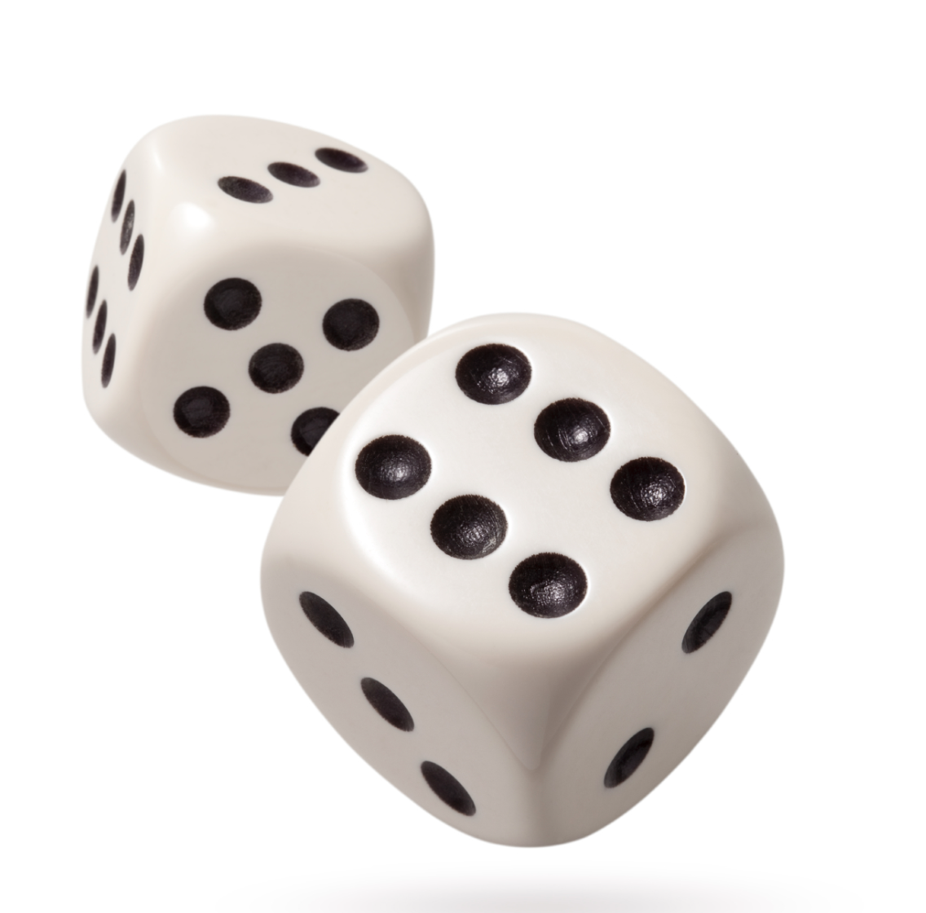
Understanding Difficulty
Target A: Total score less than twelve
(anything except two sixes)
Probability = 35/36 or 97.22% chance of success
Target B: Total score less than five
1+1 or 1+2 or 2+1 or 1+3 or 3+1 or 2+2
Probability = 6/36 or 16.67% chance of success
Target C: Total score less than three
(both dice showing one)
1 x 1 1
------- = ---
6 x 6 36
Only one throw out of every 36, or 2.78% of them will produce a winning result

Slide 13


Candidate Blocks
Each painting demonstrates a ‘Proof of Work’, but if the validation criteria is to have the qualities of a Dutch Master only one will be propagated between the peer-to-peer nodes.
Proof of Work is a Non-deterministic Polynomial (NP) time problem that forces miners to do a lot of work before they can submit a candidate block of transactions.
The time taken to create a painting is non-deterministic, but the time to decide if it is a ‘good’ painting is short.

Slide 14
A closer look at Bitcoin
Google / duckduckgo search for ‘Blockchain explorer bitcoin’
Select https://www.blockchain.com/explorer
Take a look around
Click on one of the LATEST BLOCKS ‘Height’
How much can you explain from what you see?
Return to the https://www.blockchain.com/explorer page
Scroll to the bottom, within PRODUCTS, select CHARTS
Pick a couple of the charts and try to explain what you are seeing.

Slide 15
How will blockchains be used?
Bank audit trails
Health records
Property titles
Legal agreements
Stock and share trades
Intellectual property rights
Digital currencies
???????????????

