Slide 1


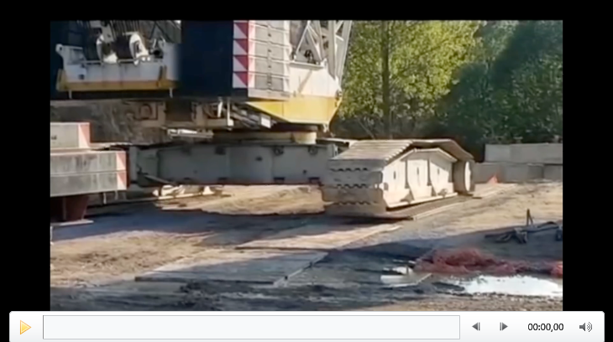
Understanding the Test and Risk in ₿itcoin
Declan O’Riordan
Risk is everywhere!

Slide 2
P-DAY Ten years from now +/- 10 years….
We awake to discover all blockchain systems are becoming corrupted by ‘forks’ in the chain
Bank audit trails, health records, property titles, legal agreements, stock trades, intellectual property rights, and digital currencies are being wrecked
It is no longer possible to distinguish valid transactions and blocks from invalid transactions and blocks
Even ‘immutable’ records are being contested by new forks in the chain reaching back into the past
No conventional attack could do this much damage
Something is fundamentally wrong
We need to solve the mystery!

Slide 3
How should Machine-to-Machine Tests work?
Bitcoin blocks should be added once every ten minutes, averaged over two weeks
The scripted equation in the Bitcoin core code is:
  New Difficulty = Old Difficulty x (Actual time of last 2016 blocks / 20160 minutes)
A ‘Difficulty Target’ is set to harness whatever mining power will result in a 10-minute block interval
For a block to be valid it must create a special ‘hash’ to satisfy the current difficulty target
For nine+ years Bitcoin M-2-M tests have worked well. Why don’t they work properly any more?

Slide 4
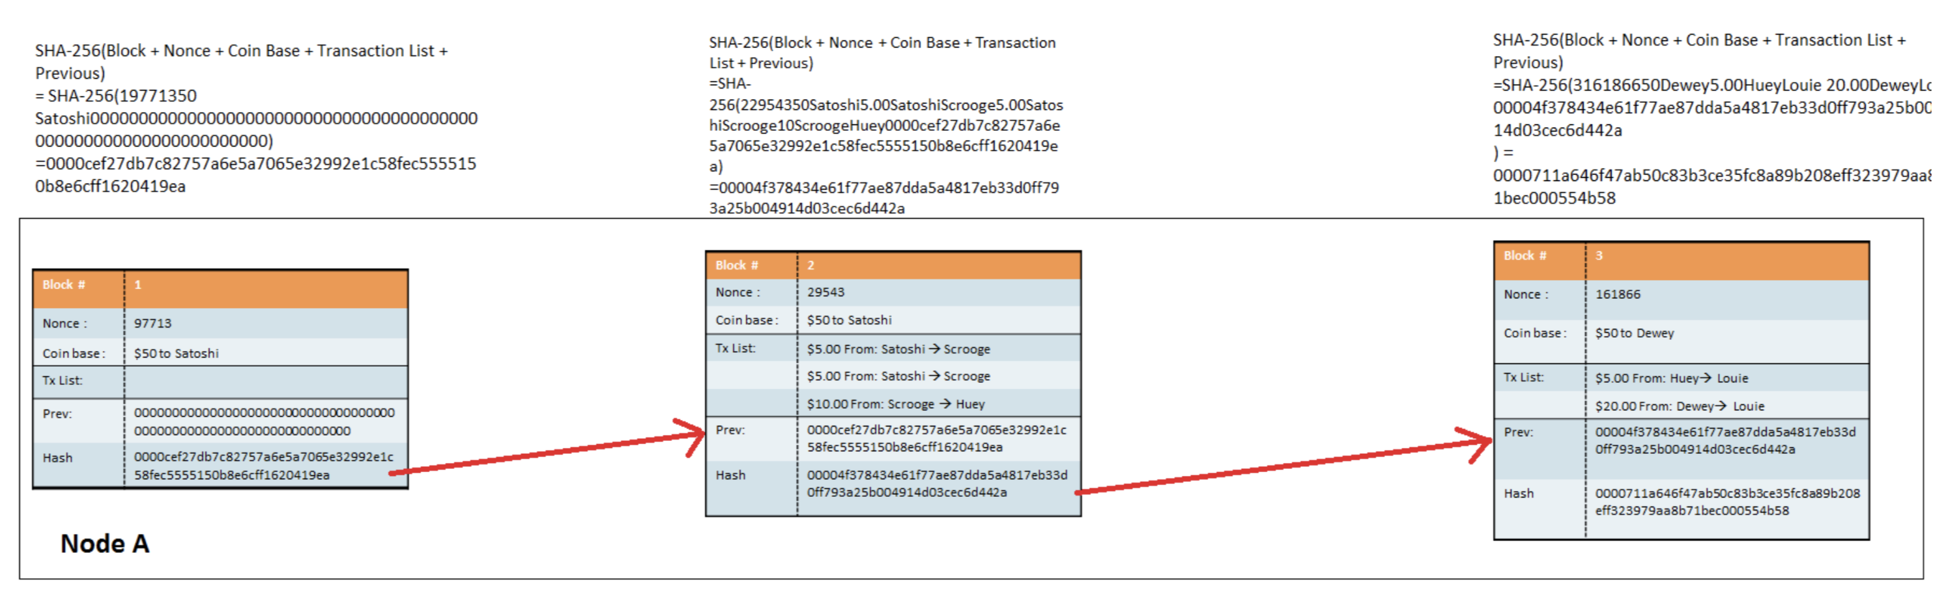
The Blockchain is a Merkle Tree linked by ‘hashes’ of the data
Every block is linked to the previous block, all the way back to the Genesis bitcoin block created on 3rd January 2009 by ‘Satoshi Nakamoto’.
Every Transaction within every block should be immutable after six blocks have been confirmed by peer-to-peer consensus

Slide 5
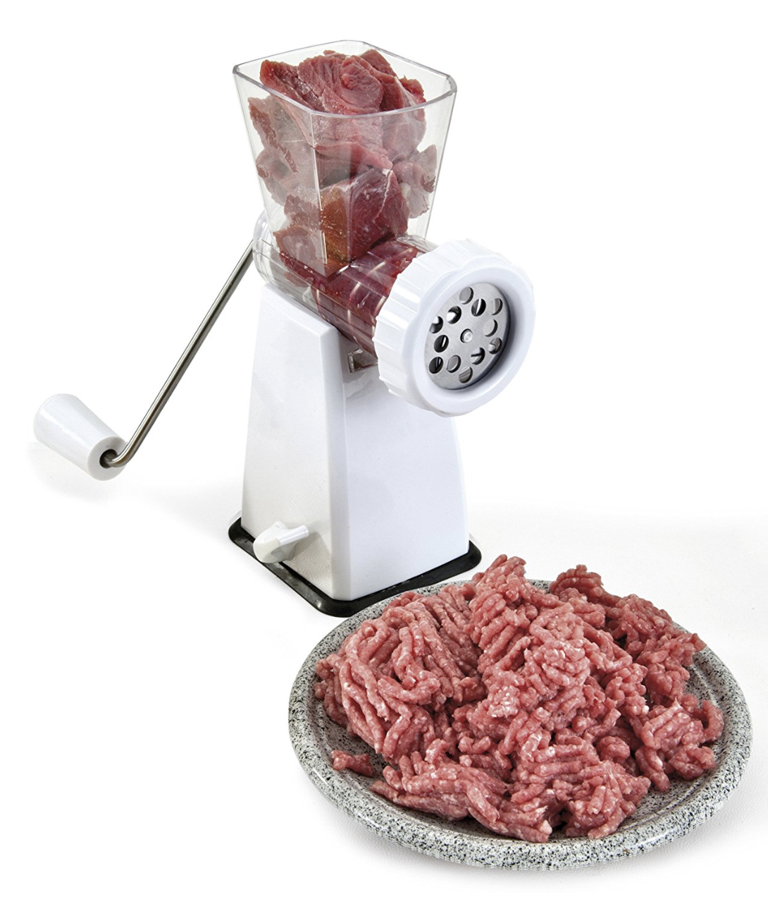
What is a hash?
Hashing is a bit like turning data into mincemeat
Mincing:
It is a one-way function that cannot be reversed.
You cannot tell what the original input looked like.
No two outputs are identical (at a detailed level).
Cryptographic hashing:
Is deterministic: the same message always results in the same hash.
Is quick to compute the hash value for any given message.
It is infeasible to generate a message from its hash value (i.e. work backwards) except by trying all possible messages as inputs.
A small change to a message should change the hash value so extensively that the new hash value appears uncorrelated with the old hash value.
It is infeasible to find two different messages with the same hash value (strong collision resistance).

Slide 6
A simple example using -> http://www.hashemall.com
Input 1 -> Declan O'Riordan 001
Output 1 - Hash (SHA-256) of selected text:
64404BC1B3F8B789B47AF20171761A469996DE0E9C95EA6BC0E7BEFBEAD2CBBB
Target = To find a hash of my input that has a single leading zero in the output
Input 2 -> Declan O'Riordan 002
Output 2 - Hash (SHA-256) of selected text:
244FC602AC259841857D95D1D8E48EAB0112F5ABC97C35124E62B7FF9ECA4160
We changed the input nonce and got a completely different hash, but not with a leading zero.
In terms of probabilities, if the output of the hash function is evenly distributed we would expect to find a result with a single 0 as the hexadecimal prefix once every 16 hashes (one out of 16 hexadecimal digits 0 through F). But randomness is not evenly distributed!
Input 7 -> Declan O'Riordan 007
Output 7- Hash (SHA-256) of selected text:
0A70C950DFED554854EFCB8E2F92927D77F8D8576C3AF4CFB3008349916589AA
A leading zero in the output meets the difficulty target!
If the target had been two leading zeros 16 x 16 = 256 (one value in 256)
Three leading zeros 16 x 16 x 16 = One value in 4096.

Slide 7

Understanding why Difficulty increases as the Target decreases
Target A: Total score less than twelve
(anything except two sixes)
Probability = 35/36 or 97.22% chance of success
Target B: Total score less than five
1+1 or 1+2 or 2+1 or 1+3 or 3+1 or 2+2
Probability = 6/36 or 16.67% chance of success
Target C: Total score less than three
(both dice showing one)
1 x 1 1
------- = ---
6 x 6 36
Only one throw out of every 36, or 2.78% of them will produce a winning result

Slide 8
A new kind of Test – Proof of Work
A ’Proof of Work’ is difficult (costly, time-consuming) to produce, but easy for others to test and verify it satisfies certain requirements.
For a block to be accepted by network participants, miners must complete a Proof of Work which covers all of the data in the block.
Each block contains the ‘hash’ of the preceding block, thus each block has a chain of blocks that together contain a large amount of work. Changing a block requires a majority vote from the peer-to-peer network of nodes.
Changing a block requires re-winning the Proof of Work race for the new block and all successors. This protects the block chain from tampering.
Solutions provided by miners are quickly tested by the network participants to establish distributed consensus, without a central authority or trusted third party.
How could Proof of Work be defeated?

Slide 9
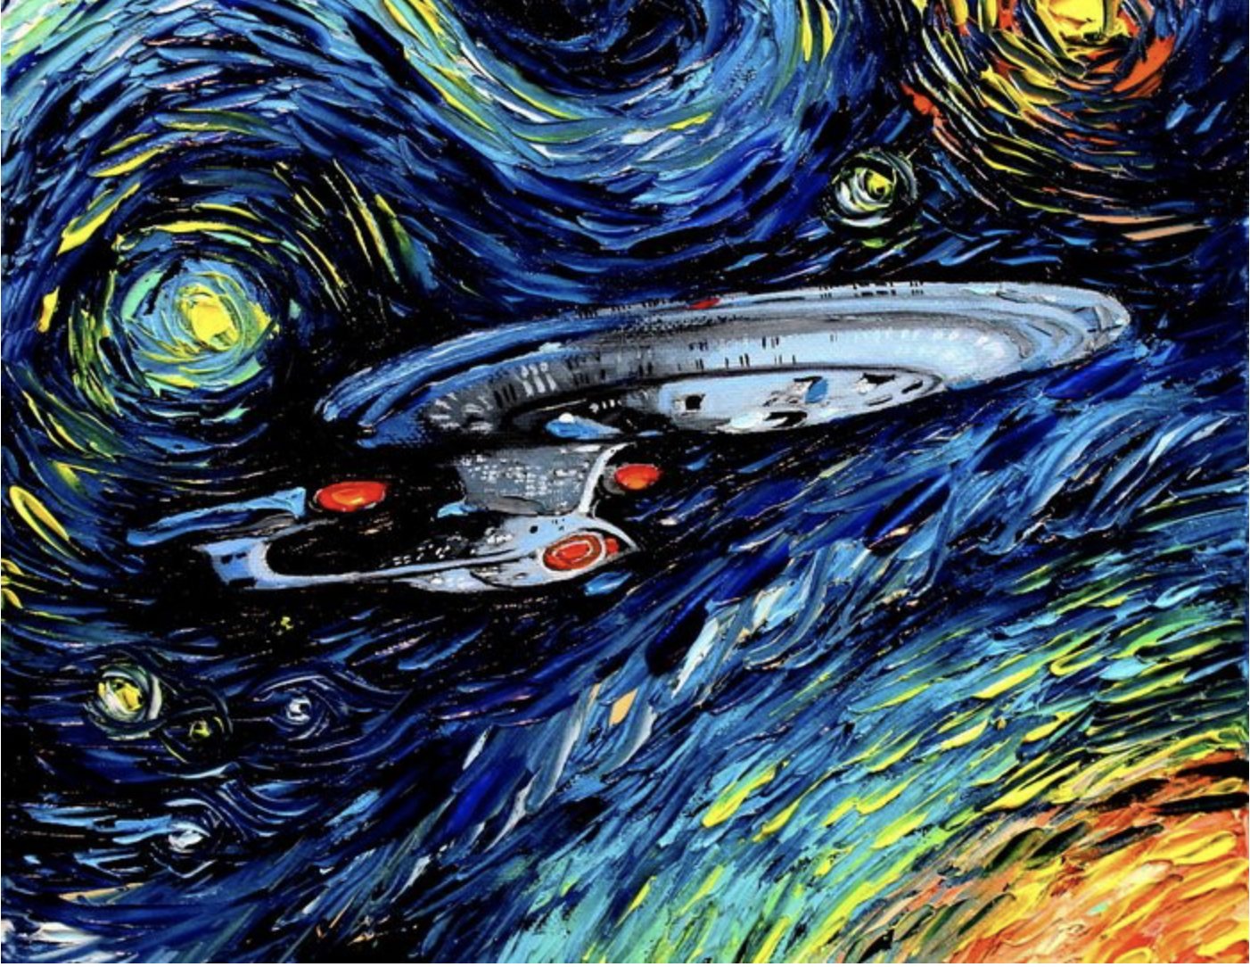




An Analogy for Proof of Work
Producing these paintings took the artists a long time.
None are forgeries.
How long does it take to identify which ones are by Dutch Masters?
The task is asymmetric.

Slide 10
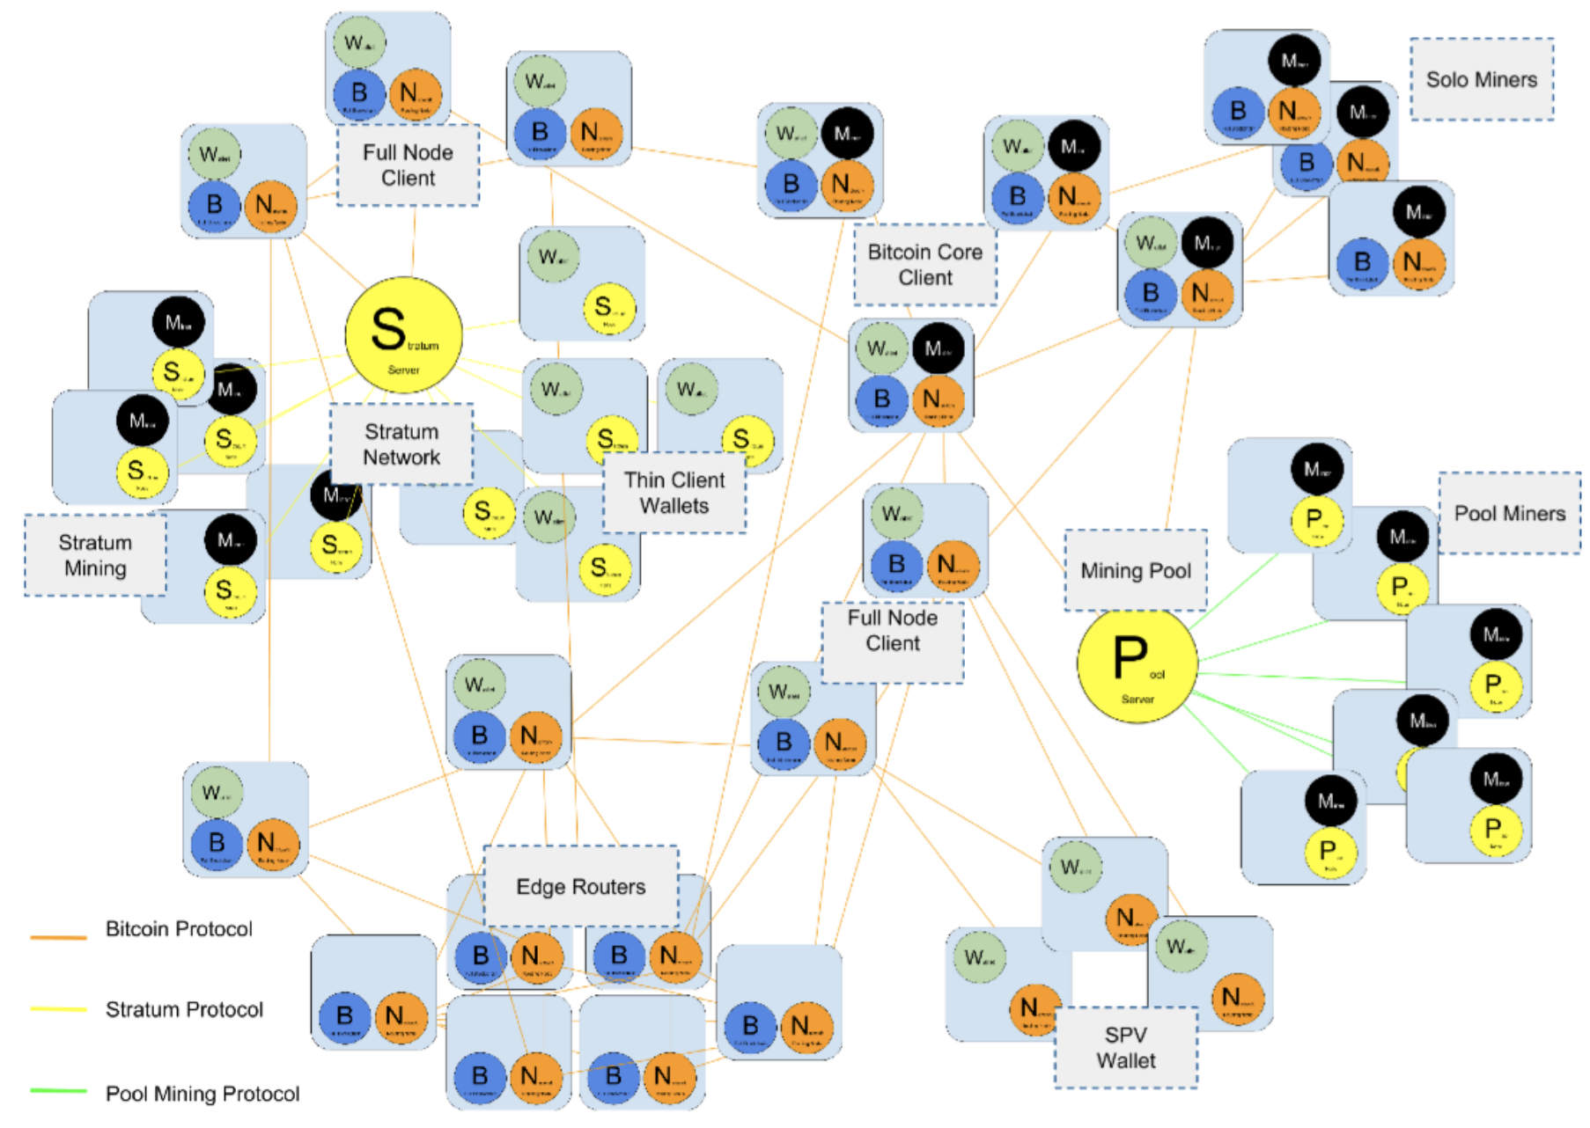
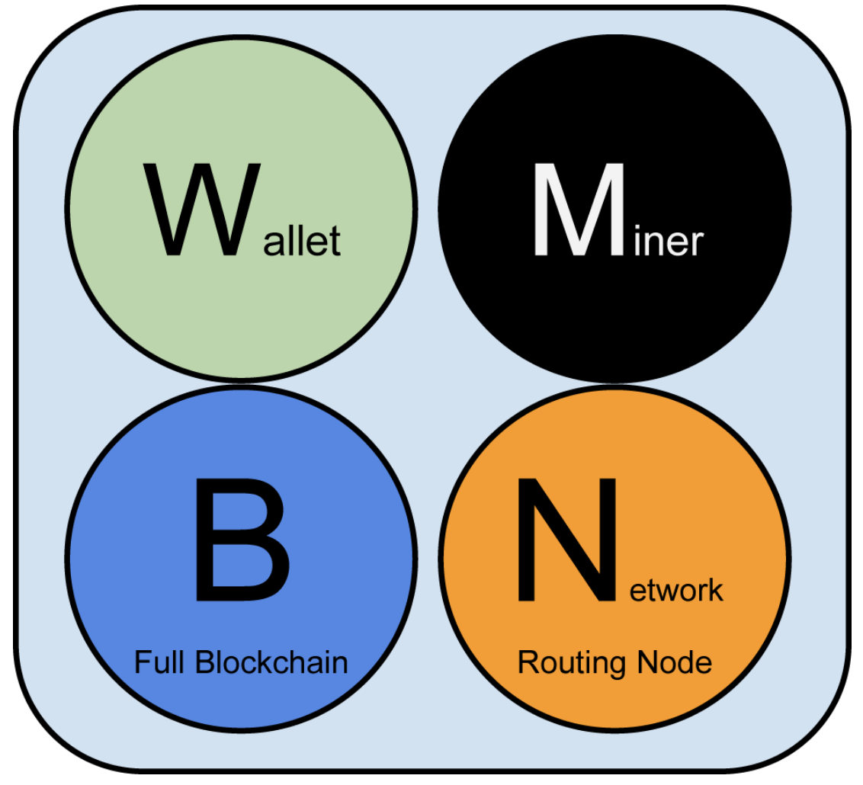
Emergent trust is established across the peer-to-peer network by nodes applying transaction verification rules before allowing blocks to join the distributed ledger (blockchain)
Bitcoin validates transactions and prevents ‘double spending’ by using a new security model.
Transactions are transmitted and stored in the clear (unencrypted).
Emergent trust uses ‘Proof or Work’ to prevent attackers swamping the system with fraudulent transactions.
Proof of Work is a Non-deterministic Polynomial (NP) time problem that forces miners to do a lot of work before they can submit a candidate block of transactions.

Slide 11
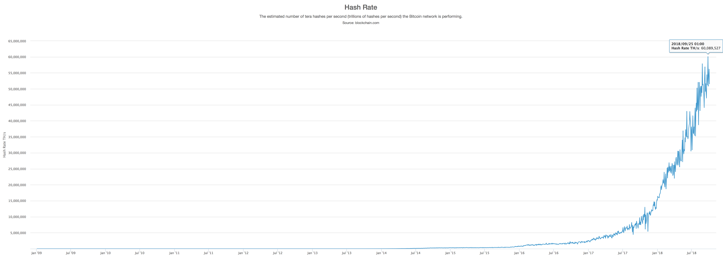
How Does Bitcoin use SHA-256 and
Machine-2-Machine Testing to Validate Blocks?
Finding a valid solution to add a Bitcoin block should take gigantic effort (e.g. over 30 sextillion operations). Checking the solution is valid takes a very small fraction of a second (in one operation).
Example Bitcoin hash within target difficulty, October 2018 = "00000000000000000015185737f8ccdc882f28305b3507e1a4f014f550d3f77a”
2009 - 0.5 MH/sec to 8 MH/sec (x 16 growth)
2010 - 8 MH/sec to 116 GH/sec (x 14,500 growth)
2011 - 16 GH/sec - 9 TH/sec (x 562 growth)
2012 - 9 TH/sec - 23 TH/sec (x 2.5 growth)
2013 - 23 TH/sec - 10 PH/sec (x 450 growth)
2014 - 10 PH/sec - 150 PH/sec in August (x 15 growth)

Slide 12
But does this work in theory as well?
“We examined the Bitcoin hardware movement, which led to the development of customized silicon ASICs without the support of any major company. The users self-organized and self-financed the hardware and software development, bore the risks and fiduciary issues, evaluated business plans, and braved the task of developing expensive chips on extremely low budgets. This is unheard of in modern times, where last-generation chip efforts are said to cost $100 million or more”.
—Michael Bedford Taylor, University of California
“The amazing thing about Bitcoin ASICs is that, as hard as they were to design, analysts who have looked at this have said this may be the fastest turnaround time - essentially in the history of integrated circuits - for specifying a problem, which is mining Bitcoins, and turning it around to have a working chip in people's hands”.
—Joseph Bonneau, Postdoctoral research associate, Princeton University

Slide 13
The Realization Dawns
Bitcoin is the original Blockchain and the first digital currency to avoid using central control, thus preventing targeted attacks on the centre of trust. It is the reference implementation for all Blockchains
We see a clue: Public key crypto systems such as TLS (Transport Layer Security) and SSH (Secure Socket Shell) are being breached. Rumours on the dark web suggest algorithmic asymmetry has been broken
Proof of Work relies upon computational asymmetry
There is only one thing that could defeat both algorithmic and computational asymmetry
The most important problem in computer science, and probably all of mathematics must have been solved.
We have an answer to P vs NP, and the answer is P = NP

Slide 14
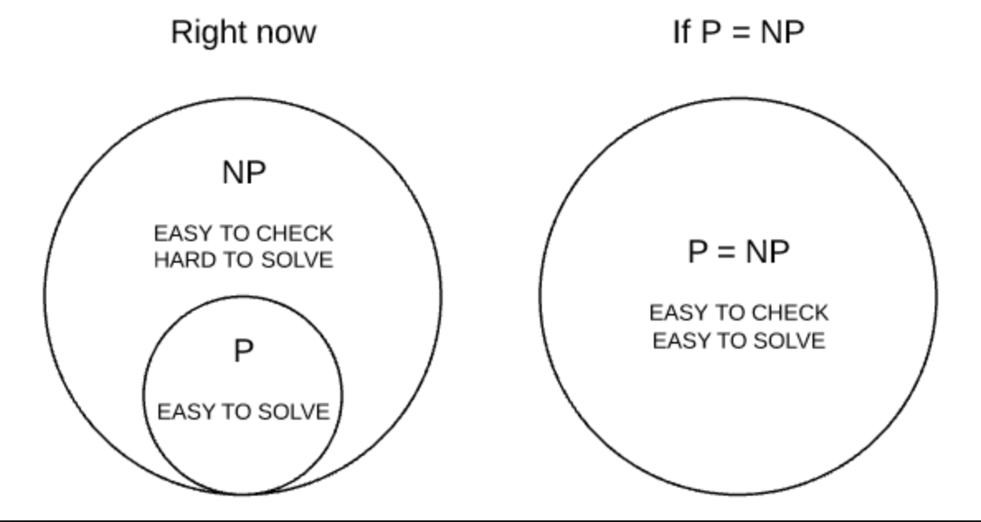
What are P and NP problems?

Slide 15
The Set P (Polynomial Time)
The Set P are problems for which there exists a Polynomial time algorithm that generates a solution. i.e. can be solved ‘quickly’.
  Addition
  Multiplication
  Linear Programming
  Determining if a number is prime
  Finding GCD (Greatest Common Divisor)
A reduction is a Polynomial time algorithm that converts a solution of one problem to a solution of another problem.
If any NP-complete problem can be solved in Polynomial time, then all NP problems can be solved in polynomial time and P = NP

Slide 16

The Clay Mathematics Institute prizes
Millennium Prize ($1m each) Problems set by Clay Mathematics Institute on 24th May 2000:
  Poincaré conjecture (Solved by Grigori Perelman in 2003)
  P versus NP ← A solution would be as significant as
  Hodge conjecture
  Riemann hypothesis
  Yang–Mills existence and mass gap
  Navier–Stokes existence and smoothness
  Birch and Swinnerton-Dyer conjecture
The six outstanding problems can be solved using the proof for P vs NP because they are in the same complexity set

Slide 17
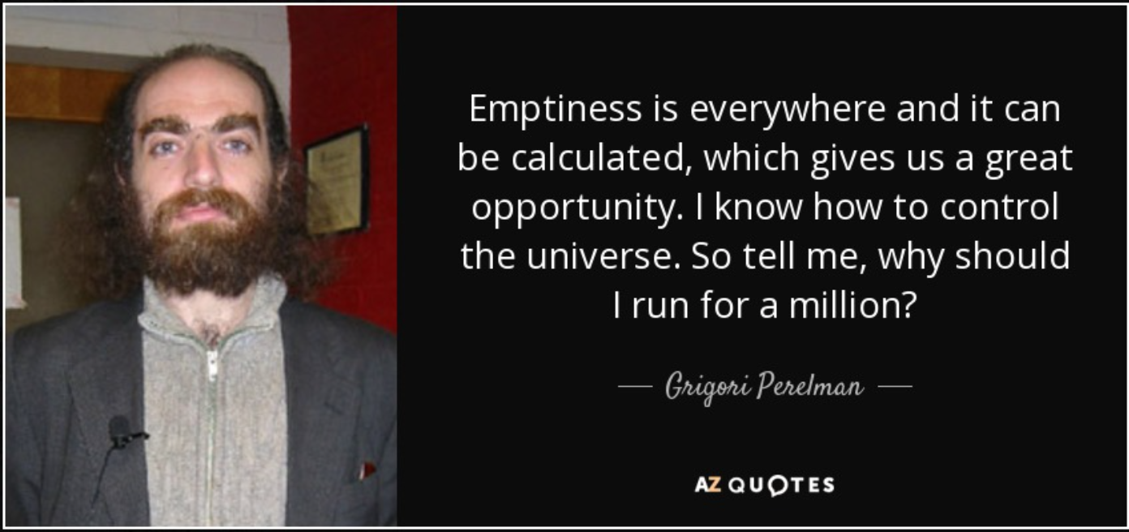
Who could have done this?

Slide 18
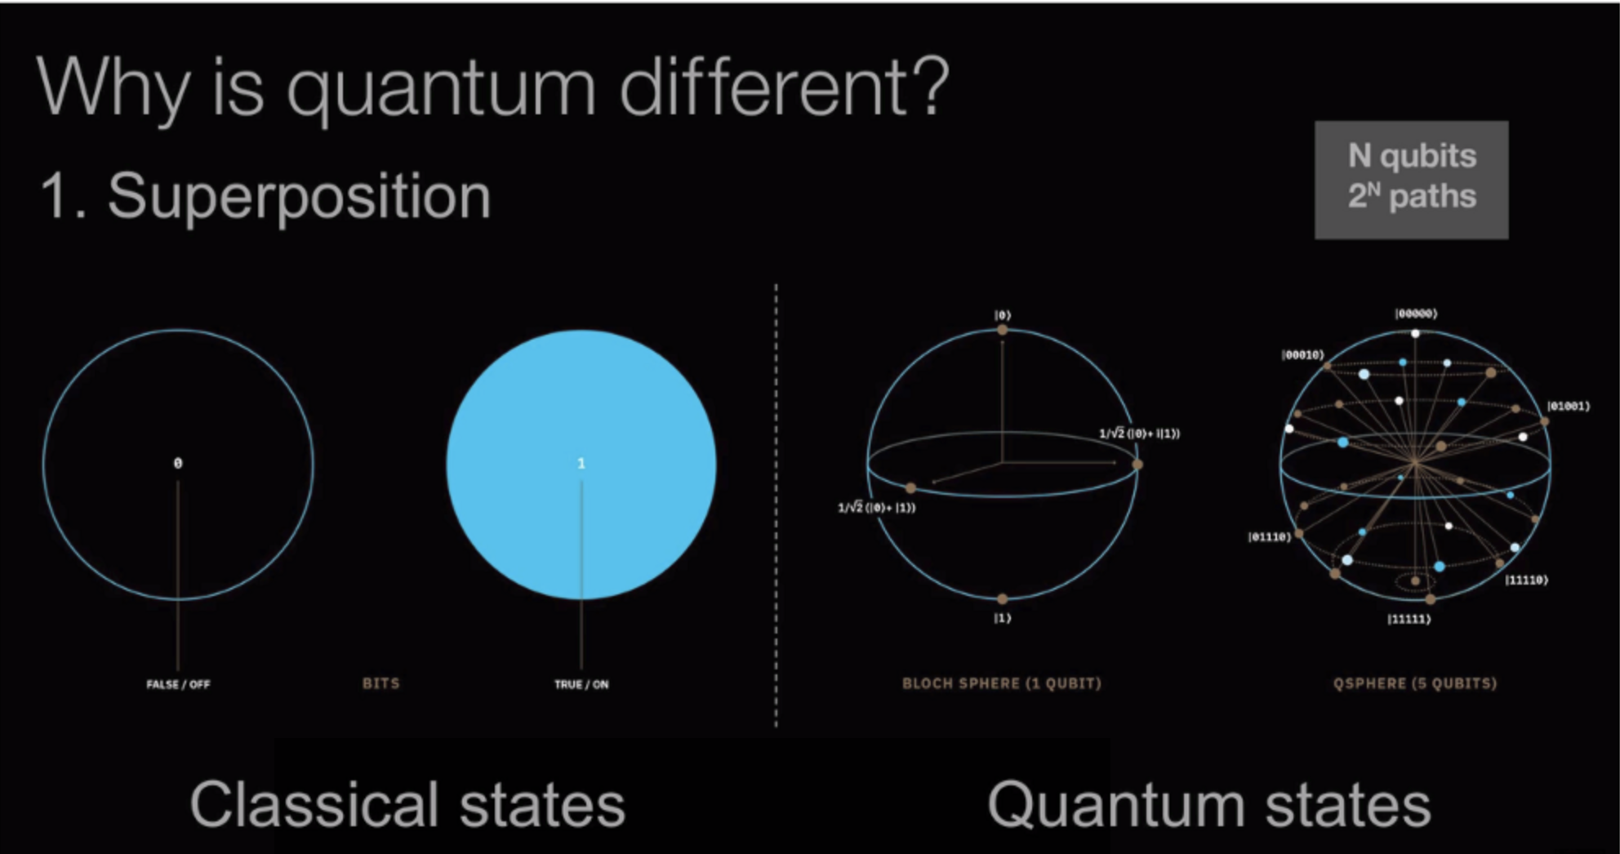
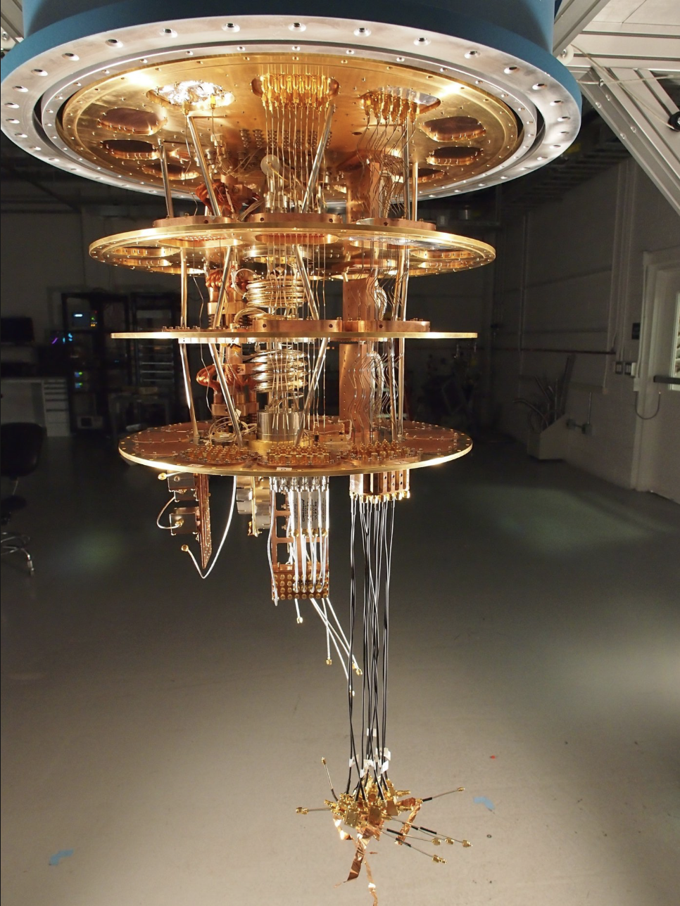
What could have done this?
A working quantum computer could factor numbers in a day that would take a classical computer millions of years

Slide 19
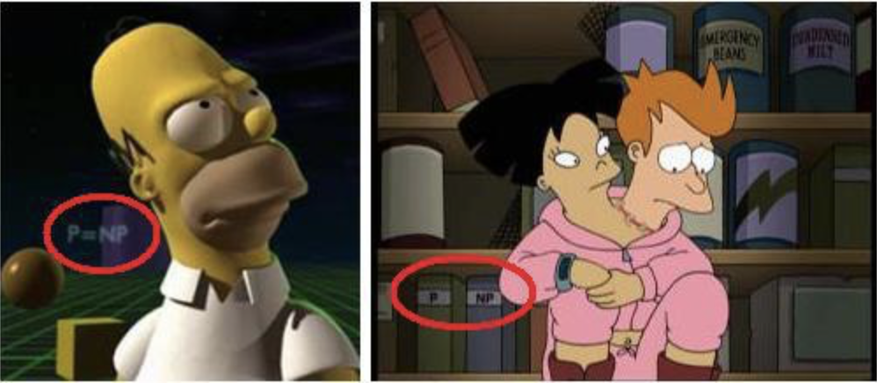
Why didn’t anyone say something sooner?
The Simpsons - Tree House of Horror 6
Futurama
Executive Producer: David X Cohen
Staff Writer: Jeff Westbrook (Yale Professor of Computer Science)

Slide 20
Why does P = NP destroy blockchains?
Proof of Work depends upon computational asymmetry (It is believed to be NP).
If attackers can submit valid-looking blocks to nodes with the correct SHA-256 header hash as fast as the blocks can be checked (i.e. in Polynomial time), emergent consensus is defeated.
Multiple forks will appear in the blockchain, many containing fraudulent transactions created by attackers.
With a powerful solution, attackers could create forks back in time and revoke ‘immutable’ transactions from the blockchain.
Also:
  Every public key cryptosystem we have becomes solvable in Polynomial time.
  The end of privacy and secrecy as we know it.
  The beginning of a new era for technology, commerce, medicine, and science.
How did we miss this risk?

Slide 21
Who Understands Risk Assessment?
ISO Guide 73: “The effect of uncertainty on objectives”
  An irrefutable yet uselessly abstract definition.
Risk = Likelihood x Consequence?
Are Risks Events, or Outcomes, or Attributes of events?
Should risk decision making be quantitative, or qualitative?
Should we approach risk with a bottom-up component-based methodology (e.g. IS1, ISO 27005), or top-down system-based holistic approach (e.g. TOGAF, SABSA, Attack Trees)?

Slide 22
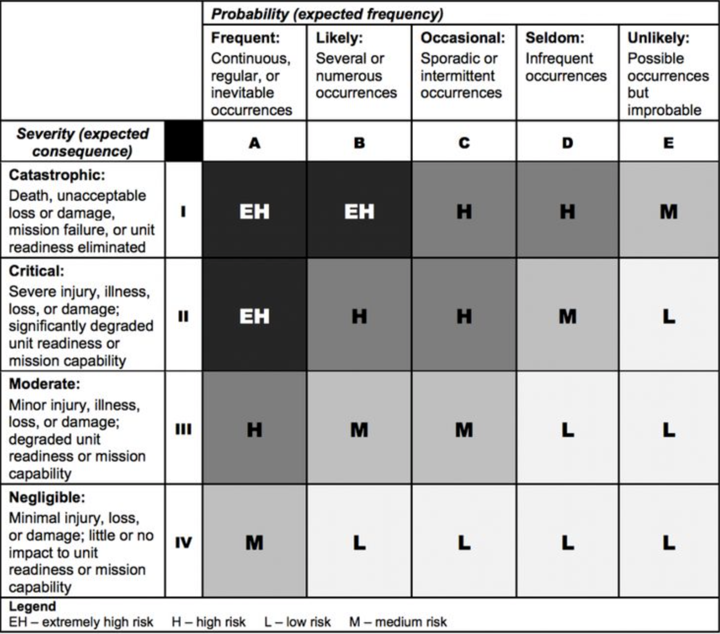
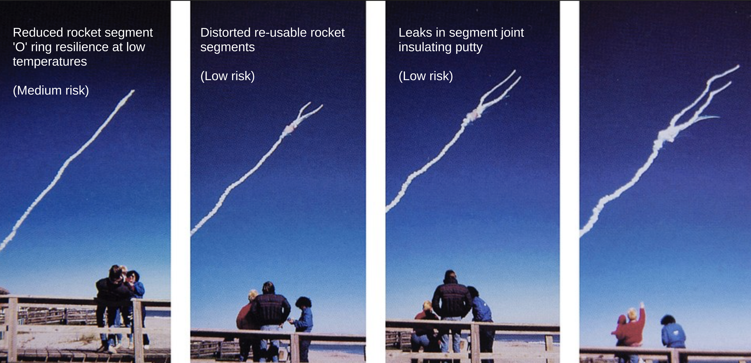
10 Risk Assessment Mistakes
Misidentifying risks
Masking uncertainty
Abstraction of reality
Losing signals in noise
Missing connections
Scope blindness
The Effect of Time
Meet in the middle
Lop-sided variety
Treatment can create risks

Slide 23
What have we learned?
Understanding advanced technology requires effort
Gaps between theory and practice hide risks
Many risk assessments are over-simplified
Ignoring risks that are difficult to understand does not treat those risks or prepare for them
Testing is a part of risk management with scope for much improvement
Testers can test ideas.

