Slide 1

HEARTBEAT
“ Are buzzwords in testing misleading US ? ”
Real Time Performance Monitoring
Presented By – Sankalp, Harish & Akash

Slide 2
pointers
Invoering
Performance Testing – A conventional Approach
Performance Testing Dashboard
IT Revolution, A Shift Towards Digitization Necessitates Performance monitoring
Performance Monitoring Dashboard
Need of Real time Performance Monitoring (RTPM)
Real time Performance Monitoring
Performance Parameters
Proposed Concept & Solution
Real time Performance Monitoring Dashboard
Differentiating Factors
Case Study
Vraag & Antwoord

Slide 3


invoering
What if? if one of the stretchers of an Umbrella gets broken!

Slide 4
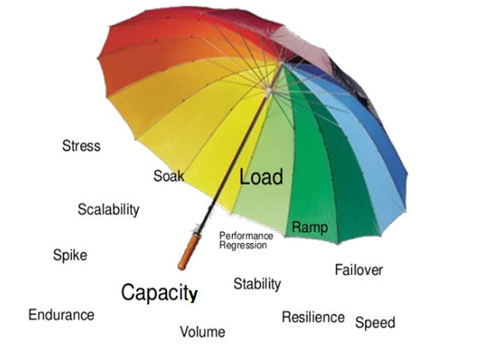
Performance Testing – A conventional Approach
Performance Testing is a type of testing to ensure software applications will perform well under their expected workload.
Intent is to check Speed, Scalability & Stability.
Analyse Application
Plan Test
Stipulate Multiple Scenarios
Execute
Analyse Results
Prepare Report

Slide 5
Performance testing Dashboard
Example : For a application like online news magazine, it is essential to ensure that the customers get a continuous uninterrupted experience and avoid any delay of page load.
The Performance Testing is done on every Sprint release to get above report. This suggests a stable application ☺

Slide 6

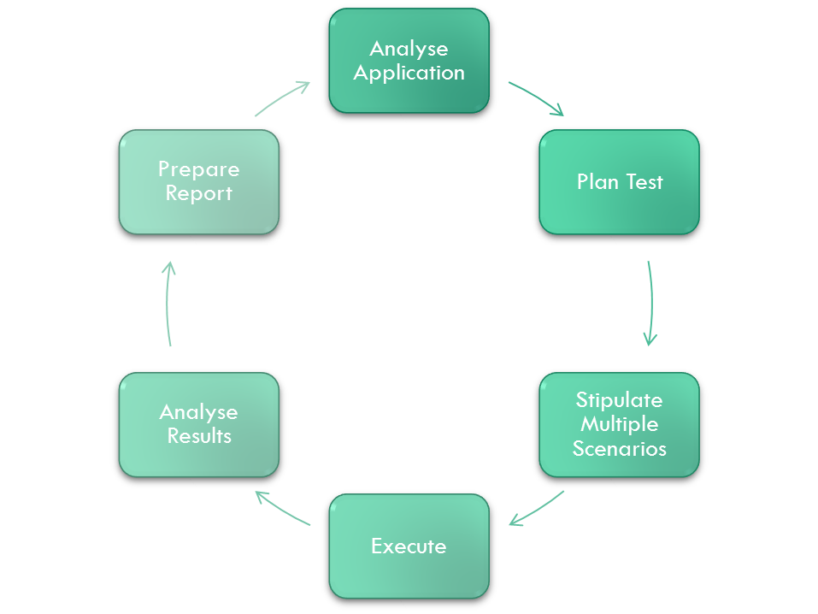
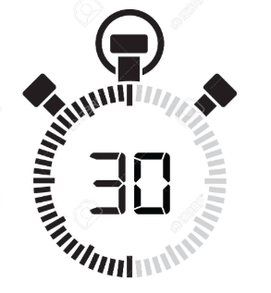
IT Revolution, A Shift Towards DIGITIZATION Necessitates Performance monitoring
In recent years, software applications have evolved to be more complex, dynamic, robust and distributed in nature. Applications have also changed their formats, starting with standalone to client-server and then mobile and distributed cloud-based solutions.
Performance monitoring deals with monitoring, identifying, collecting and reporting on the overall operational health of an application. It is performance monitoring that enables end users, administrators and organizations to gauge and evaluate the performance of a given system. Can also be reffered as time bound Perfromance Testing.
Intent is to:
Identify performance affecting issues
Gather data on all fronts of an app’s performance
Gather usage and application performance metrics

Slide 7
Performance monitoring dashboard
Fluctuation
Example : Even after successful performance testing, the readers were complaining about slow webpages. ☹
This made the team to opt for Performance Monitoring on a half hourly basis. Form the Performance Monitoring report they found that daily around 10:00 AM there is huge traffic and performance degrades.
The issue was solved by the Dev team. Dev Team is Happy ☺

Slide 8
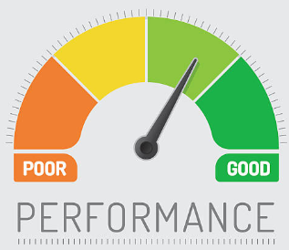
Need of Real time Performance Monitoring (RTPM)
Diverse platforms
Business continuity
Complex development process
Speed has become key success factor, hence it is important to capture the real time performance parameters, monitor them, and generate alerts to get a better experience.
Functional Test
Performance Test
Performance Monitoring
Real Time Performance Monitoring

Slide 9
Real time Performance Monitoring (RTPM)
“To capture real time performance parameters in any application and create a performance dashboard to represent heartbeat of the application.”
Real-time performance monitoring is the streaming of continuously updated information of performance parameters.
Real-time monitoring is used to enable quick reaction to momentary events. It provides constant information to make up to date informed decisions and see trends as they develop.

Slide 10
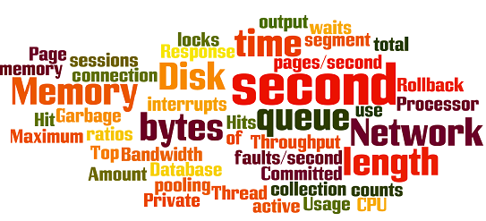
Performance Parameters

Slide 11





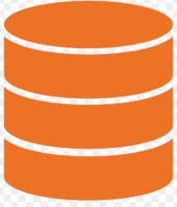


Proposed CoNcept & Solution
Task Scheduler
1
Automation Batch File
Automation Flow
Reports
2
Dashboard
Performance Batch File
Update Database
Generate Report
Notification
The Test Automation flow runs with any front end automation tool and captures the parameters like Page Load time, content load time, Wait time, Server Response time with the help of techniques like Java Navigation Timing API.
The metrics thus captured are stored in database and further utilised to generate dashboards and trigger notifications

Slide 12
Real Time Performance Monitoring dashboard
Fluctuations
Example : Our dev team still received complains from the customers, so they decided to track performance at real time and what they discovered was interesting. The performance fluctuations were way too many than what they had imagined.
Based on the report, they made fixes. And now they get notified even for minute fluctuations.
Finally, the customers never complained. Win-Win Situation ☺

Slide 13
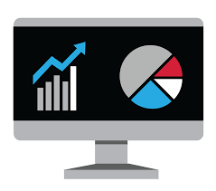

Differentiating Factors
Easy solution to scale up a Performance tool for RTPM
Can be used as a plug & play plugin with any platform / technology
Light weight and easily configurable solution for changing business needs
Easy to understand Dashboard.
Fits easily with Dev-Ops Environment.
Cross-Browser Compatible.
Improved Search Rankings
Happier Customers & Higher Sales
Notes:
Improved Search Rankings
Today, Google takes load time into account when ranking websites, so speed is an important issue. Improving your load time is an easy way to help customers get where they’re trying to go faster. Having a high Google ranking will also help you get more traffic from Google, which means you’ll have even more customers coming your way.
Happier Customers & Higher Sales
As mentioned above, customers hate having to wait for websites to load. Even a one-second delay can decrease customer satisfaction by 16%. By combining a visually appealing website and website speed, you can keep customers happy and engaged, which will lead to increased sales and conversions.
Page load time can be impacted by a variety of factors like image size, code, and videos!

Slide 14
Case Study
Experience : The homepage of any browser is the most performance intensive part. And if you show live feed Or Organisation Announcements or News on your homepage then It becomes necessary to track the performance and in case of a minute fluctuation trigger a notification so that any issue can be resolved as soon as possible.
We had a similar requirement.
Solution : We developed a RTPM model based on the solution architecture that we discussed for tracking the performance of the homepage and all links on the homepage .
Based on our analysis we noticed that, In today's Agile environments, with continuous maintenance, performance testing projects are becoming less common, and deploying every two weeks is becoming the norm. That creates new challenges because a query that gets slightly more complex for every sprint could suddenly become too complex for the system. There are two common fixes for this :
First, some modern tools can run in the cloud automatically from the command line, and they fit well when combined with continuous integration; you would receive test results daily, hourly or even more often, instead of at the end of the project.
Second, companies increasingly see performance monitoring in production, or an incremental rollout combined with monitoring, as part of the performance testing story. That is a new wrinkle, but the basic building blocks for performance testing.

Slide 15


Slide 16


