Slide 1
Test Better
Robert Shaffer, David Colter

Slide 2
Hello Wolrd World
Who are we?
What do we do?
What is this workshop about?

Slide 3
Find a partner
Take turns to tell a story
Person 1: Once, Person 2: Upon, Person 3: A Person 4: Time
Etc……..

Slide 4
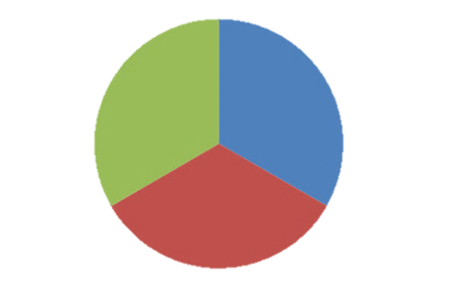
3 Sections
Testing Games
Break
Product Mind Maps
Break
Cognitive Bias
Games
Maps
Bias

Slide 5
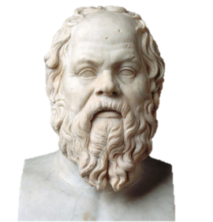
Methods of Testing
Socratic
Hypothesis elimination
Scientific
Hypothesis confirmation

Slide 6
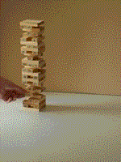
Jenga
Did you know Jenga comes from the Swahili “kujenga” to build?
The highest Jenga was ~41 levels high.
>50Million Jenga games or 2.7 billion blocks have been sold worldwide

Slide 7
Eulesis 01
Groups of 3
Dealer chooses rule
Other players dealt 12 cards
Winner guesses rule or gets rid of all cards
Other rules:
-Correct cards in a row incorrect below
-If players cant go they must show cards
-Really cant go? All new cards-1 card
-Could have gone? Existing cards+1
-End Points=12-total # of cards left

Slide 8
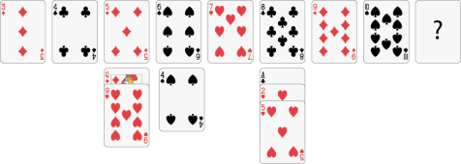
Eleusis ii
Example rules:
Cards always increase
Cards alternate in color
A heart always follows a jack
The suit must always be different from the previous card

Slide 9
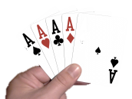
Bonus Game Cheat
Your social brain thinks cheating will exclude you from your tribe.
But as a tester you must cheat
Because we live by un tested rules
Because cheating is fun
Because cheating is fun
But don’t be evil.
Players are dealt all cards
Players must get rid of their cards.
Players must lay A,2,3,4,5,6,7,8,9,10,J,K
If other players call “Cheat” you must show your hand.
If you are caught you must pick up the pile
If you were not cheating caller must pick up cards.

Slide 10
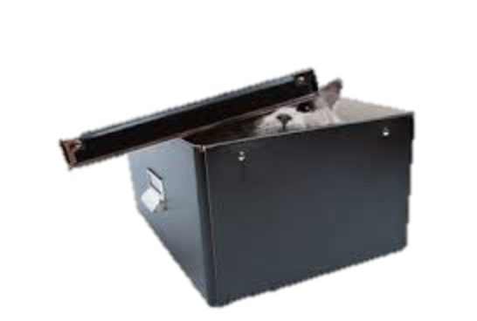
Bonus Game: Black Box Puzzles
http://blackboxpuzzles.workroomprds.com/
Try to come up with a rule for puzzles 4,5 9, 13 17 in 2 minutes each.

Slide 11
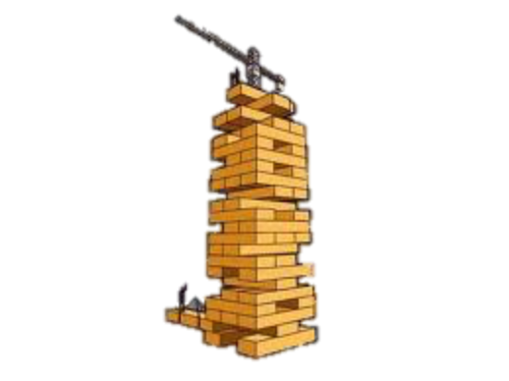
Discuss Jenga
Jenga:
Test early
Test throughout
Communicate with your devs!

Slide 12
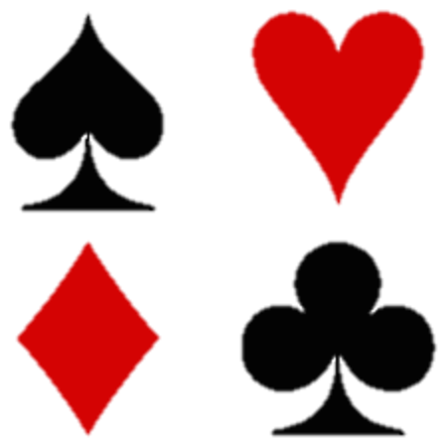
Discuss Eleusis
How did you test?
Did you tend towards disproof or proof?
Was your partner mean? Was the rule too hard?
Notes:
From http://cognitiverigor.blogspot.co.uk/2014/04/the-cognitive-rigor-of-eleusis-for.html
Eleusis and Cognitive Rigor
Cognitive Rigor superposes two popular measures of rigor, Bloom's Taxonomy and Depth of Knowledge, to generate a highly measurable way of judging the academic rigor of questions and activities. The Smarter Balanced Assessment Consortium recently adopted Cognitive Rigor and the Cognitive Rigor Matrix for selecting items for the Next Generation Assessments. Numerous state departments of education and school districts now employ the Cognitive Rigor Matrix (often called the Hess Matrix) in their training materials to help teachers enhance classroom rigor. If interested, I suggest you read the definitive article on Cognitive Rigor.
The power of Eleusis rests not so much in the game, but the follow-up questions assigned to students that can span a wide range of Bloom's Taxonomy levels and reach up to the highest levels of Depth of Knowledge. When examining each of the following, consider the type of thinking processes (indicative of Bloom's Taxonomy), as well as the amount of reflection, researching, discussion, information gathering, and reasoning (i.e., Depth of Knowledge) needed by students to formulate an adequate response.
Working as a team, form a consensus on three aspects or rules of Eleusis that best describe how scientific discovery works and summarize your reasoning.
Were you tempted to play a card you knew was incorrect? If so, why? Discuss the manner in which scientists might do the same.
Write a report that describes the strategy your team developed to win and, using this strategy as an example, develop a general strategy for other teams. In your report, discuss whether scientists employ a similar strategy and use clarifying examples.
Research and describe what "healthy competition" means, using examples, and describe how it played a role in Eleusis. In your report, discuss whether you think the competition between teams in Eleusis healthy in your opinion? Explain.
Research the role that competition plays in scientific research, then stage a Point-Counterpoint show (such as this example) discussing the pros and cons of whether competition between scientific research teams is healthy. (Warning: Preview the Point-Counterpoint video first for age-appropriateness.)
In a short essay, describe what would happen to your ability to guess the hidden rule if misses (cards that did not match the secret rule) were not shown and describe the meaning of these “wrong cards” in science. In your essay, be sure to justify your answer using real or hypothetical examples or analogies.
Research the “discovery” of cold fusion and write, using clarifying examples, an essay describing the relationship between this event and Eleusis.
Eleusis involves both theory (guessing the pattern) and experiment (laying cards down to test the pattern). Write a short article describing what would happen in Eleusis if only theory was employed, with no experimentation. Do the same for instances where only experiment was employed, but no theory.
Write a persuasive essay explaining why both theory and experiment play important roles in the scientific process using Eleusis as an analogy.
In what ways can you change Eleusis to make it resemble more closely the scientific process? Explain your reasoning.

Slide 13
Break

Slide 14
dP__Yb 88 .o 88 dP 88"" YP 88 8bodP' `YbodP' dP""""Yb 88ood8 88 d8888 888888Visualiz/se
See what you test, test what you see

Slide 15
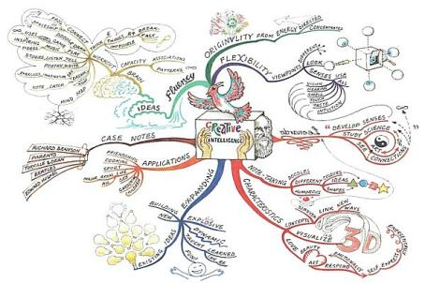
Mind Maps
Invented by Tony Buzan
Aids in Recall
Aids in Recording
Not a panacea

Slide 16
Mind Maps
Non Linear
Engages human visual system with colours pictures shape and form
Automatic Hierachy for navigation
Fun way to take notes.
Lots of software support for sharing
Too brief as software documentation
If the big topic is big it can get bewildering and overwhelming to look at and find the information you need
Catagorisation is personal opinion
Pretty useless if everything is under one node (creates unbalanced tree)

Slide 17
Mind Maps
Map your Scope
Robert Shaffer
Map your test session
David Colter

Slide 18
Discuss Mind Maps
Did they help non linear recording vs a plain list?
Would you use them again?
What other areas of software development lifecycle could they be used for?
What did you learn about your product?

Slide 19
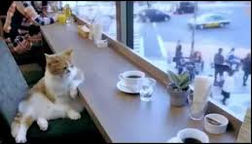
Break

Slide 20
Cognitive Bias
failure
Automatic test

Slide 21
Wason 2,4,6
Peter Cathcart Wason cog psychologist University College London pioneered Psychology of reason
I have a rule in mind that only applies to sets of 3 numbers. 2,4,6 is an example of this. Can you guess my rule?

Slide 22
Wason Selection Task
Turn the minimum number of cards to falsify the statement:
“Vowels have Even numbers on the other side”

Slide 23
Wason Selection Task
Most people turn A and 2 in an attempt to prove the hypothesis twice.
But turning the 2 is not able to disprove the hypothesis
Same for K.
There is no rule against Consonants with Even or Odd numbers.

Slide 24
Wason THOG
"I have picked a colour (black or white) and a shape (square or circle).
A symbol that possesses exactly *one* of these properties, is a THOG. The black circle is a THOG.
What can be said about the other symbols? Are you able to tell me which symbol I picked? Which symbols are THOG, not-THOG, or undecidable?"

Slide 25
Wason THOG
I have chosen one of these shapes that shares its colour or shape with the black circle.
Any shape that shares a colour or a shape with the one I chose is THOG SHARING
I chose White Circle or Black Square
It follows White Square is SHARING in either case.

Slide 26
Four Card Game
Back to the Wason Selection Task…
£10,000 to turn each card.
6 Month card turning overhead involving 100 staff.
You are fired if a test fails.
Over to David Colter
Notes:
Is it really 10000?!?!? Why? Can we do it for any cheaper?
6 Months 100 staff to turn a card are you crazy?
Why is it my fault if a test fails why do I get fired?

Slide 27
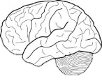
Cognitive Bias Discussion
Biases like confirmation bias skews test results
Should be aware of the affects and think more carefully about what you are testing and why.
Make the question easier to understand!
Computers can model reality but are not real.
Notes:
Discussion of other biases that affect testing
Anchoring falacy (predicting outcomes differently based on the first thing you saw)
Fundamental attribution error (putting the cause of an incident down to the perceived qualities of a product or person)
Halo affect (the lead dev made this so it doesn’t need testing as much)
Planning falacy (size estimates are always optimistic)
Hindsight bias (things always seem easier the second time round or if we are familiar with them)
Observational bias (You saw it in the wireframe therefore it gets more test attention)
Survivorship bias (99% of customers get what they want from the product (99% percent of customers fought through the myriad of quality issues to get what they wanted) )

Slide 28
Wrapping up
Testing Games
The way you test has an outcome on the result
Product Mind Maps
Visualising your testing can make it more engaging, fun and memorable
Cognitive Bias
The brain is flawed.
Awareness helps you mitigate bias as much as you can.

Slide 29
Finally…
Cheat or change the rules (but be nice)
Ask the questions no one else is asking
Provide information about everything about where your product lives and everything it touches and is touched by.
Nothing is out of your remit in your quest for knowledge
You are the hero, the most important guy on the team and in the company, you are the Tester.

Slide 30
Form a circle
I liked it when…
I learnt…
I would improve…

Slide 31
Contact
Robert.Shaffer@bbc.co.uk
David.Colter@bbc.co.uk
Special thanks to
BBC for flying us here.
Paul Rutter for helping us get our act into gear.
Aimee Rivers for programming the Wason selection task.
TesNET for letting us do this.

