Slide 1
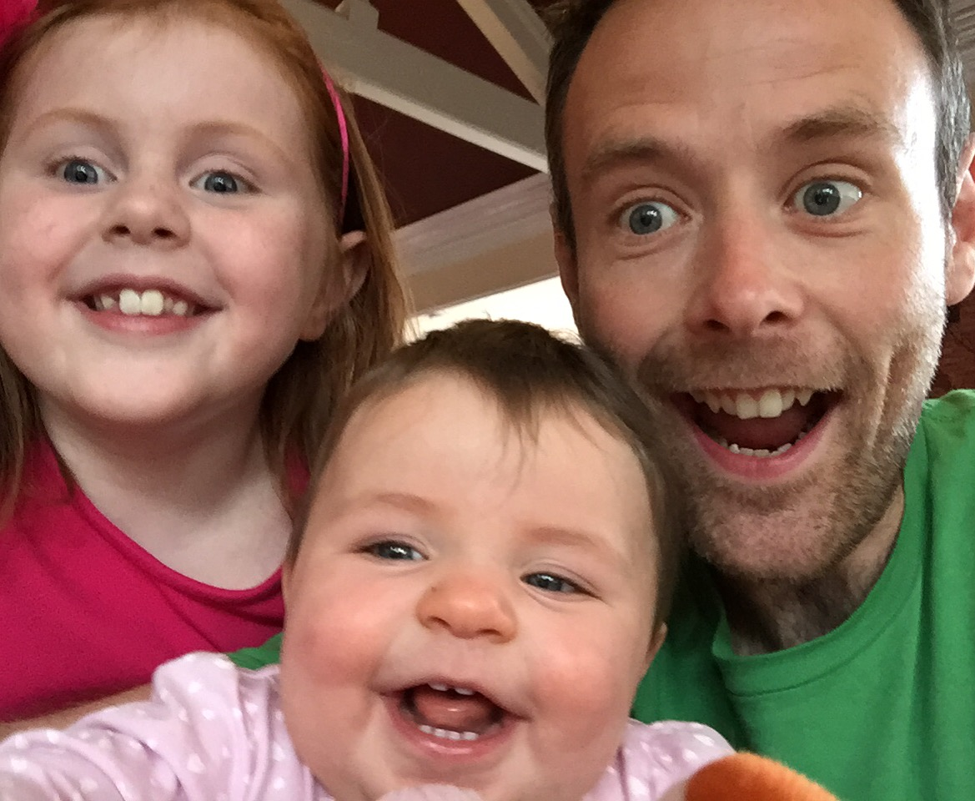
Evolution of Testing for Mobile Platforms BBC Digital
Paul Rutter
paul.rutter@bbc.co.uk
@rutter78
www.bbc.co.uk/blogs/internet/tags/Test
Notes:
I’m Paul Rutter, I work in BBC Digital in MediacityUK in Salford.
I work in the TV&Mobile Platforms teams to help deliver Mobile iPlayer on iOS and Android, iPlayer Radio on iOS and Android and a number of other mobile products and components. In addition, the department develops and maintains a whole host of products on Smart TVs and games consoles
I’m here to talk about how things have changed and evolved over the past couple of years around our testing processes, people, tools and ways of working

Slide 2
Mission:
To enrich people's lives with programmes and services that inform, educate and entertain
Vision:
To be the most creative organisation in the world
Notes:
BBC is a public service broadcaster (similar to your NPO)
Established by a Royal Charter, the BBC is a public service broadcaster funded by the licence fee paid by UK households.
Licence fee is ~ £145.50 – the equivalent of £12.13 per month or just under 40p per day.
We use the income from the licence fee to provide services including 10 national TV channels plus regional programming, 10 national radio stations, 40 local radio stations and an extensive website.
BBC World Service broadcasts to the world on radio, on TV and online, providing news and information in 27 languages and world service English language.
We also have a commercial arm, BBC Worldwide as well as a number of other commercial ventures. Profits from these activities are returned to the BBC for investment in new programming and services.

Slide 3
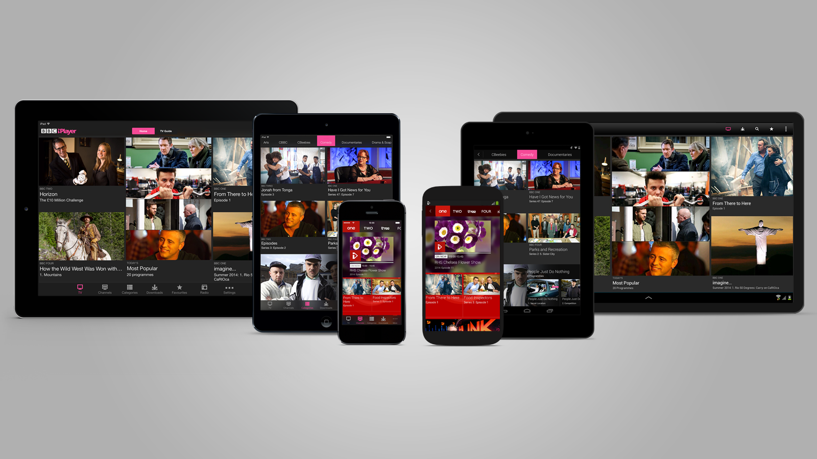
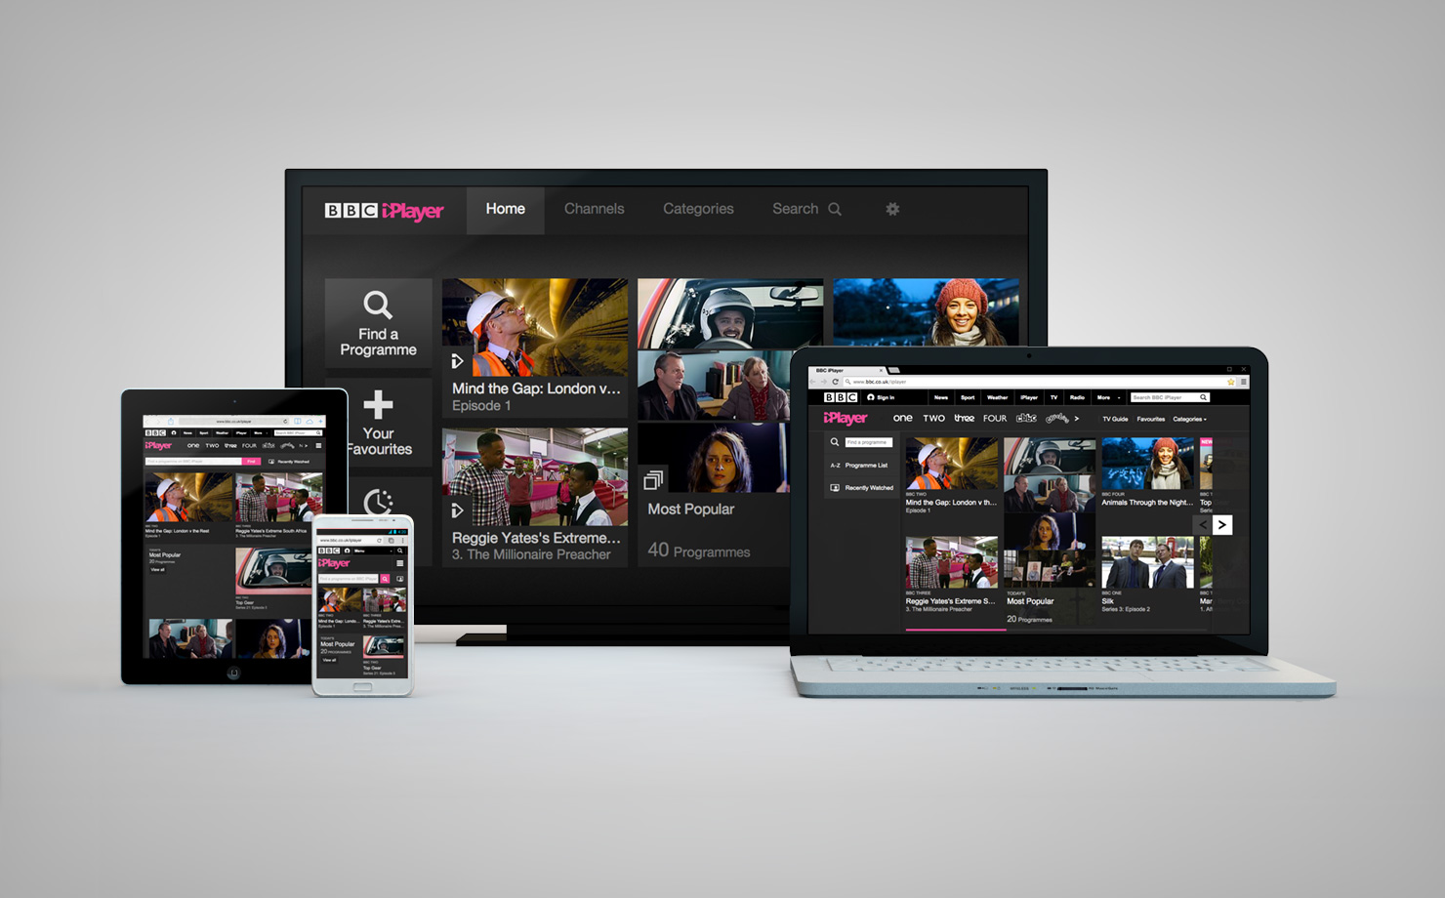
Notes:
BBC iPlayer
- More than 10000 (9000 android devices, 1600 tvs, etc)
Online streaming service for video and audio on-demand, and live simulcast playback.
Content is generally available for 30 days after
Also supports downloads on some devices
Available on more that 10000 devices (web, smart TVs (>1600), games consoles, smartphones and tablets (>9000))
And for this case study and the team I’m talking about, we’re specifically focussing on Mobile

Slide 4
315 million monthly requests for programmes
9 on consoles
44 on connected TVs
99 on responsive web
163 on native mobile apps
35 million app downloads
Notes:
And to give you an idea of scale
315 million daily requests for programmes across all platforms:
9 million games consoles
44 million connected TV/smart TV's
66 million Responsive web
163 million smartphones and tablets
With 35 million application downloads

Slide 5
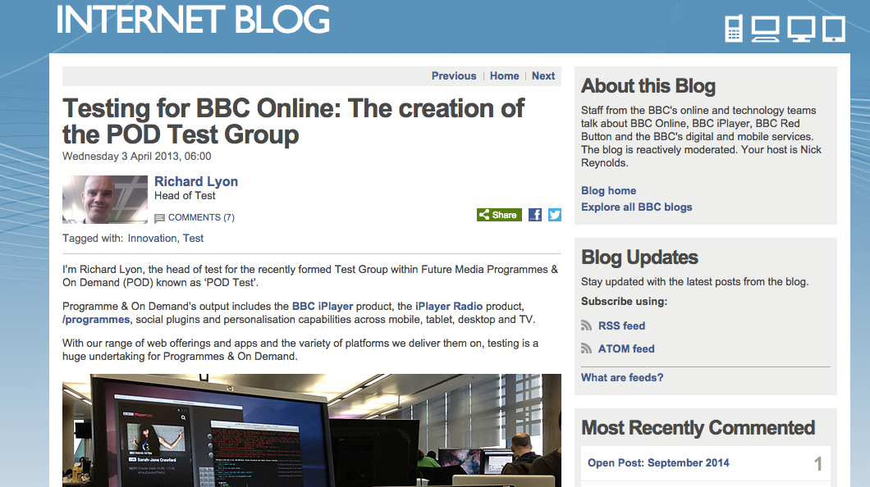
January 2013 - a Test organisation!
Notes:
I’d like to start the story in January 2013.
A WHOLE Test organisation. All Testers in ultimately reporting into one place
With a head of test!
Someone ultimately accountable for good testing, and someone who could help influence change
Collaboration and shared learnings across teams, a collection of Test managers across the organisation who were invested in working together
Had to be very certain we maintained our embedded ways of working and weren’t perceived to be offering Testing as a service

Slide 6
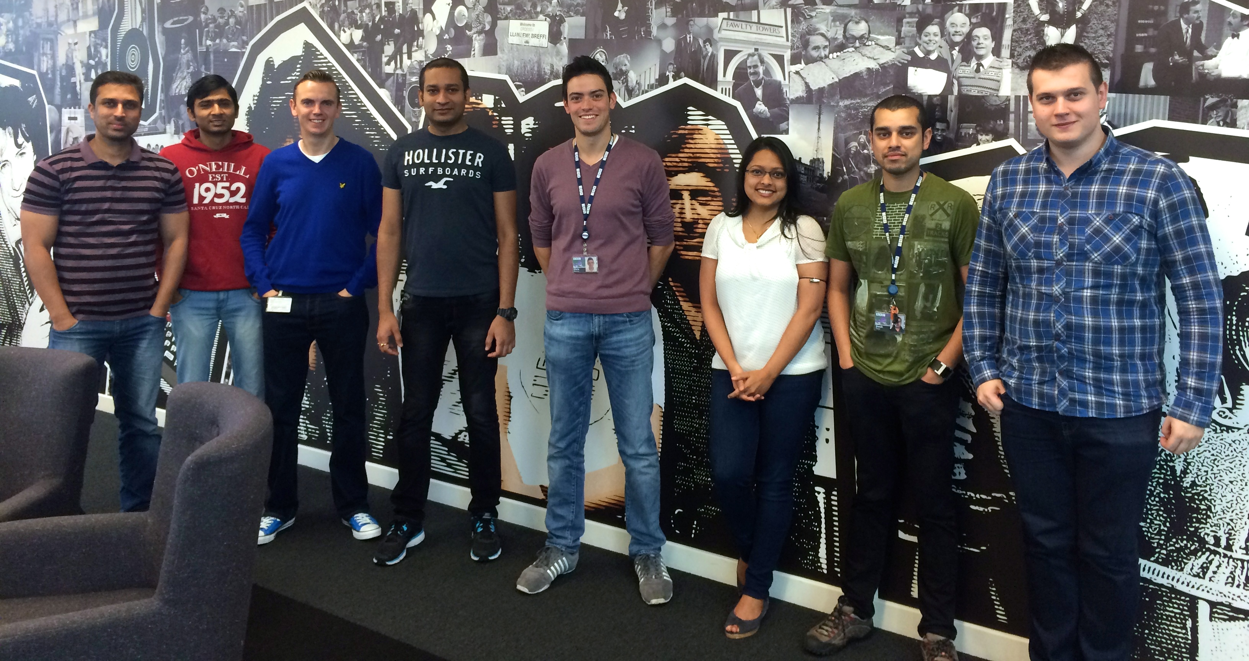
People & passion
Notes:
- Test team of ~20 including Test Manager - To support 3 development teams (~30 engineers)
50/50 between permanent staff and our test partner
Apprentice rotations
- Testers embedded in Development Teams
- Test Engineer - Tester, Device expert, explore and question the product and are the advocate for our audiences
- Developer-in-Test - Automated check and BDD expert
- Enable application developers to write automated checks
- Primary contact for CI and build pipeline
- Test Lead - Role in a team not a job title
- AND TITAN team – a whole team of software engineers who are tasked with building test tools and frameworks for use across all of BBC Digital

Slide 7
Mobile Compatibility Program
Notes:
In 2014 we started our Mobile Compatibility Program
Understand what our supported devices are across Mobile native apps
- Evaluate pre-production devices for compatibility in meeting requirements for BBC mobile products
- Evaluate pre-production firmware updates (iOS and Android)
- Advise on classification of devices for products which categorise devices for specific features
- Run service external to product teams and agnostic of products
- One stop shop for all products (pan-FM)
- Maintain and publish results (internal & external)
- Ultimately provide a mechanism for OEMs to run a first pass MCP compatibility suite in advance of submitting devices

Slide 8
Five Principles of Software Development
Notes:
At the end of 2013, TV&Mobile Platforms introduced their 5 principles around ways of working – recently, we’ve refined these to focus on continuous delivery
There are some very strong messages in there – and particular challenges around rethinking our Testing processes and practices
I’m going to look at each in turn, briefly explain what the mean and show how Test is involved

Slide 9
Five Principles of Software Development
RADIATE
A CLEAR VISIBILITY OF STATE
Notes:
At the end of 2013, TV&Mobile Platforms introduced their 5 principles around ways of working – recently, we’ve refined these to focus on continuous delivery
There are some very strong messages in there – and particular challenges around rethinking our Testing processes and practices
I’m going to look at each in turn, briefly explain what the mean and show how Test is involved
RADIATE
By making all our work visible, we expose the delays, impediments and invisible queues that make it more difficult for us to get to market quickly.
Visible metrics which includes pipeline visibility, regression test status and audience device coverage in particular.
Builds available every day to stakeholders

Slide 10
Five Principles of Software Development
RADIATE
A CLEAR VISIBILITY OF STATE
SMOOTH
THE FLOW OF WORK
Notes:
SMOOTH THE FLOW OF WORK
The main problem comes from lots of code waiting to be tested, long lead times because we are trying to work on too many things at once, and big delays before we find out what our audience think about our products.
We will get better results as a department by limiting the amount of work in progress, ensuring that we keep a close eye on the build up of queues, and by focusing on the cost of delay when deciding what to work on.
Swarming to get done – whole team works to move the biggest or blocking tasks to done. This means regression testing is a team effort, not just in the hands of test – until it is complete, we can’t release so it is effectively blocking the pipeline

Slide 11
Five Principles of Software Development
RADIATE
A CLEAR VISIBILITY OF STATE
SMOOTH
THE FLOW OF WORK
DELIVER
AT A REGULAR AND PREDICTABLE CADENCE
Notes:
DELIVER
Our products are only useful once they are in the hands of our audience, so having the ability to release regularly, predictably and cheaply is vital.
Releasing often, in ideally 2 week cycles – less work in, less functionality to test, shorter regression testing, quicker to audience and shorter feedback loops

Slide 12
Five Principles of Software Development
RADIATE
A CLEAR VISIBILITY OF STATE
IMPLEMENT
FEEDBACK LOOPS
SMOOTH
THE FLOW OF WORK
DELIVER
AT A REGULAR AND PREDICTABLE CADENCE
Notes:
IMPLEMENT (new)
Feedback is at the core of agile software development.
Feedback loops happen everywhere in the product development process but the most important one is that from the audience who use our technology to access BBC content.
Building the wrong feature or product is the biggest waste and risk we face, so we should focus on validated learning by testing our assumptions with empirical data and audience product behaviour.
Again, this comes back to working closely across functions to make sure we’re building the right thing. We have in iPlayer a dedicated UX and D person who is responsible for gathering audience feedback and feeding that directly into the work we do.

Slide 13
Five Principles of Software Development
RADIATE
A CLEAR VISIBILITY OF STATE
IMPLEMENT
FEEDBACK LOOPS
SMOOTH
THE FLOW OF WORK
IMPROVE
COLLABORATIVELY WITH EXPERIMENTS
DELIVER
AT A REGULAR AND PREDICTABLE CADENCE
Notes:
IMPROVE (new)
We work in a complex, unpredictable business: people, processes and technology interacting in often unexpected ways.
Predicting the effect of big change is difficult if not impossible; the best we can do is adopt a structured way to test our assumptions and ideas.
Every product, process or organisational change should stand up to the rigour of testing hypotheses with experiments and measurements.
Test: More exploratory testing – early and often. Closer working with dev and test pairing. Test involvement in planning (3 amigos)

Slide 14
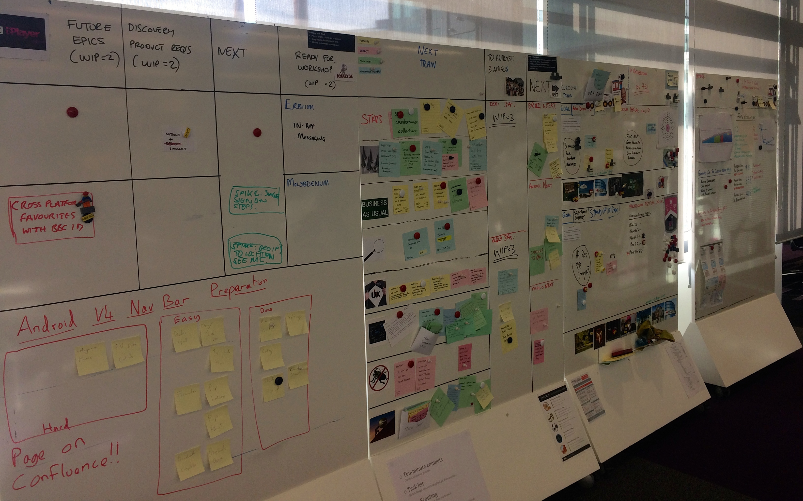
Ways of working
CHALLENGES NOT SPRINTS
READY FOR TEST?
DEFECTS
Notes:
iPlayer as an example of integrated working
Challenges not sprints
Stories are 5 day challenges
Release every two weeks – independent feature squads working behind feature flags
Testing features against hero devices
No Ready for Test state – everything in a pool of ‘in progress’ until it can be moved to ‘done’
Kanban, WIP limits on in progress, next and 3A
Regular ‘show mes’
Done – can be forgotten about – ie, feature tests passed, automated checks written and passing, regression packs updated
Testers pairing – test early, defect prevention over detection. ‘shift left’
No defect reports within a challenge when working on a feature
Iterative regression

Slide 15
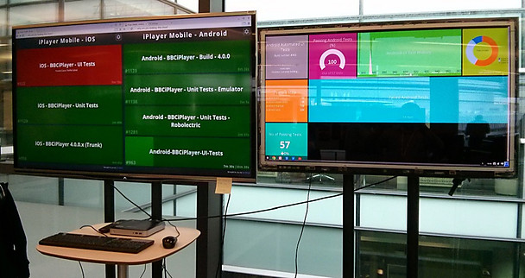
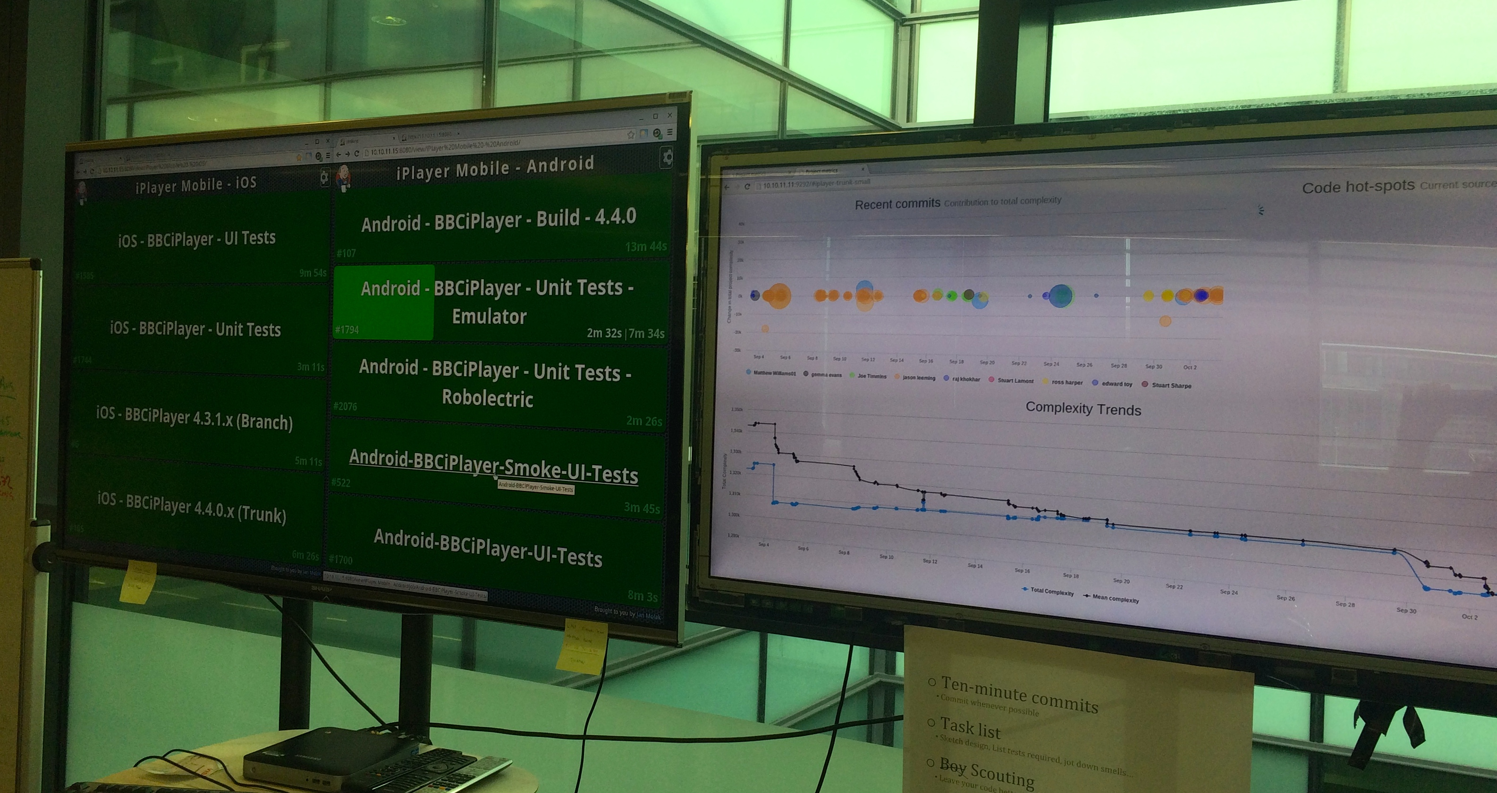
Ways of working
VISIBILITY OF STATE
VALUE EARLY & OFTEN
REGRESSION TESTING
Notes:
Radiating a visibility of state
Build monitors
- Every commit made to trunk goes throughout he build pipeline
- This way we get early feedback on how the app is progressing on every change made to it
- Helps flag up any issues early so it can be fed back into the development process
- If a build makes it through the pipeline its made available to all team via hockeyApp
- with a nightly release made available to all our key stakeholders
Builds every day from hockeyapp to stakeholders – value early and often
Test ownership
Iterative regression Testing
Team planning – as a team, just in time
Regression testing – as a team, swarming to get done

Slide 16
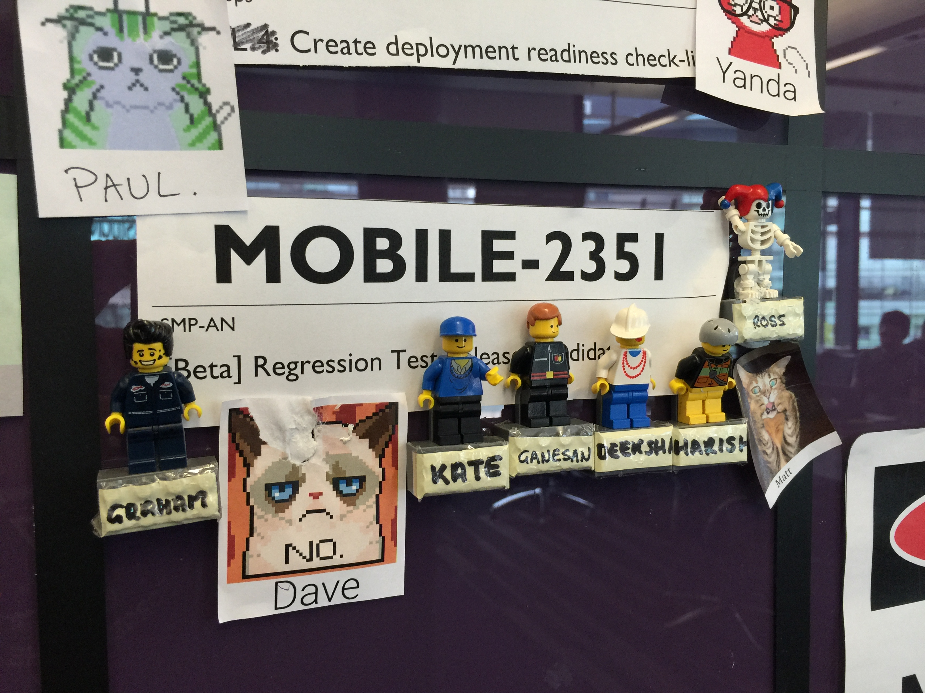

Slide 17
Code and Test metrics
Notes:
We not only make our build pipelines visible but also the status of our automated tests and code health
We run a number of simple metrics on our code to give developers an idea of how the state the code is in
types of metric we run our
commit size
we try to encourage small and often commits
general rule of thumb being 10 minute commits
basic code complexity
Is the code we add or remove making the code more or less complex
the complex number it self does matter
its the trend that we are interested in
use our own complexity metrics run on each file
BES - Braches X efferent coupling (imports) X super classes
code hotspots
are we likely to be working in an area of code that is volitile
if a file is constantly changing and has a high complex values in comparison to other files then it can be used as a warning sign of potential problems
or a place where we should focus our refactoring
We also do some basic graphing of our automated test runs
lets the team know of any failing tests
number of running tests
general history
how often they run
new tests
generally stability

Slide 18
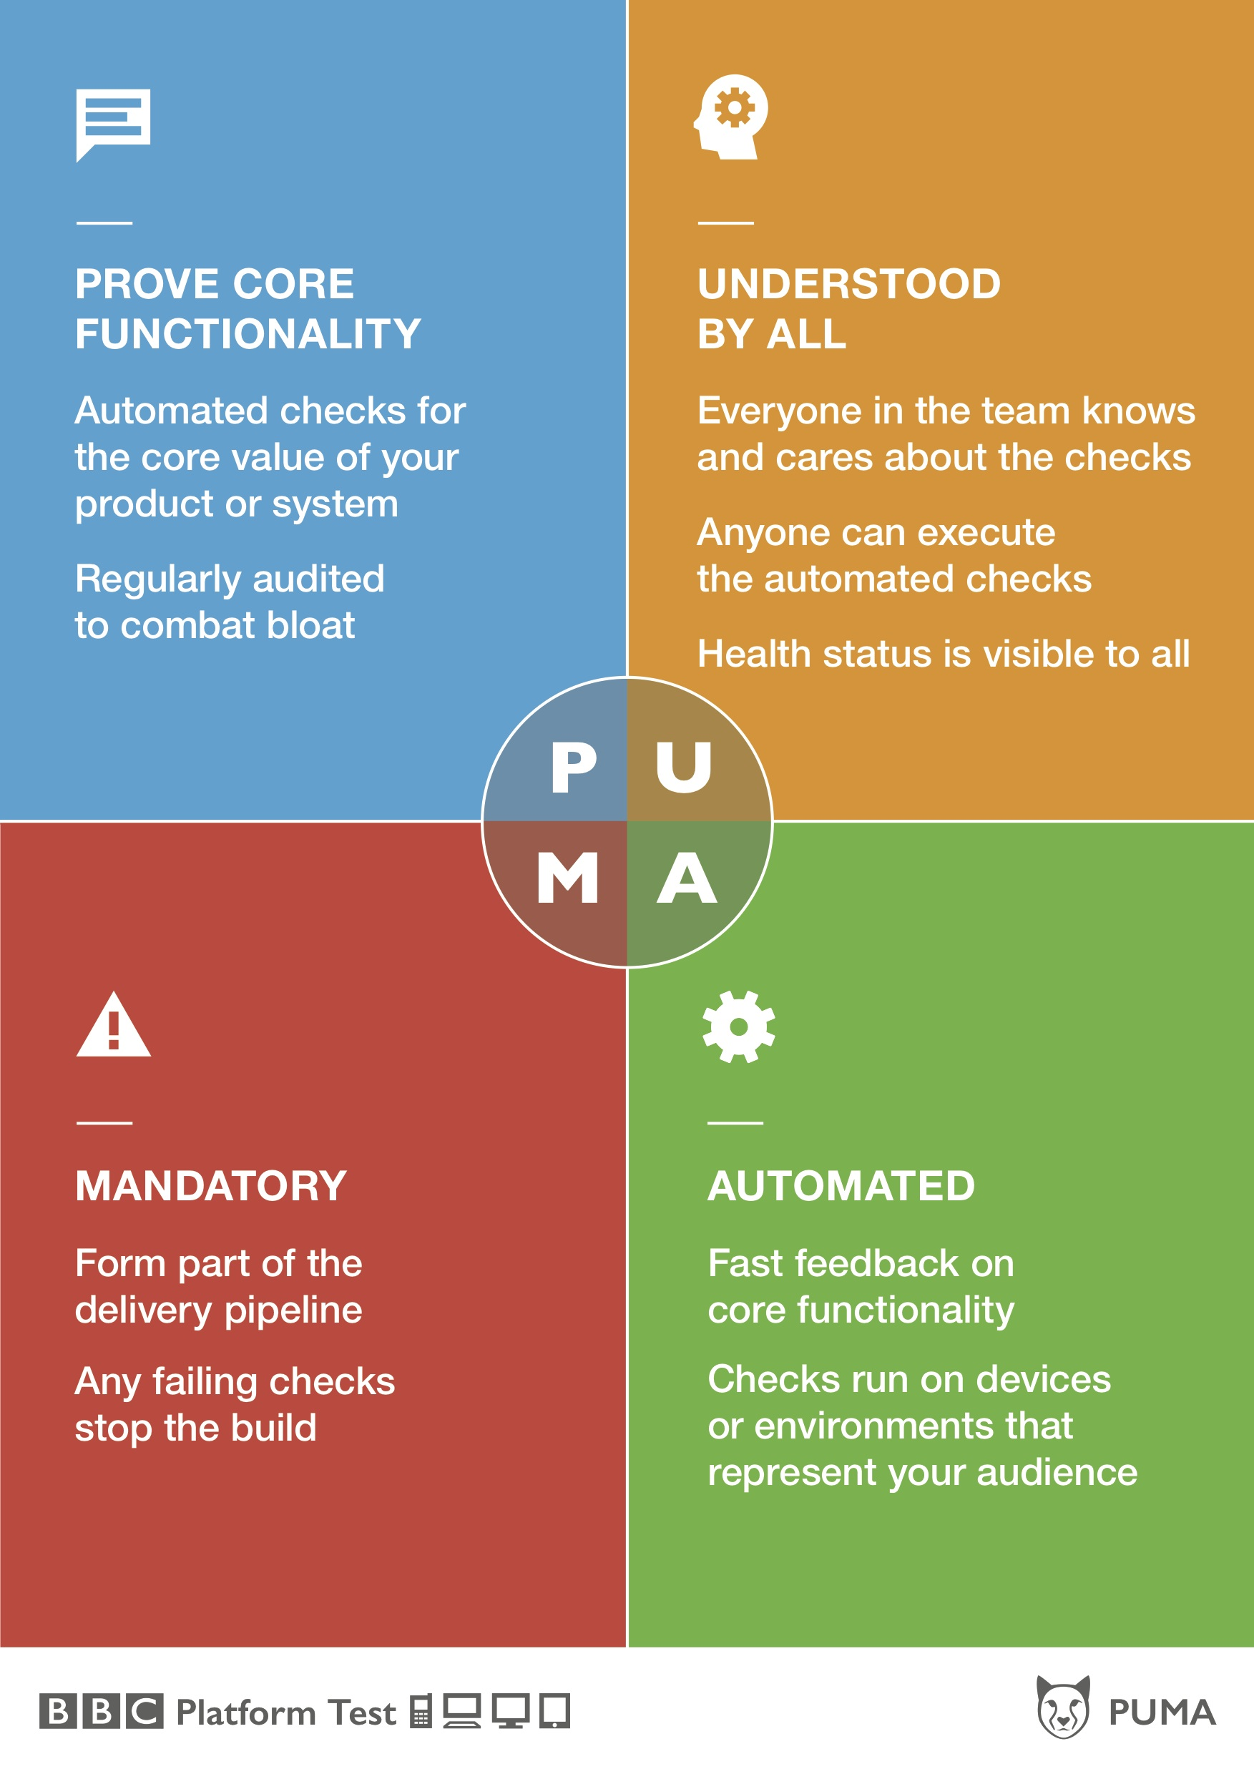
Notes:
Another initiative we’ve introduced is our PUMA checks.
It’s our attempt to address automated test bloat and one of our big goals which is to have all automated tests understood by all members of the team.
It also focuses on fast feedback and checking the core functionality of the product.

Slide 19
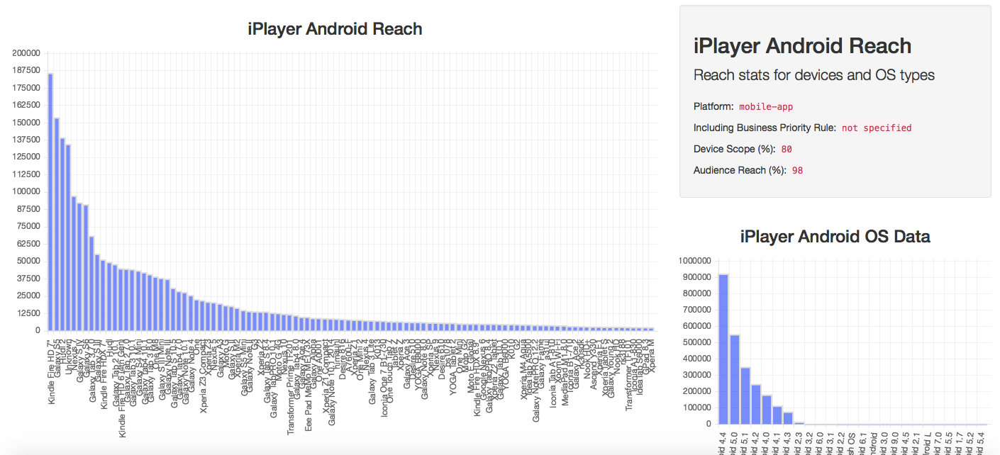
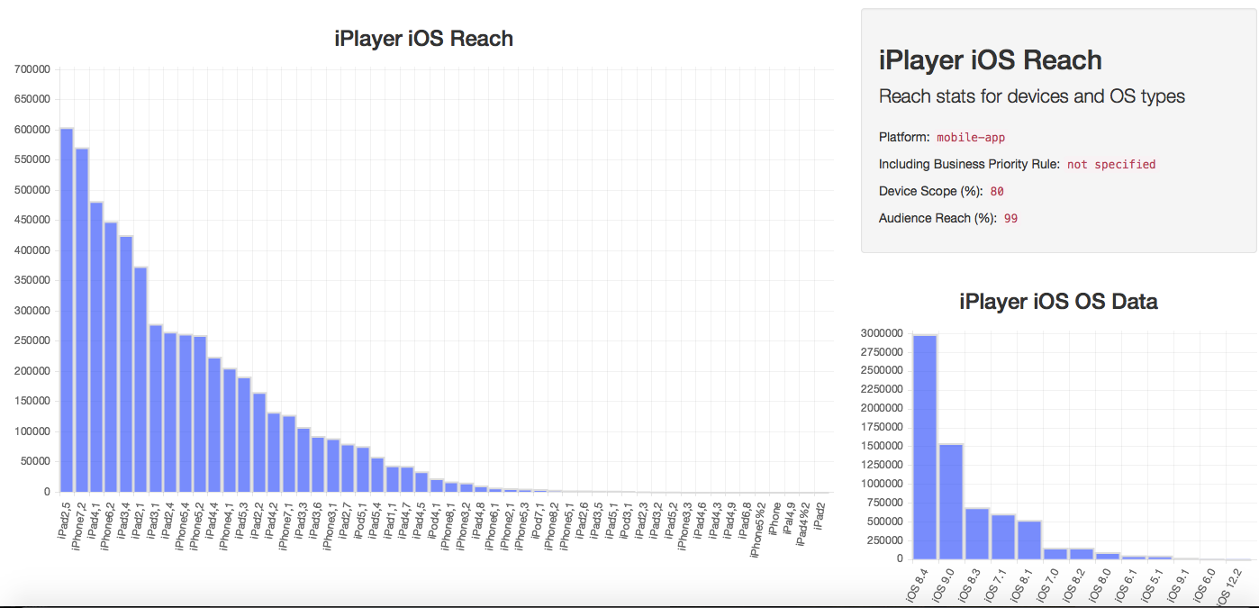
Device reach
Notes:
More radiating data and on to internal tools built and supported by our TITAN team.
This time we’ve built a device usage visualisation system that gives us dynamically updated stats of device and OS version usage across the audience.
This is really useful in many ways
Reminding us how many millions of users we have!
Informing on what our most popular devices and OS versions are
And being able to intelligently target a percentage of the audience with a device scope

Slide 20
http://www.bbc.co.uk/opensource
@bbcopensource
Notes:
I mentioned our TITAN team. They now look after the BBC Open Source projects.
Everything they create is designed to be open-sourced.
- They have invested a lot of time and effort over last couple of years in building libraries and tools and a dedicated CI system to address the challenges of testing on devices (TV & Mobile)
- Will be making them all open-source by end of this year
- Our invitation to come and join us to help make testing on devices brilliant
- On device audio and video playback testing
- @bbcopensource

Slide 21
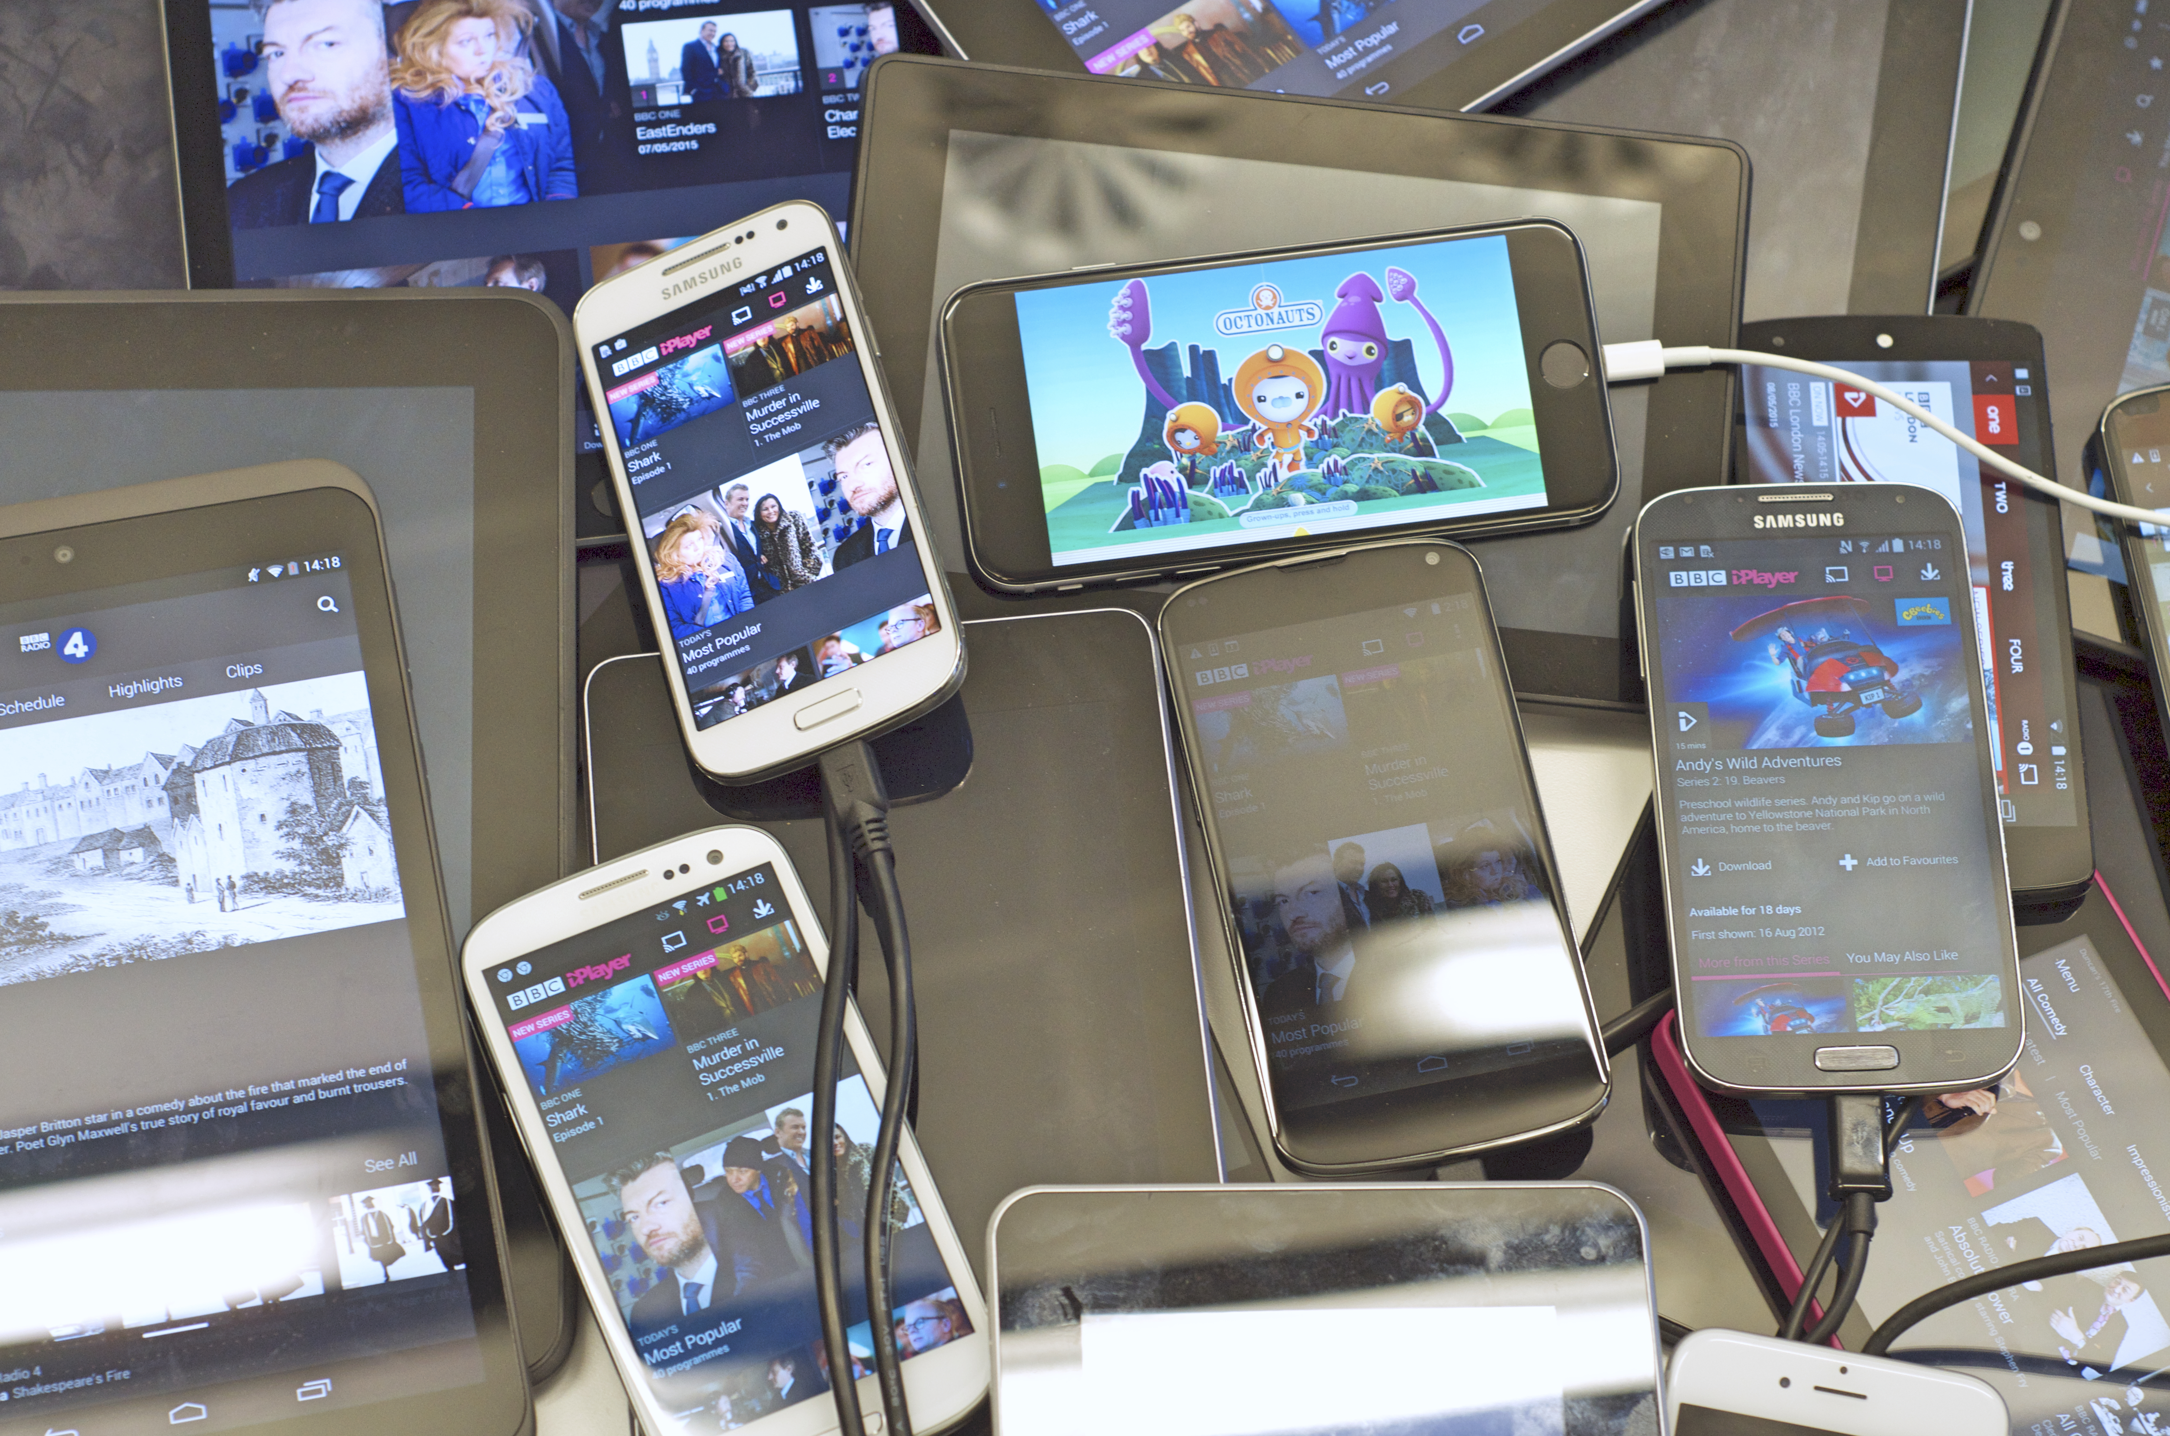
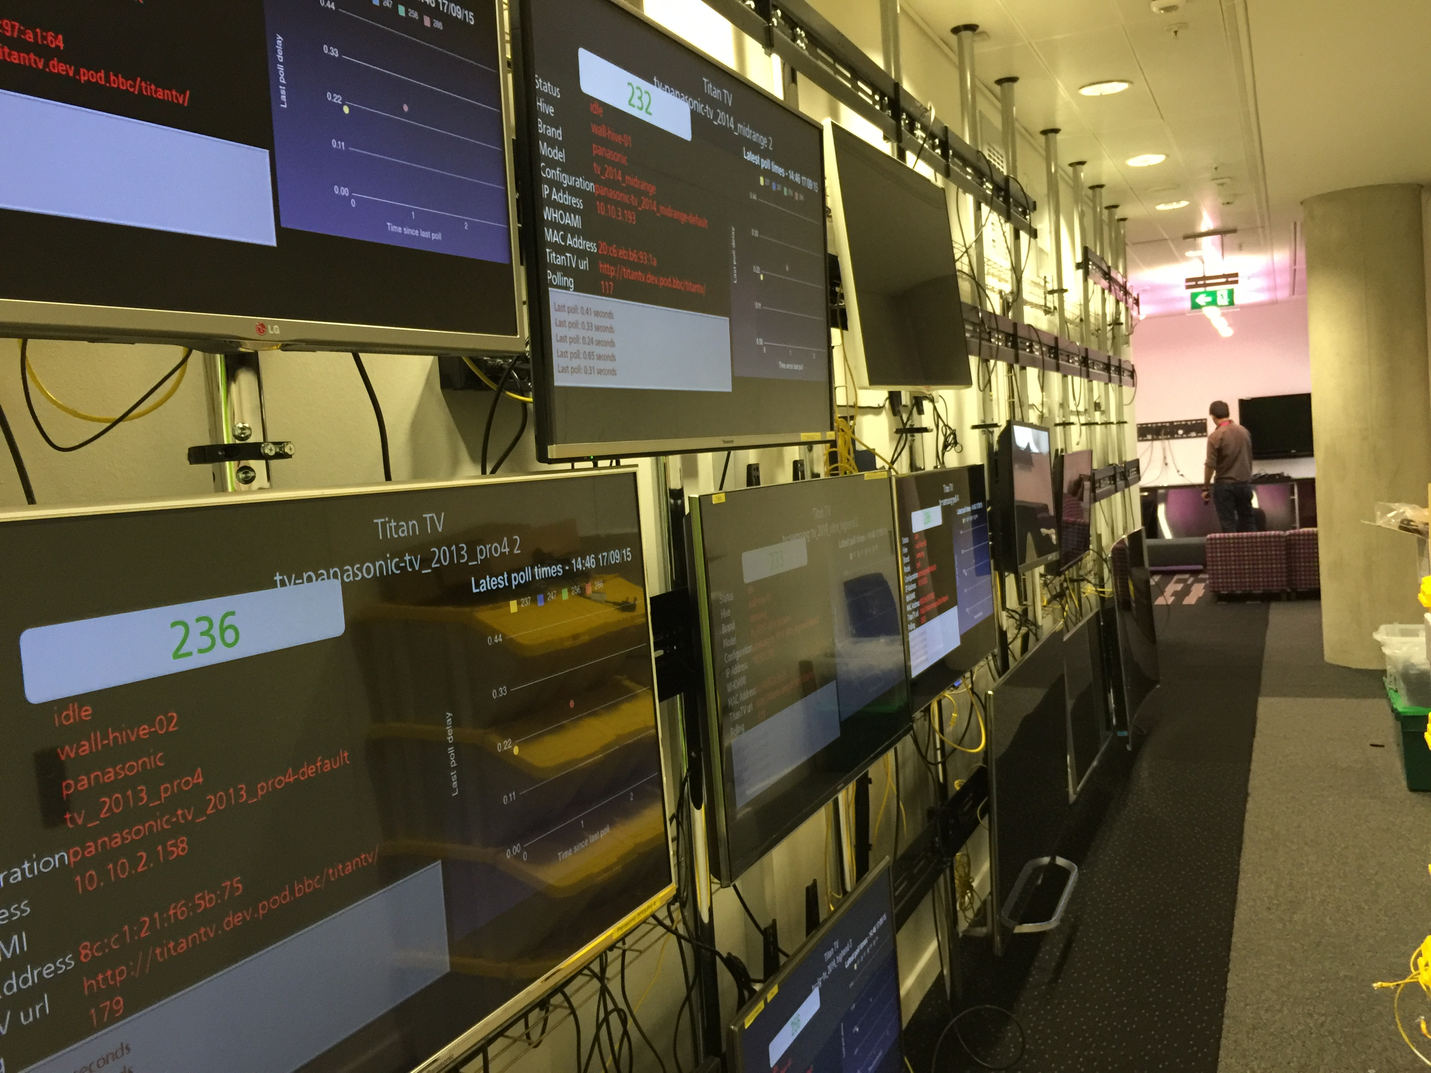
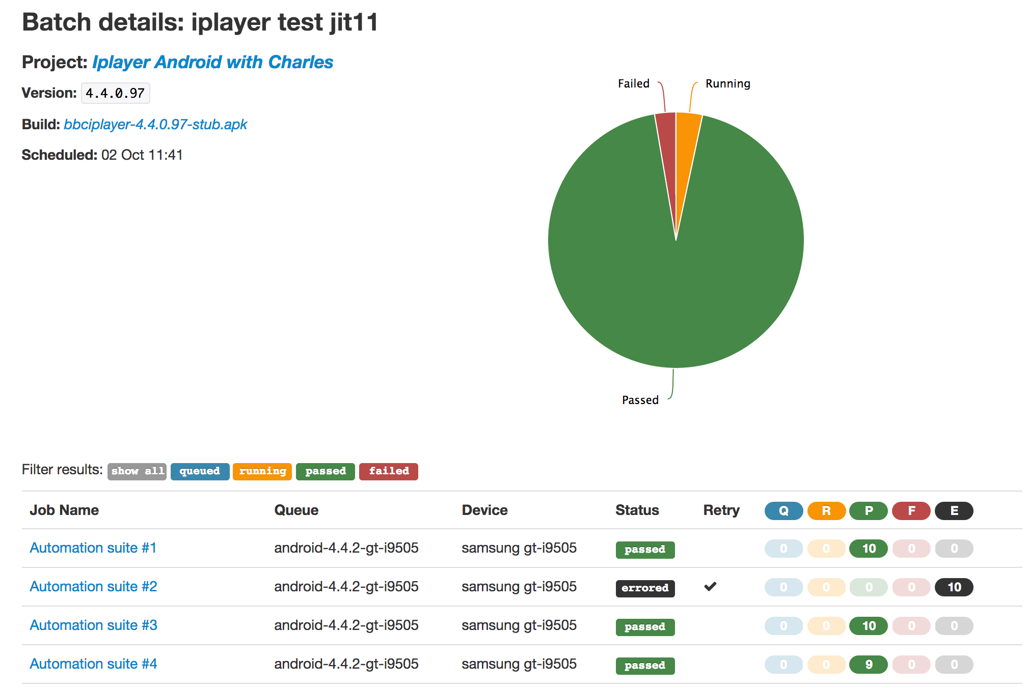
HiveCI
Notes:
Allows us to run the same automated checks on multiple devices
device agnostic
can be used for TV, mobiles, tablets, watches!
Automation formwork agnostic
supports almost any automation framework
calabash, appium, KiF etc
In this example its been used to run iPlayer tests in parallel on 2 SGS4
to speed up test execution and feedback times, parellise and give greater device breadth

Slide 22
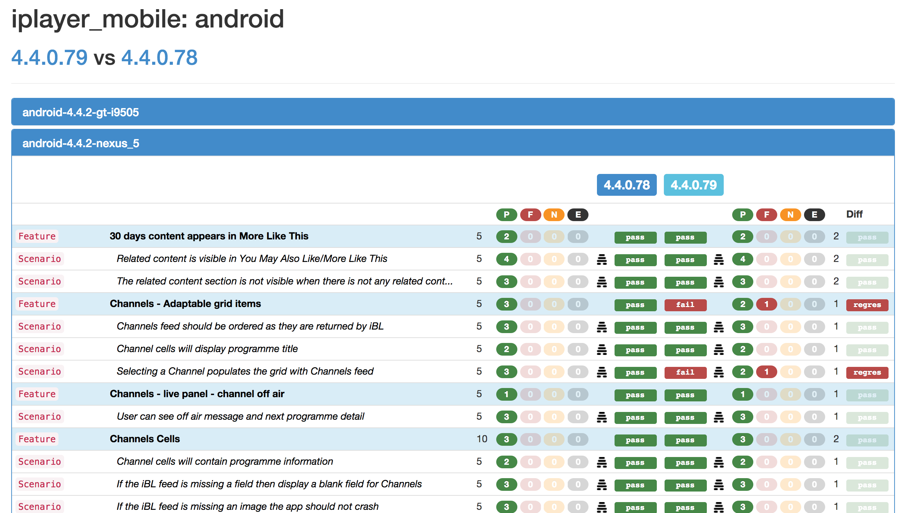
TestMine
Notes:
But with running on our automated checks on multiple devices has resulted in vast amounts of test data to work through
To simplify all the data we use another internally built tool called Test mine
This aggregates all the test data
This allows use to
- minitor test runs
- view results
- and compare past runs
- either across time or application versions

Slide 23
Tools & technologies
Notes:
We use a number of different tools and technologies
ruby
cucumber
calabash - mobile automation framework
And more recently:
android:
robotium, expresso
iOS:
Instruments
Test rail - test management tool
Jira - defect and general project management
HockeyApp – and starting to use this for crash reporting
Charles Proxy - network traffic and mock out app data
Android
Xcode

Slide 24
What next..
Further categorisation of automated UI checks
Fewer UI checks?
LION tests
Testing as a craft
Continue our open sourcing
Continuous Delivery
Security Testing
Accessibility Testing
Notes:
Live insights and operational notifications
Address Automated UI test bloat
Lets know, all the time, and at any time, exactly what our app is doing and how it’s behaving
Which will give us more confidence to do less testing and listen more to feedback from Live
More work on devicehive. Open source. Scale up for iOS.
CD. Priority for BBC Digital. Challenge for native mobile development. Daily builds to hockey. Partly there.

Slide 25
Questions?

