Slide 1
Agile performance testing Michael Kok - mBrace Rodric Vos Cygnus Infrastructure
14/10/2015
TestNet Najaarsevent

Slide 2
Contents
Agile Performance testing presented at Najaarsevent 2014
So far non-intrusive data collection to application but with load generators and scripting
New:
Developer inserts statements for data collection
Not non-intrusive anymore – acceptable for developers?
Still great advantages!
Short cycle build – test – optimise
No surprises at implementation
Test done by developer without consultancy
Current phase:
Implemented for .NET
beta testing
Practical results? – First beta test

Slide 3
Adapted plan Application X
Specification Design / Construction Implementation Acceptance Improve SW Exploitation
nov 2013 feb 2014 sep 2014 dec 2014 jan 2015 march 2015
Sprint1 Sprint 2 Sprint 3 . . . Sprint n
Performance test
Performance test
Rework! Boehm?

Slide 4
Why not alternative plan Application X?
Specification Design / Construction Implementation Acceptance Exploitation
nov 2013 feb 2014 sep 2014 dec 2014 jan 2015
Sprint1 Sprint 2 Sprint 3 . . . Sprint n
Performance
evaluation:
Code
Dev(Ops)
Performance
evaluation:
Capacity
(Dev)Ops
Performance
evaluation:
Implementation
Conventional
load test
+ benchmarks
10% of cases
Performance
acceptatance
test
Formality
???

Slide 5
The Beta test
Preparation test environment – install tooling
Conduct performance test
Results performance test

Slide 6
The application under test
Nuros – urenregistratie, kilometers etc.
Built for Nexor
Built by Cygnus Infrastructure, Rodric Vos
.NET / C# platform + MySQL
Multitier:
Client – Web server – Database server

Slide 7
Nuros application (1)

Slide 8
Nuros application (2)

Slide 9
Nuros application (3)

Slide 10
The performance test
Purpose: code quality assessment
Test environment:
multitier on developer laptop
With VMWare
1 VM for mBrace measurement control
1 VM for Web Server
1 VM for Database Server
mBrace DLL for profiling
Connection to mBrace site for parsing and modelling
Headless test – client not included

Slide 11
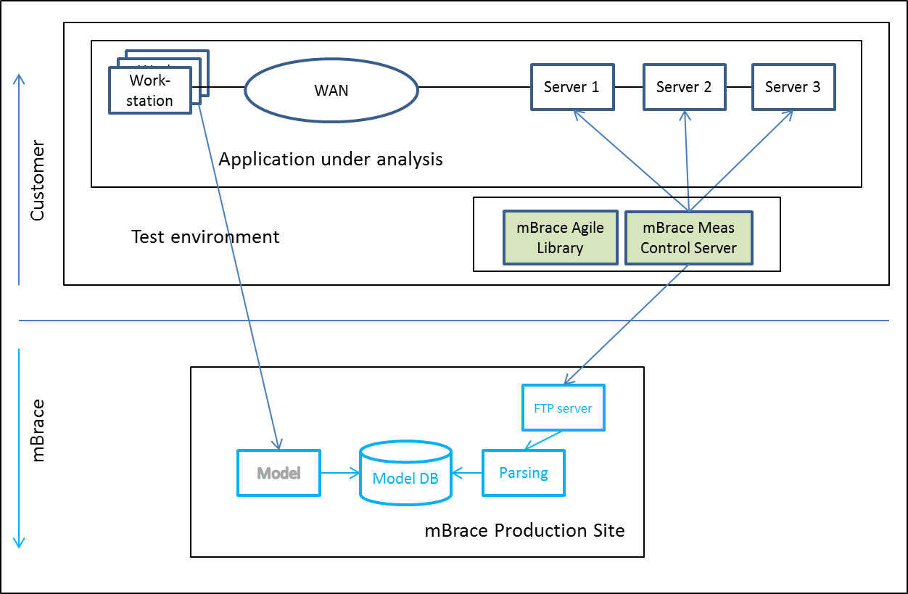
mBrace test tooling Architecture

Slide 12
The DLL

Slide 13
Insert the profiler statements

Slide 14
Preparation environment / tooling
Provide the host names of the configuration
Test tooling is further self-deploying
Areas of attention:
Default values in tooling
Keep overview
GUI

Slide 15
Conduct performance test
Insert the 2 mBrace statements
Start test tooling
Execute prepared transactions (3 times)
Stop test tooling == > automatic upload data
Login in mBrace model and examine transaction profiles
Decide: done or optimise code
Repeat until done
The whole cycle takes minutes
Areas of attention:
Automatic parsing not yet completed
Only one exit in code
Access to Model

Slide 16
After Continue all data are collected and uploaded

Slide 17
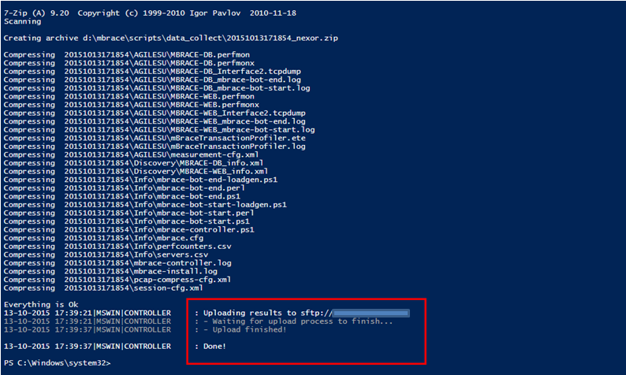
Performance test done

Slide 18
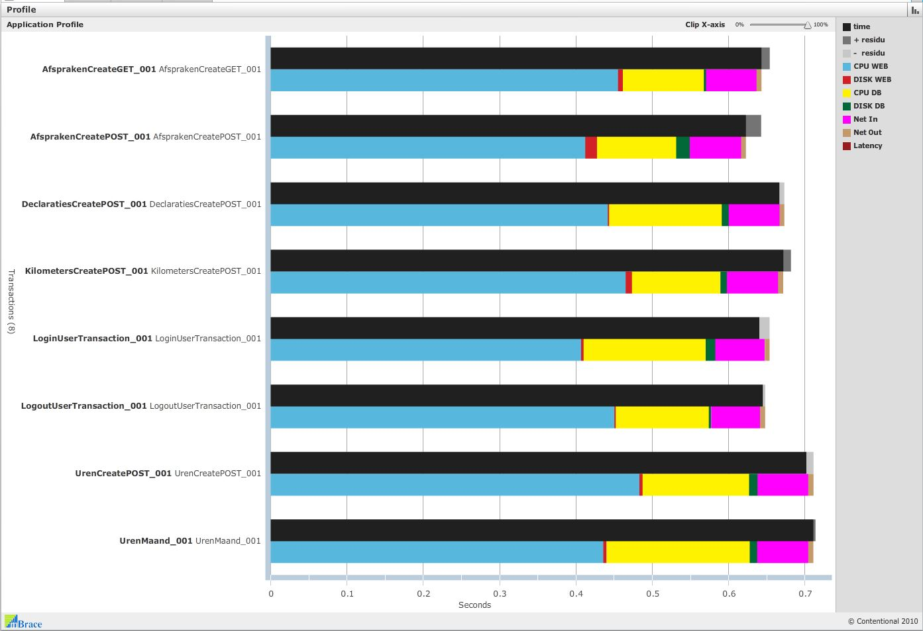
Profile validation
Notes:
These profiles (one for each transaction) are made for validation of the measurement results.
For each transaction there is a double horizontal bar:
The black one describing the directly measured response time and
The colored bar in which the response time is calculated from the measured resource usage.
These two must be (approximately) equal, which they do neatly in this case. Otherwise there
is a problem in the test that must be solved first.
The length of the bars represents the transaction response time. The colors show how much time
The transactions spent on each resource in the multitier infrastructure.
The profiles represent the full end-to-end performance on the multitier infrastructure.

Slide 19
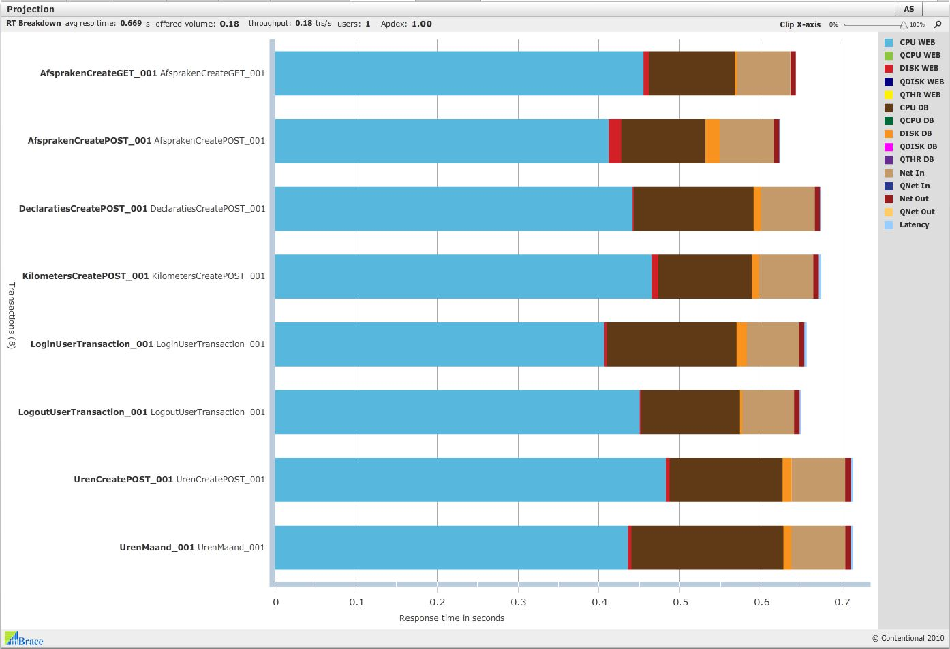
Profiles ready for projection
Notes:
This picture from the model shows the same transaction profiles as the previous picture.
These profiles represent the performance of the transactions measured in the test environment.
After the transaction profiles have been validated and accepted they are going to be
used for predictive projection on the production environment to show
the performance that can be expected in the production environment.
The developer cannot use these profiles to judge the performance of the transactios he has built,
because this is the performance in the test environment, which is not the same as production.

Slide 20
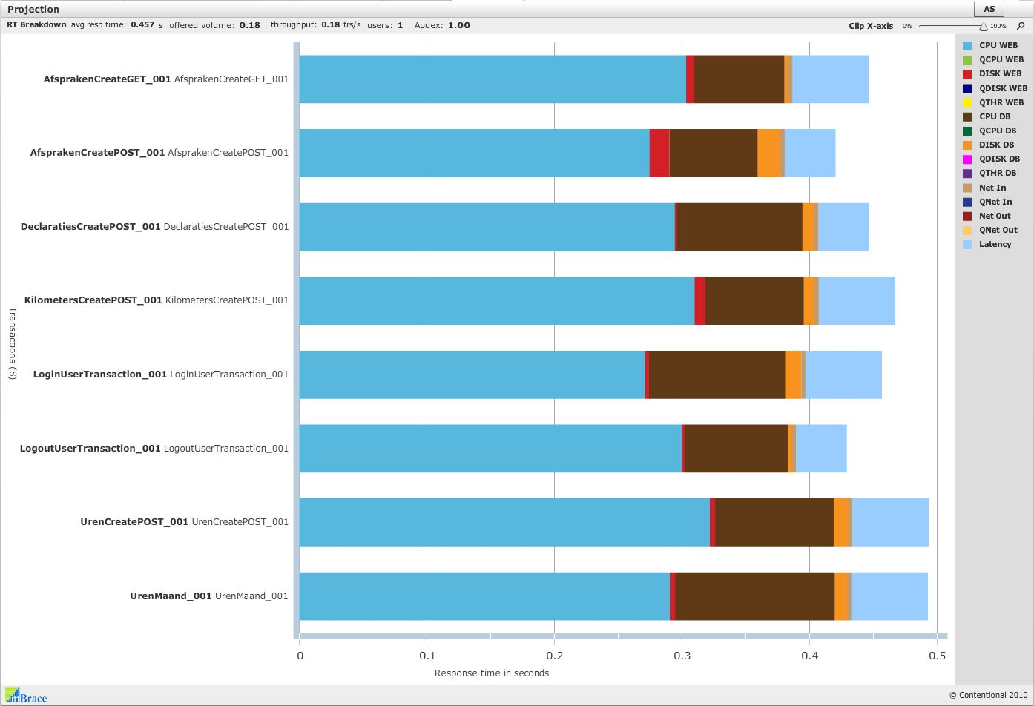
Profiles projected on P-environment
Notes:
This figure shows the projection of the profiles on the production environment.
This shows the performance of the transsactions that can be expected in the production environment.
Due to the faster hardware of the production environment the max response time reduced from 0.7 to 0.5 seconds.
The developer uses this figure to judge the performance of the transactions he has built.

Slide 21
Conclusions of test
Response times < 1 second
Apdex Index = 1 (excellent performance)
Hence performance of Nuros application is OK (unfortunately)

Slide 22
In production
The statements can be left in the code to provide:
Response times
Of transactions by name
This provides a perfect application performance monitor
Helps mBrace to prove its accuracy
Measurement can be turned on or off

Slide 23
Summary Agile Performance Testing
Performance testing during Construction is feasible
The performance test can be done by the developer
No specialists required
Short cycle build – performance test – optimise
Definition of done now includes performance
No surprises at implementation
Conventional performance testing may be needed for only < 10% of cases
Spectacular business case for Agile performance testing

Slide 24
Vragen?
michael.kok@mbrace.it
rodric.vos@cygnus-infra.nl

Slide 25
Dank U

