Slide 1
RESTful API testing met REST Assured
Workshop TestNet thema-avond 8 november
Bas Dijkstra
bas@ontestautomation.com
www.ontestautomation.com
@_basdijkstra

Slide 2
Voorbereiding
Setup a JDK (1.8 strongly preferred)
Install an IDE (IntelliJ, Eclipse, …)
  Also install Maven and TestNG support (for Eclipse)
Download and import the Maven project
  https://github.com/basdijkstra/testnetapitesting
  https://www.ontestautomation.com/files/testnetapitestingworkshop.zip
Run tests in RestAssuredSmokeTest.java

Slide 3
Wat gaan we doen?
RESTful APIs
REST Assured
Zelf doen
Andere testtools

Slide 4
Wat zijn RESTful APIs?
HTTP request methods (GET, POST, PUT, …)
URI’s
CRUD operations on data
  POST Create
  GET Read
  PUT Update
  DELETE Delete
  … …

Slide 5



Waar worden RESTful APIs gebruikt?
Mobile
Internet of Things
API economy

Slide 6
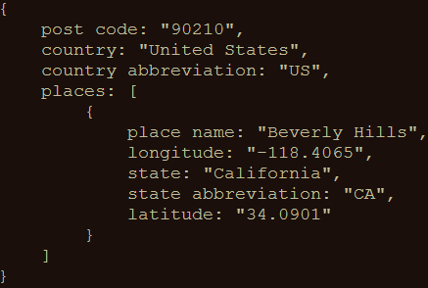
Een voorbeeld
GET http://api.zippopotam.us/us/90210
Result:

Slide 7
Wat willen we testen?
Connectiviteit
  Is de API ‘live’?
Syntactische correctheid
  Statuscodes
  Headers
  Schema’s
  Dataformaten
  …
Semantische correctheid
  Worden de juiste gegevens teruggegeven?
  Worden gegevens goed opgeslagen?
Verwerking verzoeken door service provider
  Individueel
  Scenario’s

Slide 8
Wat willen we dan testen?
Vergeet ook de nonfunctionals niet…
Performance
Security
  Authenticatie (mag ik de API gebruiken?)
  Autorisatie (CRUD + rechten)

Slide 9
Case study
How applying API testing saved us from thousands of slow end-to-end tests

Slide 10
Tools for testing RESTful APIs
Browser (using plugins like Postman for Chrome)
Open source (SoapUI, REST Assured, …)
COTS (Parasoft SOAtest, SoapUI Pro, …)
Build your own (using HTTP libraries for your favourite programming language)

Slide 11
REST Assured
Java DSL for writing tests for RESTful APIs
Removes a lot of boilerplate code
Powerful, readable and maintainable tests
Developed and maintained by Johan Haleby

Slide 12
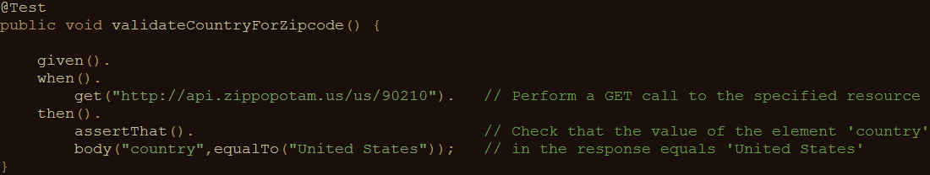
Een voorbeeldtest

Slide 13
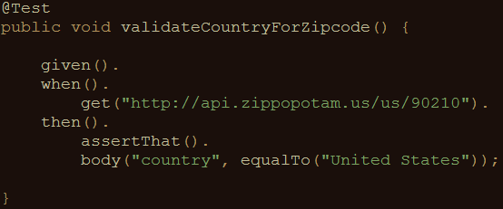
REST Assured features
Support for HTTP methods (GET, POST, PUT, …)
BDD/Gherkin – like syntax
Use of Hamcrest matchers for checks (equalTo)
Use of JsonPath for
selecting elements from
JSON response

Slide 14
About Hamcrest matchers
Express expectations in readable language
Examples:
http://hamcrest.org/JavaHamcrest/javadoc/1.3/org/hamcrest/Matchers.html
equalTo(X) | Does the object equal X?
hasItem(“Rome”) | Does the collection contain an item “Rome”?
hasSize(3) | Does the size of the collection equal 3?
not(equalTo(X)) | Inverts matcher equalTo()

Slide 15
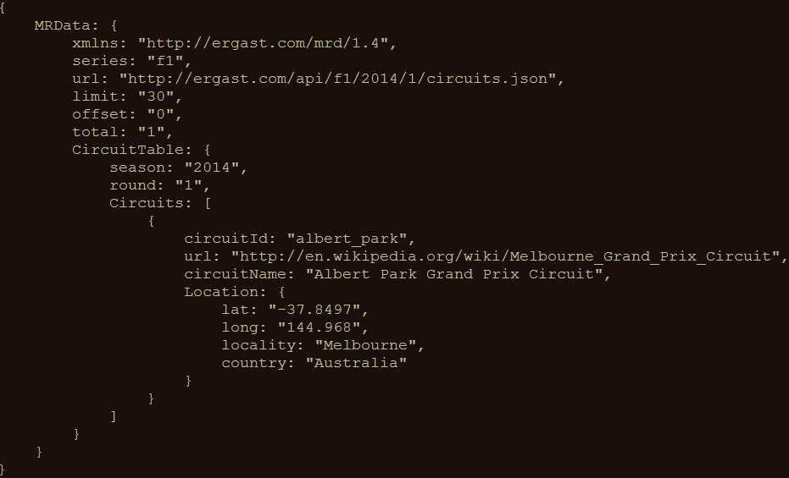
JsonPath example
http://goessner.net/articles/JsonPath/

Slide 16
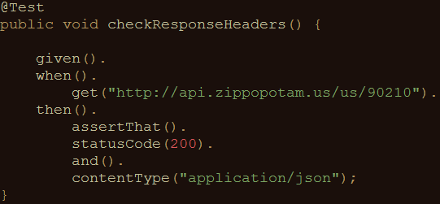
Validating technical response data
HTTP status code
MIME-type of received responses
Cookies and their value
…

Slide 17

Ons ‘system under test’
Ergast F1 API
Offers historical data of Formula 1 races, drivers, circuits, etc.
API documentation at http://ergast.com/mrd/
Mocked for demo effect mitigation purposes using WireMock

Slide 18
Voorbeelden
Data for driver Max Verstappen (in JSON):
  http://ergast.com/api/f1/drivers/max_verstappen.json
A list of circuits for the 2015 season (in JSON):
  http://ergast.com/api/f1/2015/circuits.json

Slide 19
Demo
Starting the stub server
How to use the test suite
Executing your tests
Reviewing test results
Writing a first test

Slide 20
Aan de slag!
RestAssuredExercises1
Simple checks
  Validating individual elements
  Validating collections and items therein
  Validating technical response properties
Stubs are predefined
  You only need to write the tests using REST Assured
RestAssuredExamples contains the zipcode example

Slide 21
Parameters in RESTful APIs
Path parameters
  Identify specific (set of) resource(s)
  http://ergast.com/api/f1/drivers/max_verstappen.json
  http://ergast.com/api/f1/drivers/hamilton.json
Query string parameters
  Filter a set of resources
  http://md5.jsontest.com/?text=testcaseOne
  http://md5.jsontest.com/?text=testcaseTwo
There is no official standard!

Slide 22
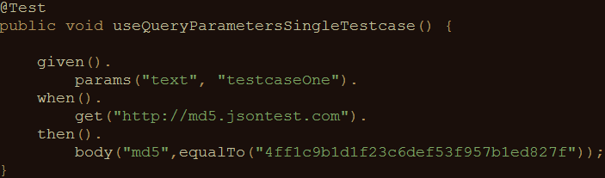
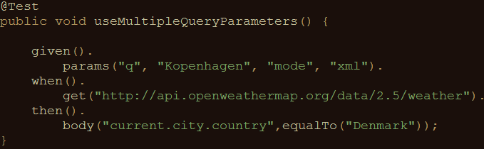
Using parameters in REST Assured
Examples for query parameters:
  Call to http://md5.jsontest.com/?text=testcaseOne
  Call to http://api.openweathermap.org/data/2.5/weather/?q=Kopenhagen&mode=xml

Slide 23
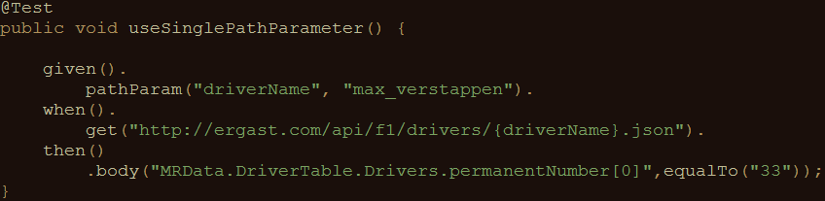
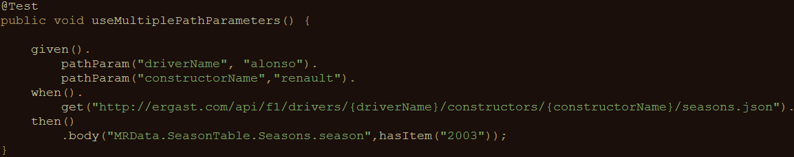
Using parameters in REST Assured
Examples for path parameters:
  Call to http://ergast.com/api/f1/drivers/max_verstappen.json
  Call to http://ergast.com/api/f1/drivers/alonso/constructors/renault/seasons.json

Slide 24
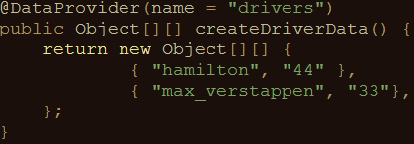
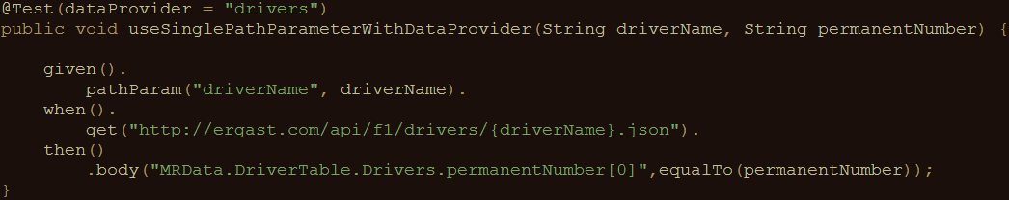
Using parameters in REST Assured
Iterating over a collection of parameter values:
  Creating pairs of driver ID’s and numbers:
  Using test data in API calls and validation of response data:

Slide 25
Aan de slag!
RestAssuredExercises2
Data driven tests
  Creating a test data object
  Using test data in calling the right URI
  Using test data in assertions
RestAssuredExamples contains all examples from the presentation

Slide 26
Hergebruik
Improving maintainability
Avoiding duplicate code
Sharing variables between steps
Reusing request or response specifications

Slide 27
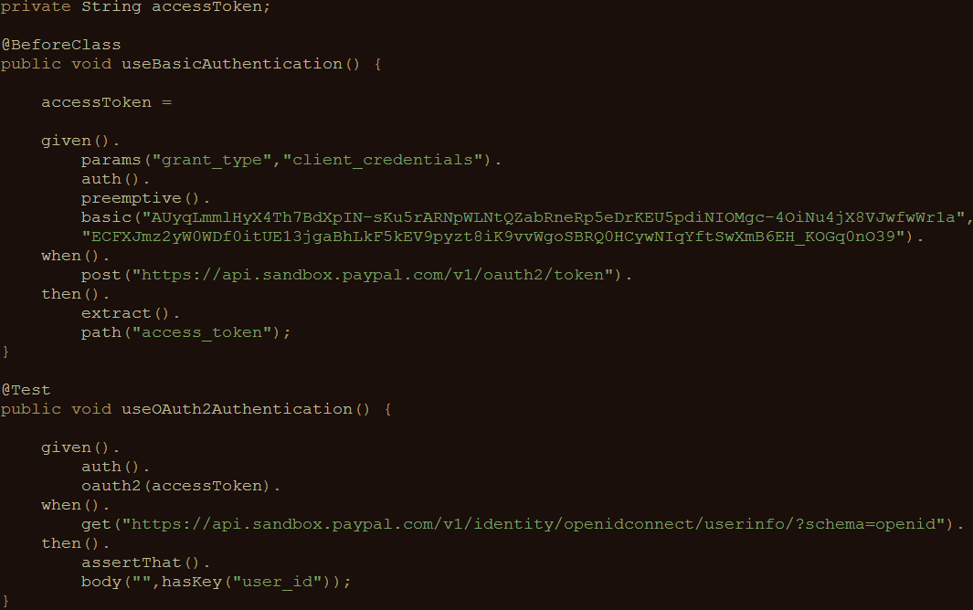
Variabelen delen tussen tests
REST Assured
supports this
with extract()

Slide 28
Controles delen tussen tests
Example: checking status code and MIME type for all responses
Maintenance burden if specified for each individual test
What if we could specify this once and reuse throughout our tests?

Slide 29
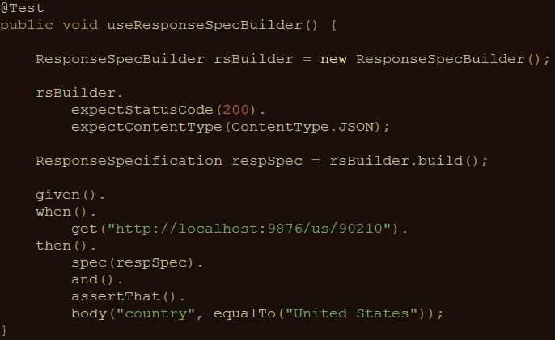
Controles delen tussen tests
Solution: ResponseSpecBuilder

Slide 30
Aan de slag!
RestAssuredExercises3
Try it for yourself
Can you think of additional applications for reuse ?
RestAssuredExamples contains all examples from the presentation

Slide 31
Authenticatie
Securing APIs
Basic authentication (preemptive / challenged)
OAuth(2)
Digest / Form

Slide 32
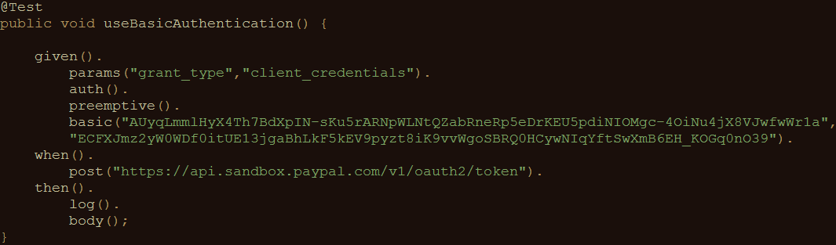
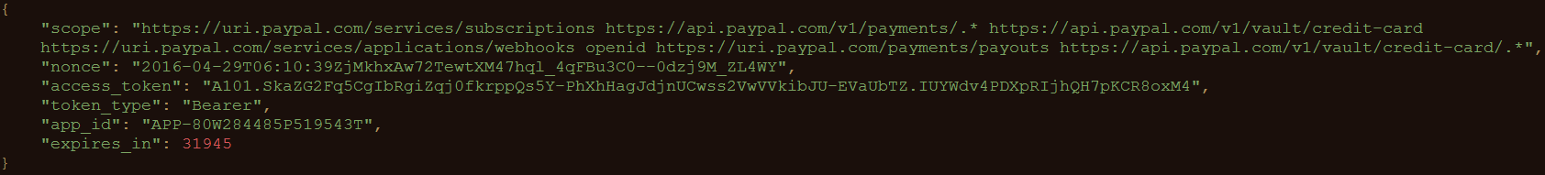
Basic authentication
Username/password sent in header for every request

Slide 33
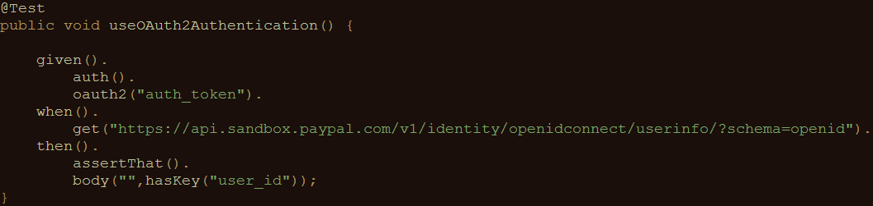
OAuth(2)
Request of authentication token based on username and password (Basic authentication)
Include authentication token in header of all subsequent requests

Slide 34
Measuring response times
Measuring response times for individual requests
Setting response time thresholds
  Test fails when threshold is exceeded
No full-fledged performance test
First rough indication of API performance

Slide 35
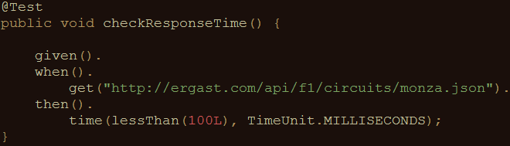
Measuring response times
An example:

Slide 36
Aan de slag!
RestAssuredExercises4
Communicating with an OAuth2-secured API
  Requesting authentication token
  Using authentication token in subsequent requests
Measuring API response times
  Execute a specific API call
  Evaluate response time against predefined threshold
RestAssuredExamples contains all examples from the presentation

Slide 37
XML support
So far, we’ve only used REST Assured on APIs that return JSON
It works just as well with XML-based APIs
XmlPath instead of JsonPath

Slide 38
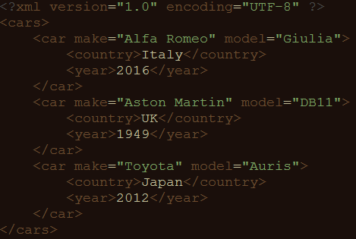
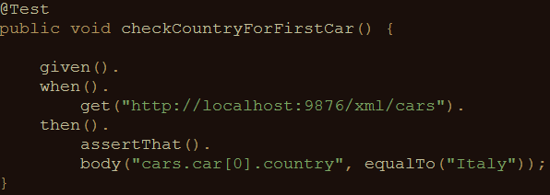
XmlPath – examples
Check country for the first car in the list

Slide 39
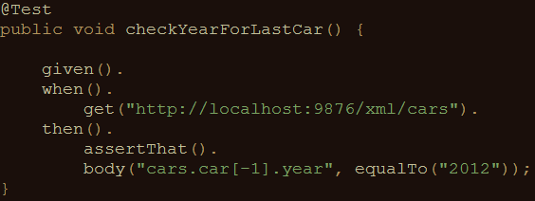
XmlPath – examples
Check year for the last car in the list

Slide 40
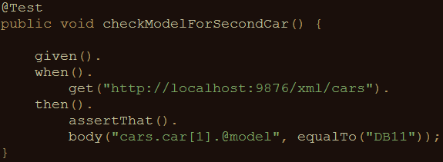
XmlPath – examples
Check model for the second car in the list

Slide 41
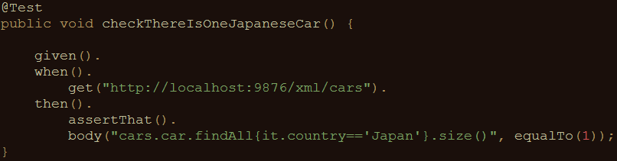
XmlPath – examples
Check there’s only one car from Japan in the list

Slide 42
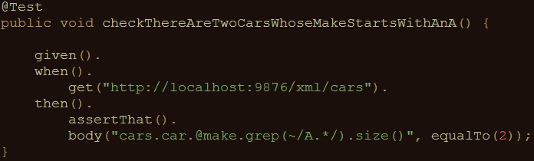
XmlPath – examples
Check there are two cars in the list whose make starts with ‘A’

Slide 43
Get your hands dirty!
RestAssuredExercises5
Communicating with an API returning an XML document
Use XmlPath to select the right nodes
Use filters, in, grep(), size() where needed
All examples can be reviewed in RestAssuredExamplesXml.java

Slide 44

Andere tools

Slide 45
Contact
Email: bas@ontestautomation.com
Blog: https://www.ontestautomation.com
LinkedIn: https://www.linkedin.com/in/basdijkstra
Twitter: @_basdijkstra

