Slide 1
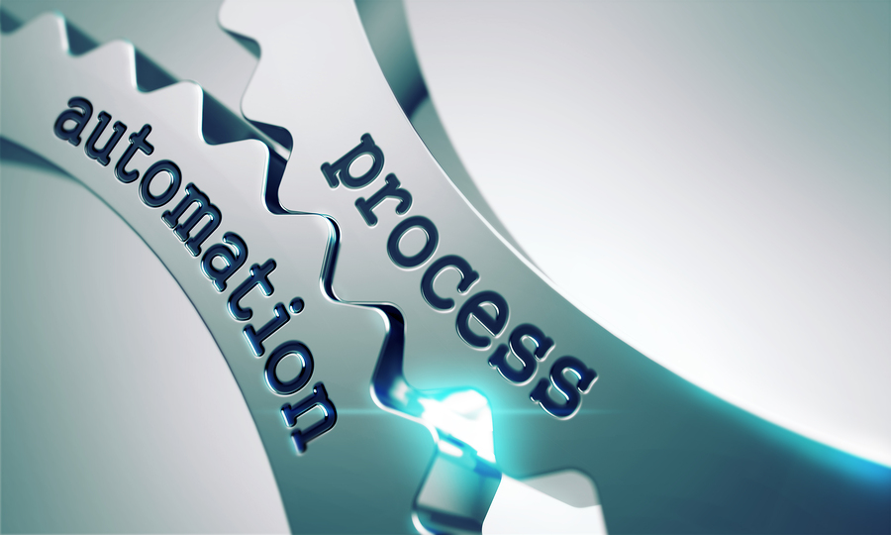

Automation is NOT Automatic!
About Process Automation
@RickDTracy
Rick Tracy Testnet 15/3/2017

Slide 2
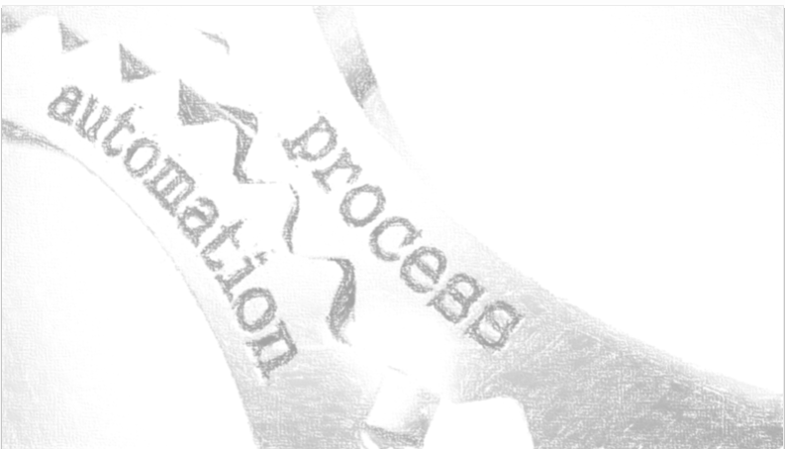


The Story So Far…
@RickDTracy
Notes:
Tester for Five Years at Rabobank

Slide 3

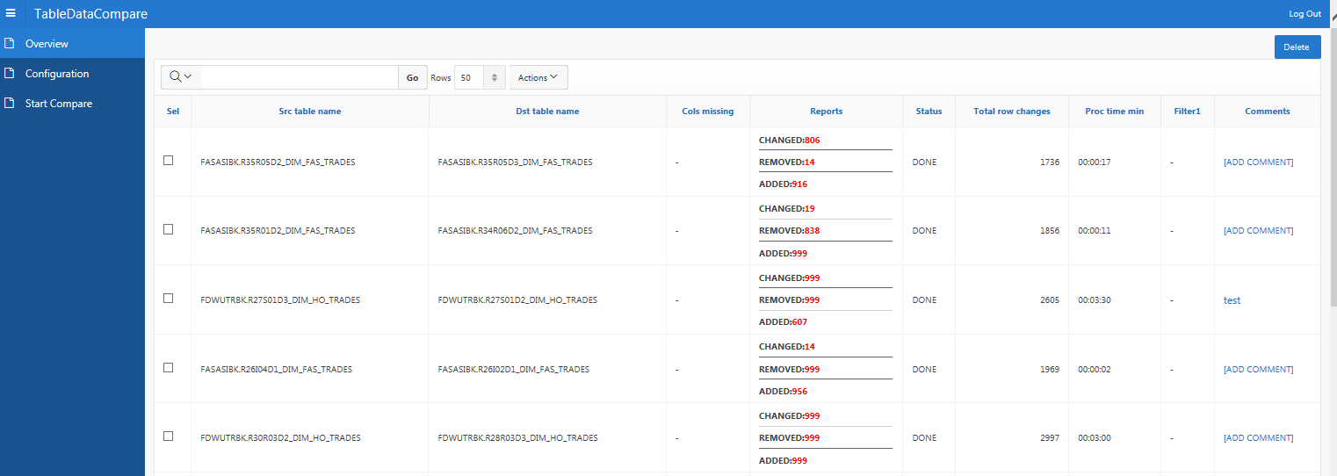
The Story So Far…
@RickDTracy
Notes:
First Contact with Automation was a full SIT Automation Suite
Milestones 24 hour challenge
Creation of Full Automatic run and validation suite
Limitations on amount due to scope of automation
Heavy Maintenance
Lots of results to analyze

Slide 4
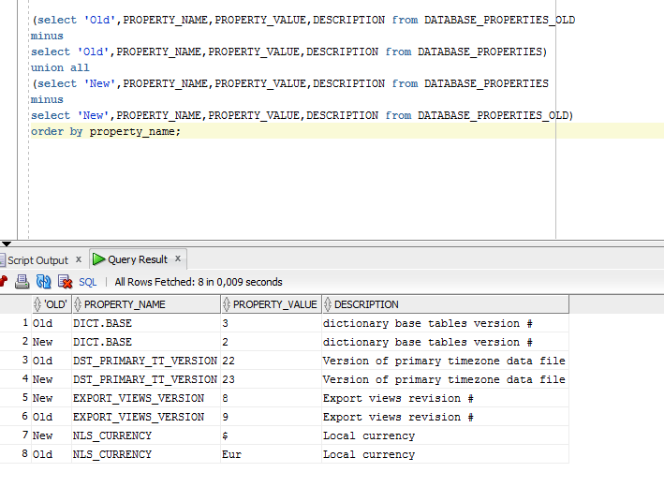

The Story So Far…
@RickDTracy
Notes:
Reverse Engineered Test Scripts
Took the principles in the tool and used them to create my own validations
Saved me the time to isolate them all and let me analyze

Slide 5
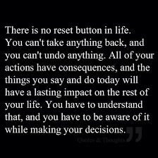
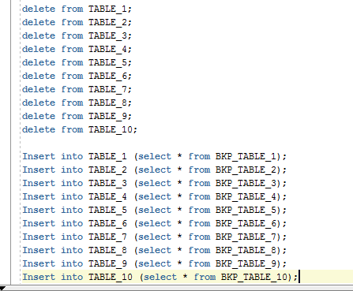
The Story So Far…
@RickDTracy
Notes:
No do-overs in life, but definitely possible in testing!
Environment Reset Script
Didn’t have to wait, could fail often

Slide 6
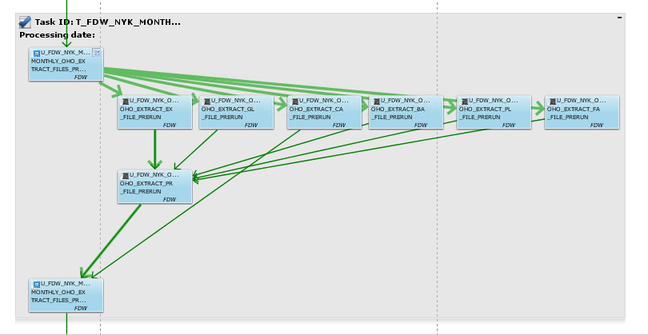
The Story So Far…
@RickDTracy
Notes:
Batch/Report Generation Automation
Took Batch commands and added them to validations
Combined the reset and the validations with the process
Used Validation rules to decided if it went on or not

Slide 7
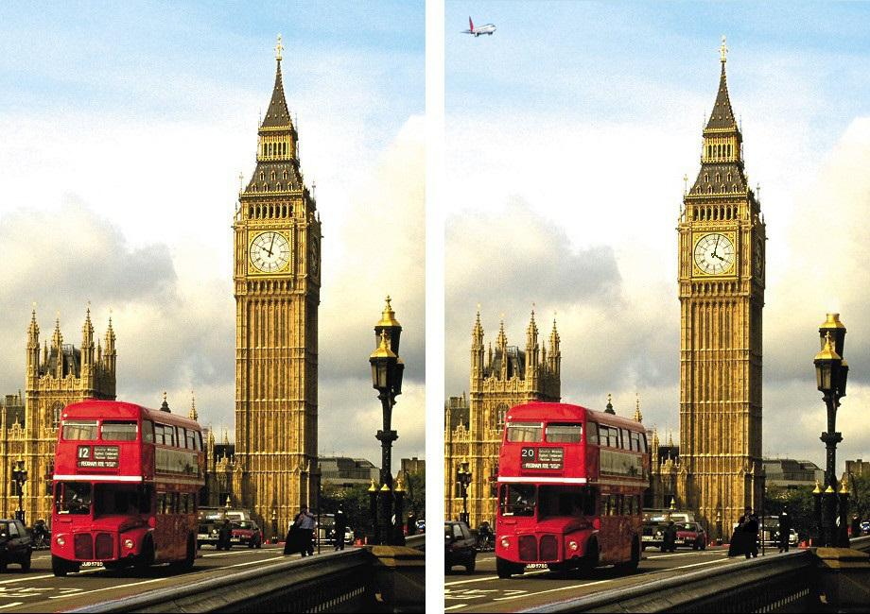
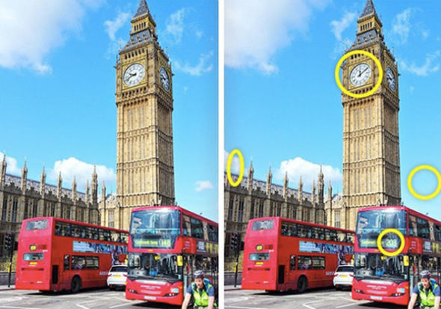
The Story So Far…
@RickDTracy
Notes:
Automated Validation Process
All the known or expected items automated in rules
If Green, not even indicated anymore
Leaves all the novel and unique issues for manual analysis

Slide 8
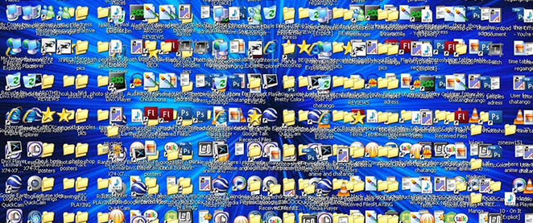

The Story So Far…
@RickDTracy
Notes:
Moved to Financial Reporting Team
Heavy GUI testing
Process intermingled with user actions

Slide 9
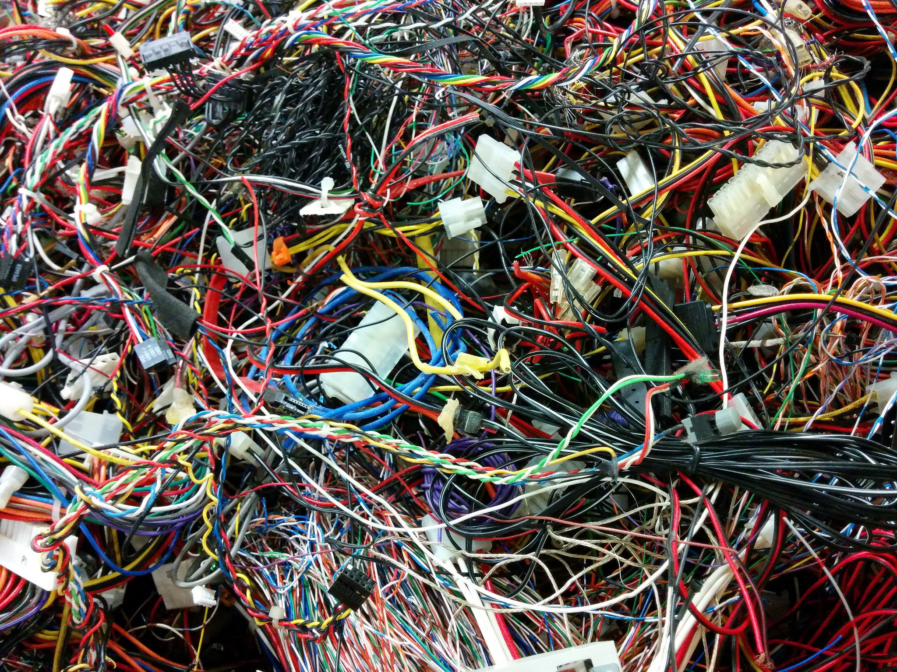
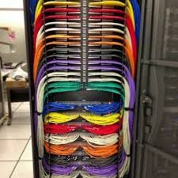
The Story Right Now…
@RickDTracy
Notes:
Automating the SIT Again
This time in a GUI heavy remote server with real data and potential user interference with unknown outcomes or expectations
Explanation of task to automate (folder transfer)

Slide 10



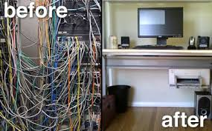
The Story Right Now…
@RickDTracy
Notes:
Searching for the right approach
Key command log
Cloud based automation
Background functionality scripts

Slide 11
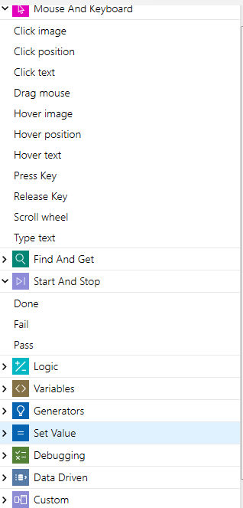
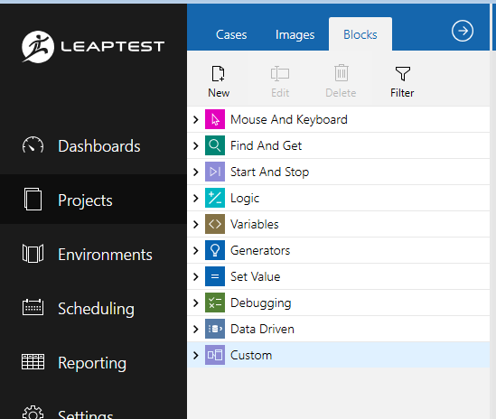
The Story Right Now…
@RickDTracy
Notes:
LeapTest
GUI reliant, but flexible
Block-like automation
Maximum Customization

Slide 12
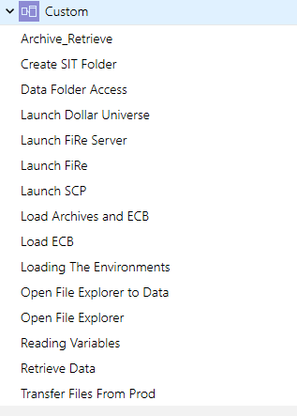
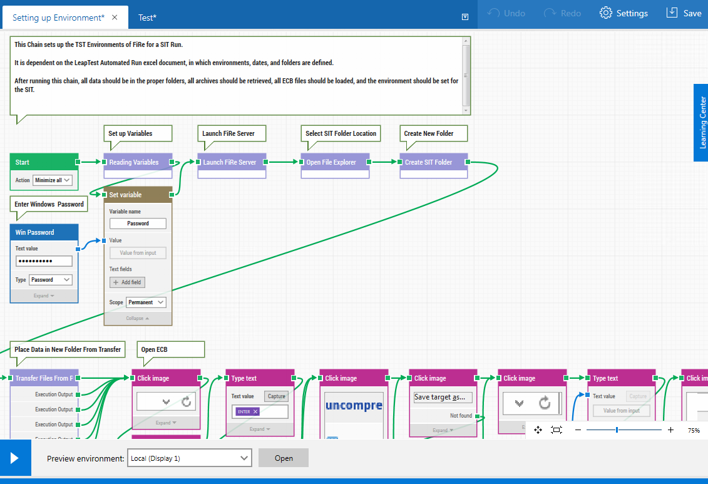
The Story Right Now…
@RickDTracy
Notes:
Making it your own
Automated annoying manual processes
Small functions
Little blocks
Redesigned the purpose of the test suite to automate process

Slide 13
The Story Right Now…
Automation
Process
Versus Test Automation
@RickDTracy
Notes:
Why Go for Process?
Why Not?
Plug in tests everywhere, then remove just as easily

Slide 14
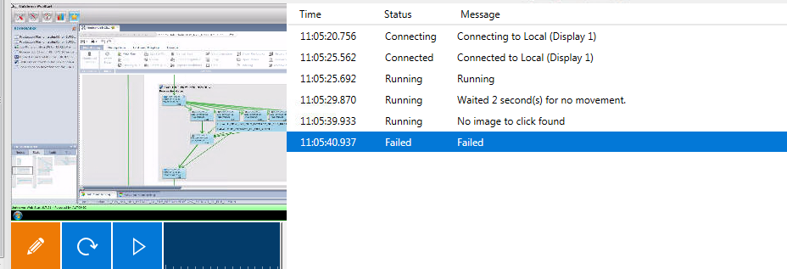
The Story Going Forward…
Lessons Learned
  GUI Failure needs backup and log
@RickDTracy
Notes:
Demonstration of Approach

Slide 15
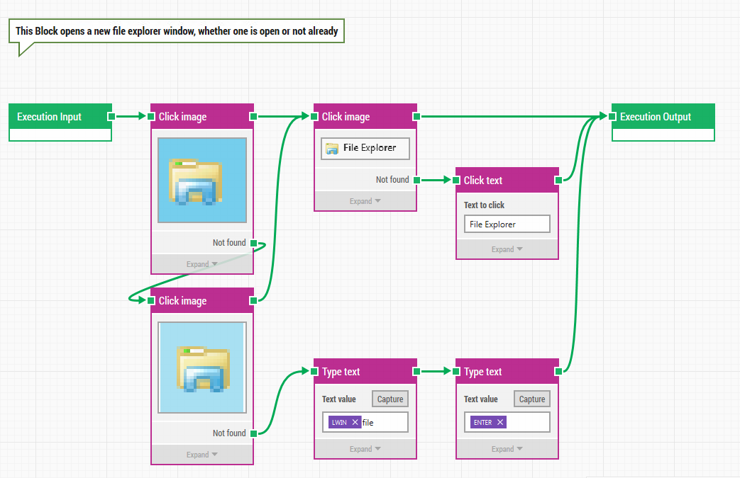
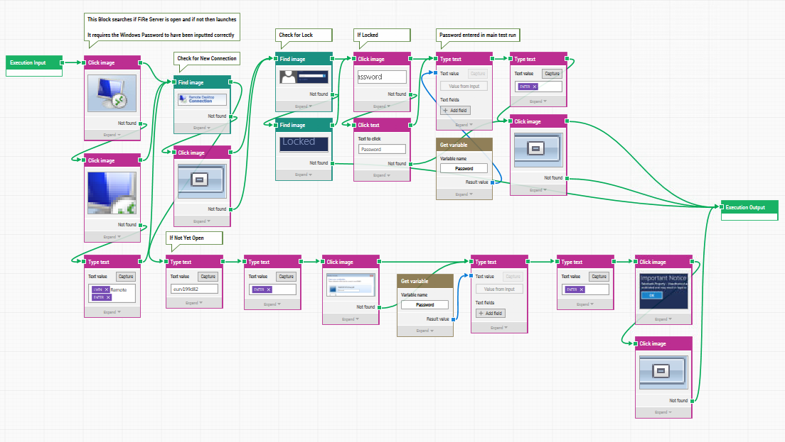
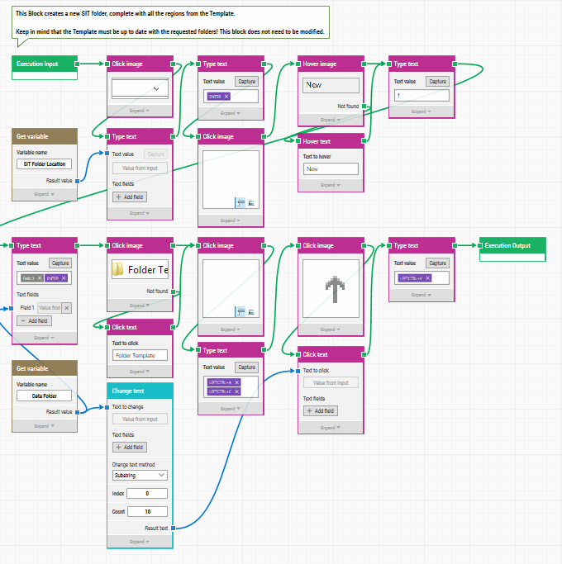
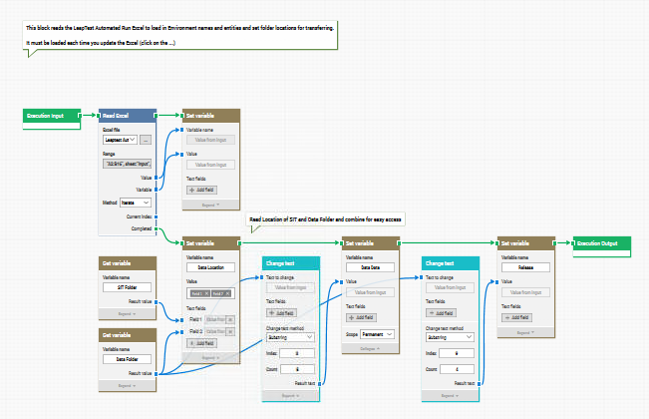
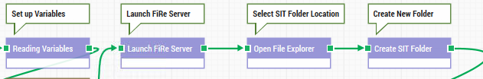
The Story Going Forward…
Lessons Learned
  Functionality in blocks easier to manage
@RickDTracy

Slide 16
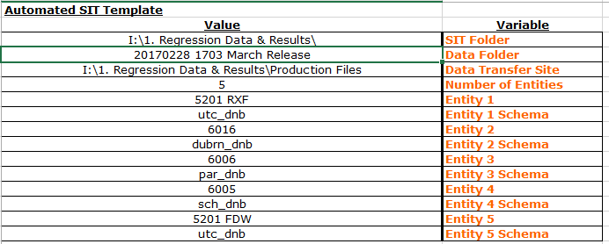
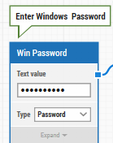
The Story Going Forward…
Lessons Learned
  Single Point of Maintenance, easily defined
@RickDTracy

Slide 17
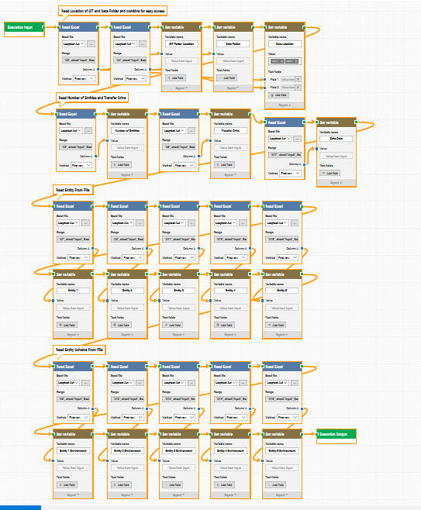
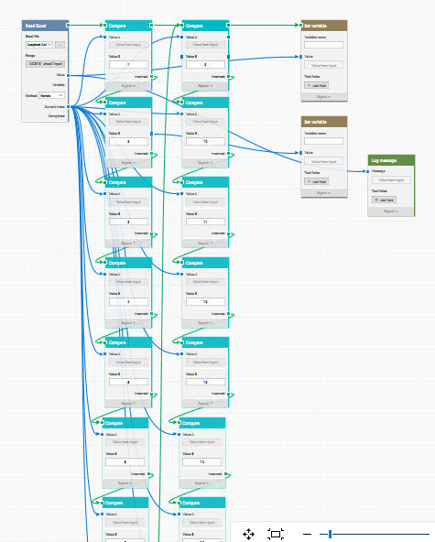
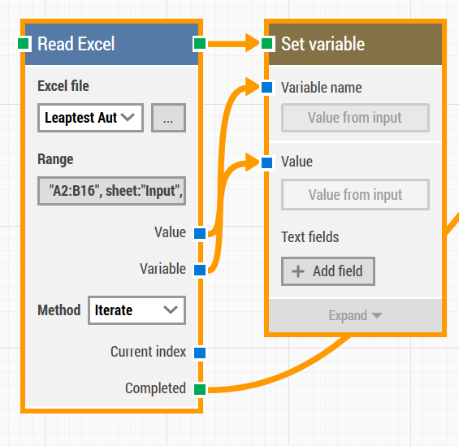
The Story Going Forward…
Lessons Learned
  Approach global, not individual
  What can be combined?
@RickDTracy

Slide 18


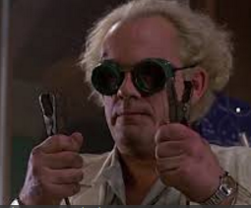

Overall:
Focus on what you want to produce
Look at how you do it now (and improve!)
Think about your approach
EXPERIMENT!
Automate the process for easy recycling of tests and to help others save time (ex: UAT)
@RickDTracy

Slide 19

Questions?
@RickDTracy

